Slide 1
Collecting, Analyzing and Using
Visitor Data
Chapter 12

Slide 2
Overview and Objectives
To understand what is meant by web mining, and in particular by:
  web-content mining
  web-structure mining
  web-usage mining
To understand web-server access logs and their formats
To learn how to analyze access logs with the following tools:
  Analog (for summarizing data)
  Pathalizer (for performing clickstream analysis)
  StatViz (for visualizing individual user sessions)
To learn and appreciate some of the cautions one must keep in mind when interpreting web-server access logs

Slide 3
Web Mining
Web-content mining: Concerned with the content of web documents
Web-structure mining: Concerned with the “topology” of a website and the use of hyperlinks that connect one page to another
Web-usage mining: Concerned with secondary data generated by user interactions with a website

Slide 4
Data in Web-server Access Logs
The IP address of the client making the request
The date and time of the request
The URL of the requested page
The number of bytes sent to serve the request
The user agent (the program that is acting on behalf of the user, such as a web browser or web crawler)
The referrer (the URL that triggered the request)

Slide 5
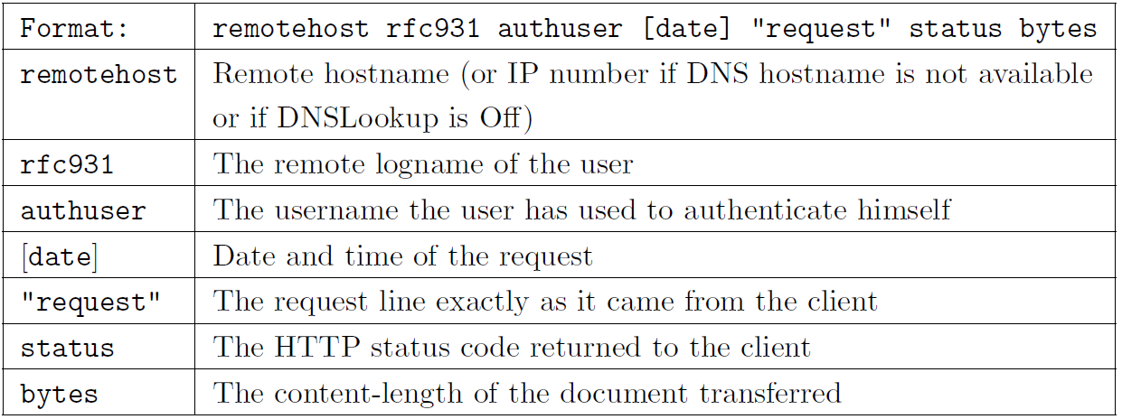
Common Log Format

Slide 6
Common Log Format: Examples
140.14.6.11 - pawan [06/Sep/2001:10:46:07 -0300]
"GET /s.htm HTTP/1.0" 200 2267
A GET request that retrieves a file named s.htm
From a computer with the IP address of 140.14.6.11
A dash (-) tells us that the information is unavailable
140.14.7.18 - raj [06/Sep/2001:11:23:53 -0300]
"POST /s.cgi HTTP/1.0" 200 499
A POST request that sends data to the program s.cgi.

Slide 7
A Log File in Extended Format
#Version: 1.0
#Date: 12-Jan-1996
#Fields: time cs-method cs-uri
00:34:23 GET /foo/bar.html
12:21:16 GET /foo/bar.html
12:45:52 GET /foo/bar.html
12:57:34 GET /foo/bar.html

Slide 8
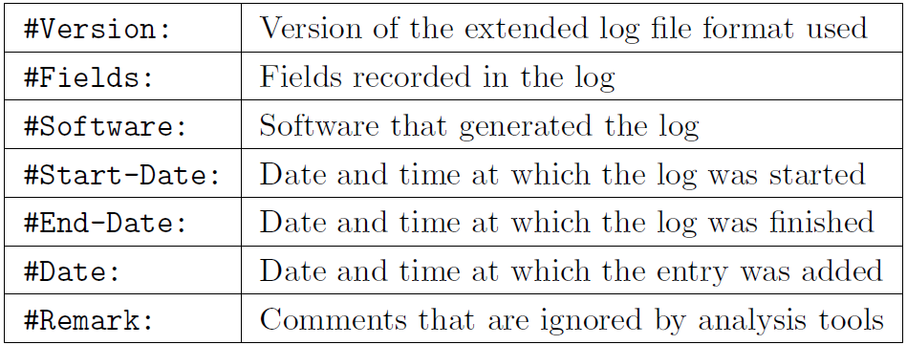
Extended Log File: Directive Types

Slide 9
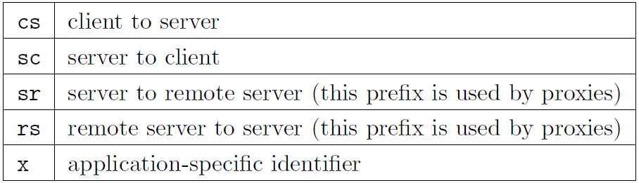
Extended Log File: Identifier Prefixes

Slide 10
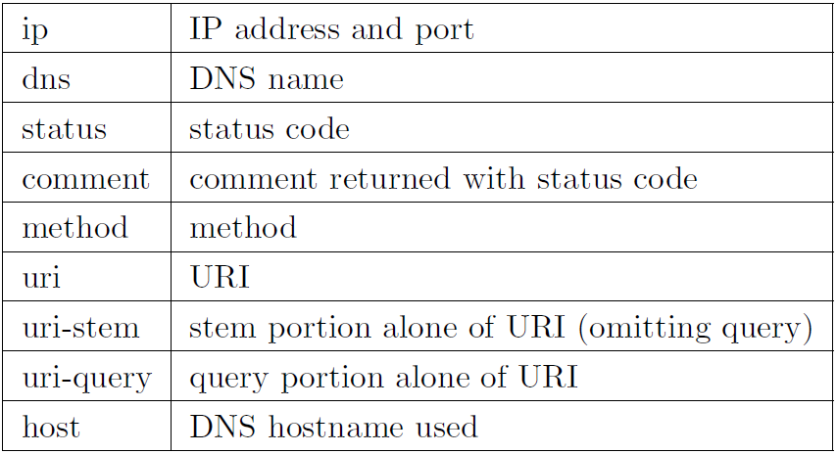
Extended Log File:
Mandatory Identifiers

Slide 11
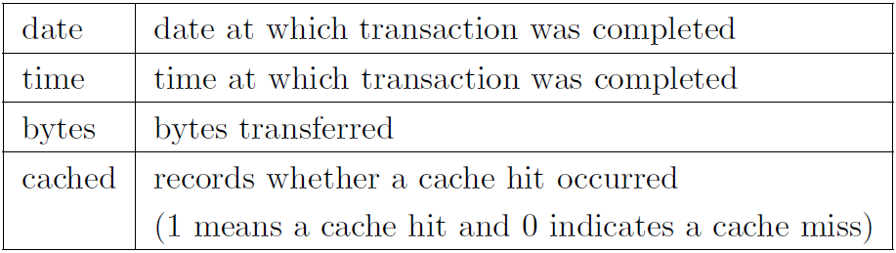
Extended Log File:
Identifiers with No Prefixes

Slide 12
Apache Web-server Access Log Entries
LogFormat directive is used to specify the selection of fields in each entry
The format uses a string styled after the printf format strings in the C programming language
The Common Log Format entry
  140.14.6.11 - pawan [06/Sep/2001:10:46:07 -0300]
  "GET /s.htm HTTP/1.0" 200 2267
  can be represented using the following LogFile directive:
  LogFormat "\%h \%l \%u \%t \"\%r\" \%>s \%b" common

Slide 13
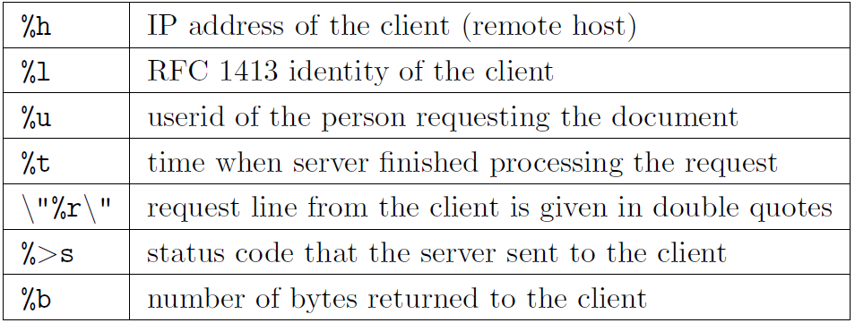
Apache Common Log: Parameters

Slide 14
Some Web Access Log Analyzers
Analog | www.analog.cx
BBClone | bbclone.de
The Big Brother Log Analyzer | bbla.sourceforge.net
Dailystats | www.perlfect.com/freescripts/dailystats
HitsLog Script | www.irnis.net/soft/hitslog
Http-Analyze | www.http-analyze.org
Kraken Reports | www.krakenreports.com
phpOpenTracker | www.phpopentracker.de
PowerPhlogger | pphlogger.phpee.com
Relax | ktmatu.com/software/relax
Report Magic for Analog | www.reportmagic.com
RobotStats | www.robotstats.com/en
Sherlog | sherlog.europeanservers.net
WebLog | awsd.com/scripts/weblog
Webtrax Help | www.multicians.org/thvv/webtrax-help.html
W3Perl | www.w3perl.com/softs
ZoomStats | zoomstats.sourceforge.net

Slide 15
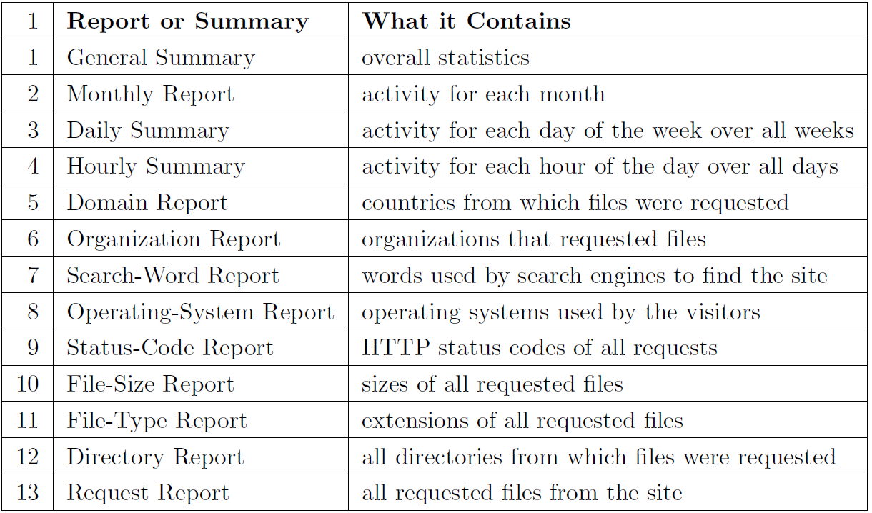
Analog:
Summarizing Web-server Access Logs

Slide 16
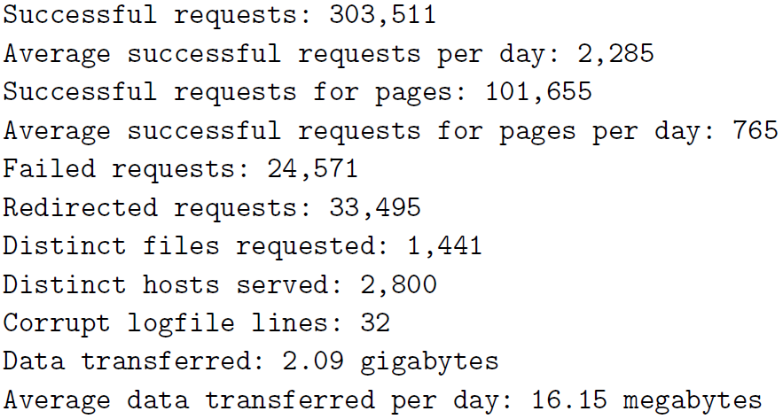
General Summary from Analog

Slide 17
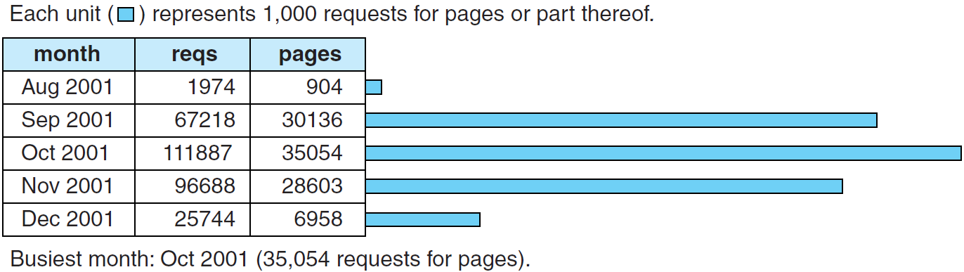
Monthly Report from Analog

Slide 18
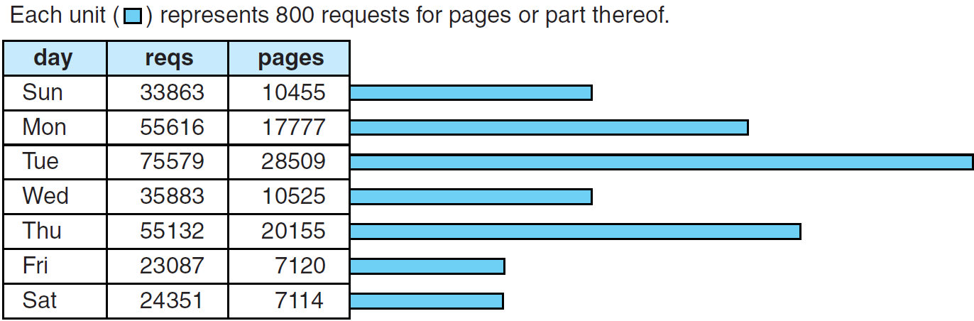
Daily Summary from Analog

Slide 19
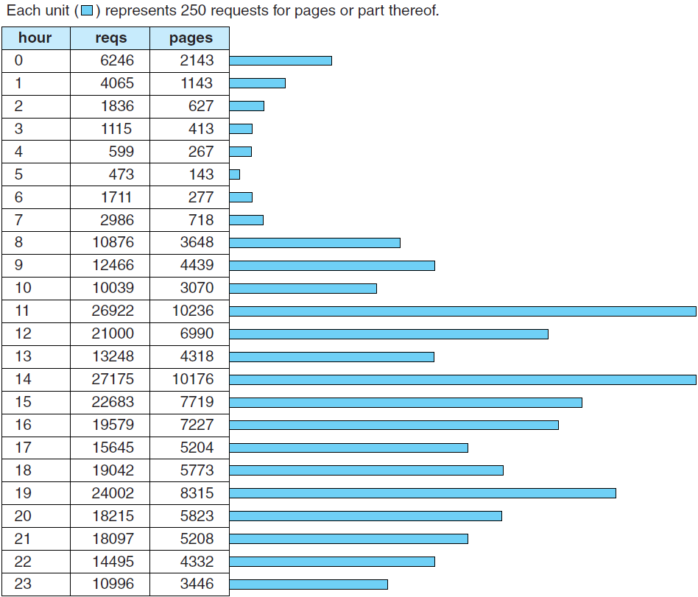
Hourly Summary from Analog

Slide 20

Domain Report from Analog

Slide 21
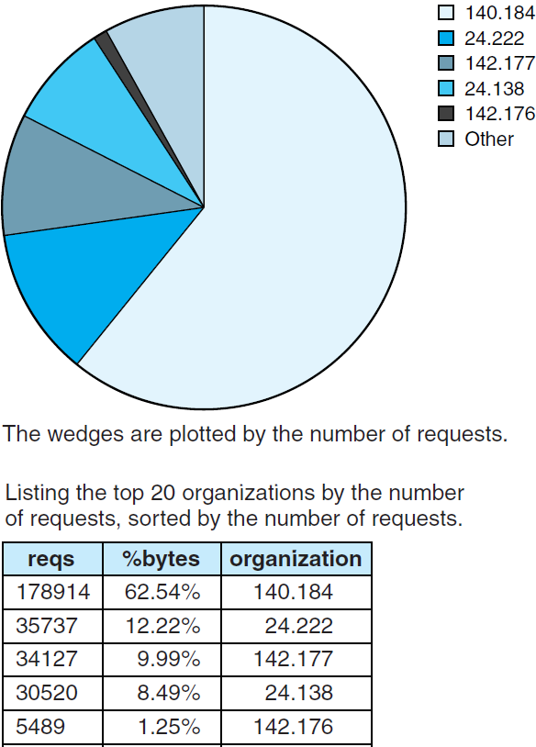
Organization Report from Analog

Slide 22
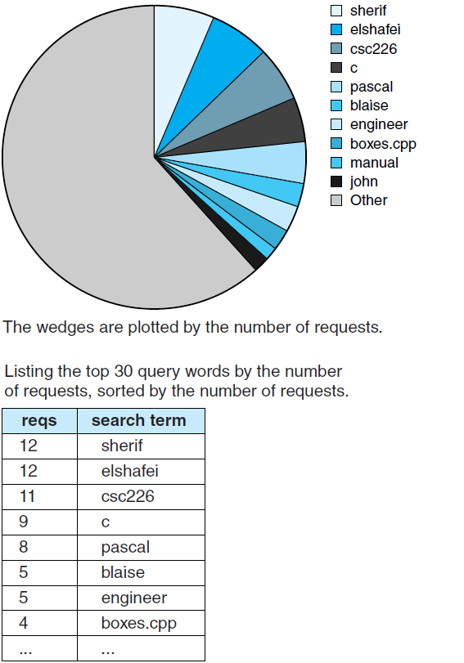
Search-word Report from Analog

Slide 23
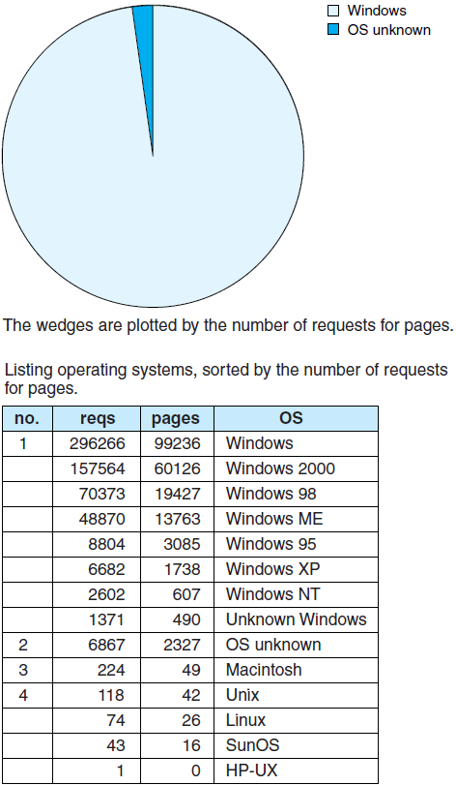
Operating-system Report from Analog

Slide 24
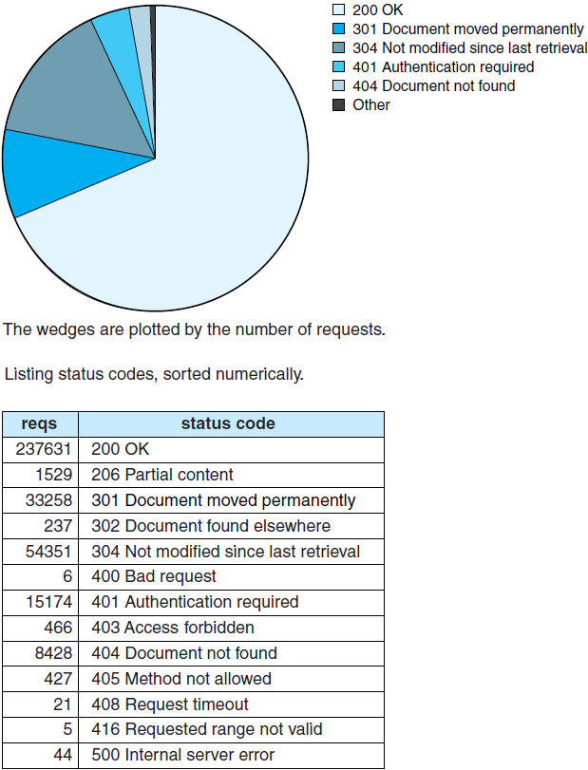
Status-code Report from Analog

Slide 25
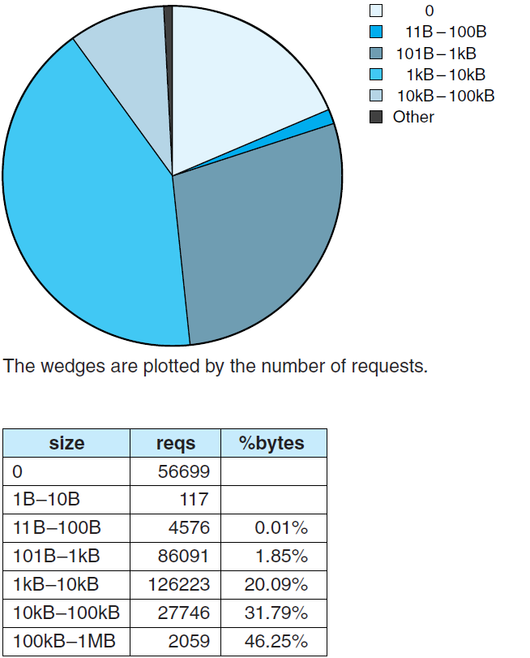
File-size Report from Analog

Slide 26
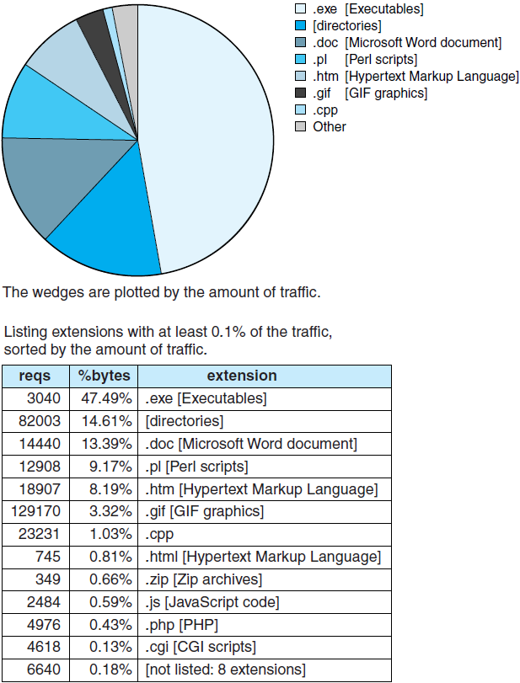
File-type Report from Analog

Slide 27
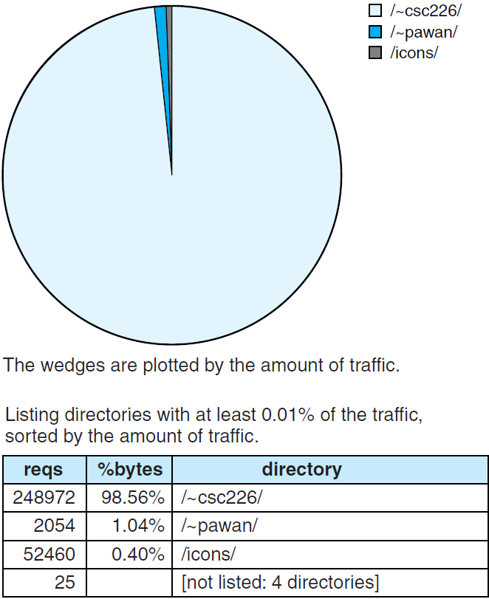
Directory Report from Analog

Slide 28
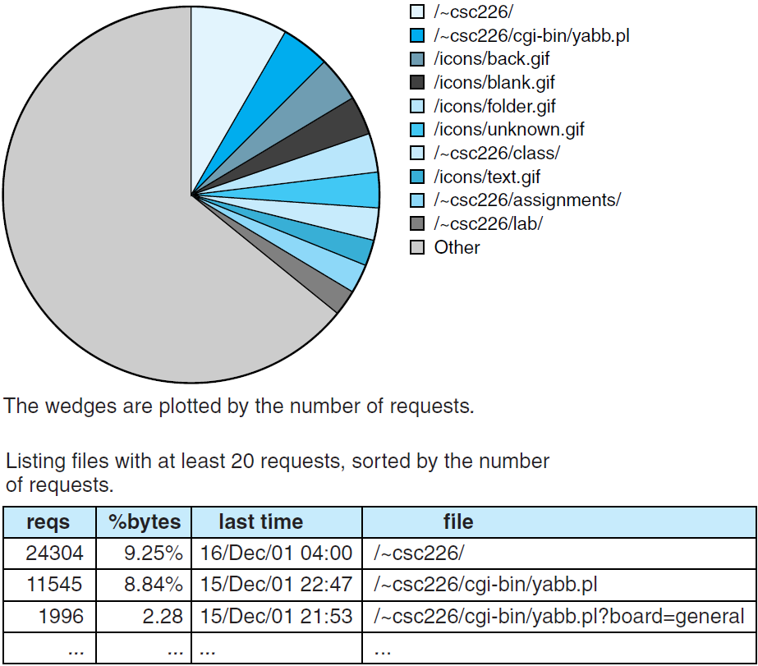
Request Report from Analog

Slide 29
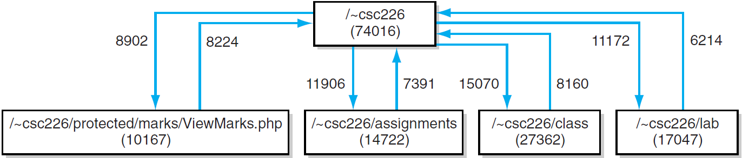
Clickstream with Pathalizer: 7-link

Slide 30
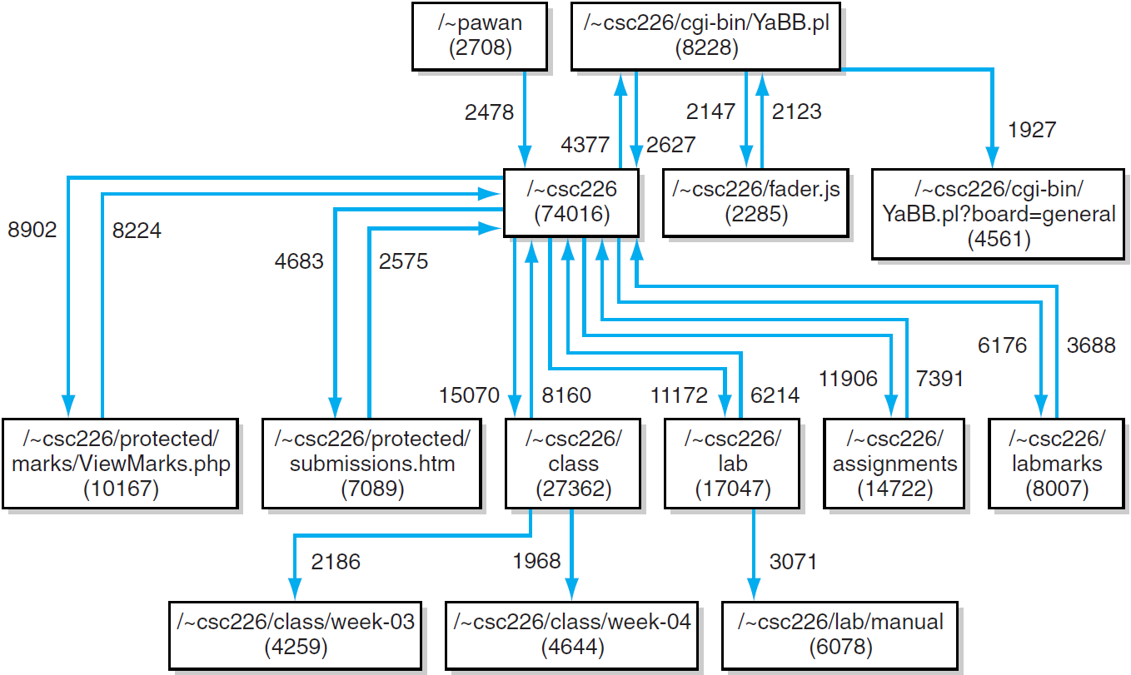
Clickstream with Pathalizer: 20-link

Slide 31
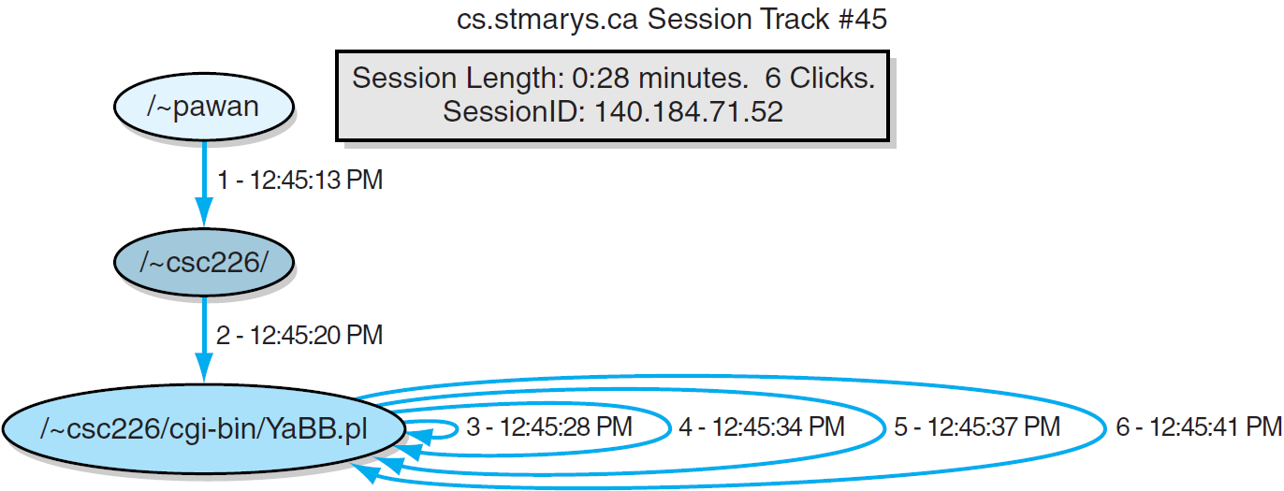
StatViz: On-campus Session that Browses the Bulletin Board

Slide 32
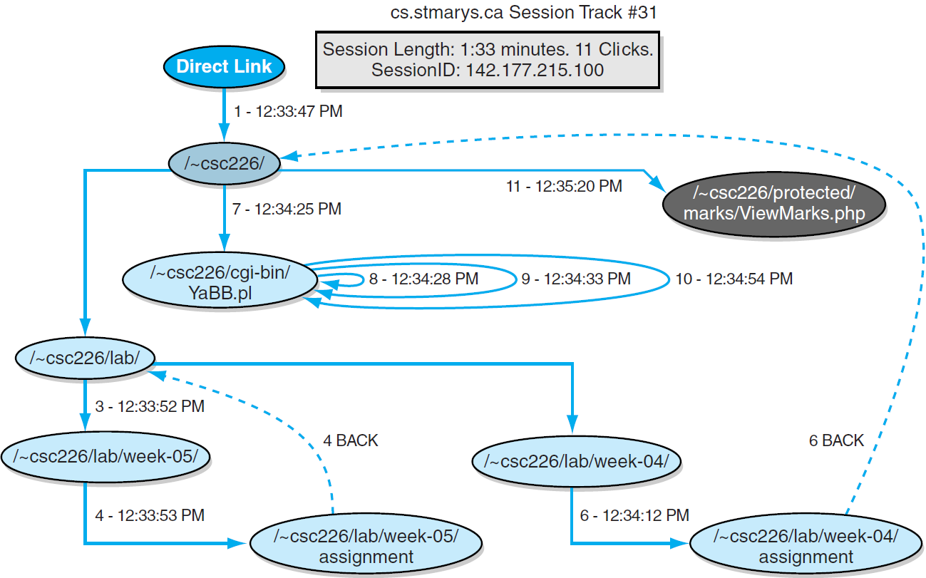
StatViz: Off-campus Session with Three Distinct Activities

Slide 33
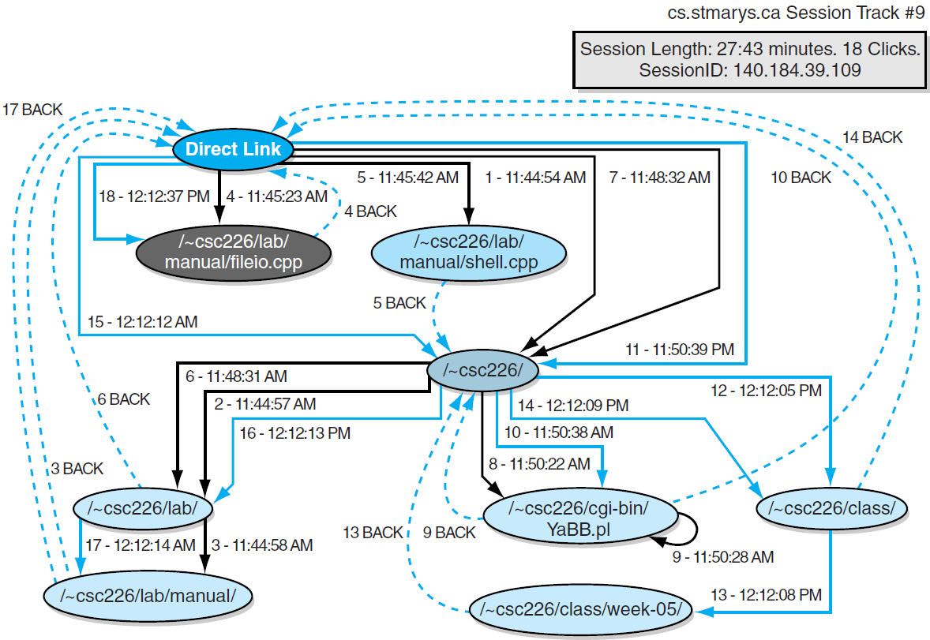
StatViz: On-campus Session with Multiple Activities

Slide 34
Caution: Interpreting Web-server Access Logs (Turner 2004)
You do not really know any of the following:
The identity of your readers
The number of your visitors
The number of visits
The user’s navigation path through the site
The entry point and referral
How users left the site or where they went next
How long people spent reading each page
How long people spent on the site

Slide 35
Nevertheless … (Turner 2004)
I’ve presented a somewhat negative view here, emphasizing what you can’t find out. Web statistics are still informative: it's just important not to slip from “this page has received 30,000 requests” to “30,000 people have read this page”. In some sense these problems are not really new to the web---they are just as prevalent in print media. For example, you only know how many magazines you've sold, not how many people have read them. In print media we have learned to live with these issues, using the data which are available, and it would be better if we did on the web too, rather than making up spurious numbers.

