Slide 1
XML (eXtensible Markup
Language) for Data Description
Chapter 11

Slide 2
Overview and Objectives (1 of 2)
To learn what XML is and what it isn’t
To learn why XML may be very useful to any business
To learn the basic syntax rules of XML
To understand what it means for an XML document to be well-formed and the consequences when it isn’t
To understand what it means for an XML document to be valid, and the consequences when it isn’t
To understand the structure, syntax and use of a basic Document Type Definition (DTD)
To understand what will (probably) happen when you attempt to view a “raw” XML document in a browser
To learn how to style an XML document using CSS

Slide 3
Overview and Objectives (2 of 2)
To have a very brief exposure to each of the following, just to know what they are:
  XSL (eXtensible Style Language)
  XSLT (XSL Transformations)
  XPath (to help you find your way around an XML document)
  XML namespaces (to help avoid name clashes in XML documents, and to provide useful collections of XML tags)

Slide 4
What Is XML?
XML is a “meta language”, a language used to describe other languages, which are called “markup languages”. So, XML can also be called a “meta markup language”.
XML has been used to describe a particular version of the markup language HTML that we know as XHTML.
XML can be used to create “languages” to describe many different kinds of data for business, science, or any other area of human endeavor.
XML is not a programming language.

Slide 5
A Fundamental XML Idea
XML lets you create your own “markup language” but it has no tags of its own.
That forces you to make up your own tags:
  Example: If your business sells vitamins, you might want a vitamin “element”, which could be enclosed in a <vitamin>…</vitamin> “tag pair”.
Note the similarity in terminology to HTML. The big difference is that the tags in HTML are fixed and you can’t make up any new ones. In XML you have to make up new ones. This is the source of the adjective “extensible” in the name.

Slide 6
The Basic Rules of XML (1 of 2)
XML is just text, so any editor can be used to create it, but there are also XML-specific editors.
You create your own tags to describe your own elements:
  <tag>…content…</tag> is an element with content.
  <tag/> is an empty element.
Every XML document must have a single root element, with all other elements nested within it.
XML elements may have attributes:
  Every attribute must have a value.
  Each value must be enclosed in quotes (single or double).
XML is case-sensitive, and …
  Any name must start with a letter or underscore.
  The first character can be followed by any number of letters, digits, hyphens or underscores.

Slide 7
The Basic Rules of XML (2 of 2)
XML has only five predefined entity references (see next slide).
An XML comment has the (familiar) following syntax:
<!-- … text of comment -->
XML “preserves whitespace”, but there are subtleties involved in exactly what this means that you may or may not have to deal with.
With XML, unlike with HTML, you have to get it right. That is, you have to make sure you have followed the rules of XML, or your XML document will simply not be processed.

Slide 8
The Five Pre-defined XML Entities
Entity | Symbol | Meaning
&lt; | < | less than
&gt; | > | greater than
&amp; | & | ampersand
&apos; | ' | apostrophe (single quotation mark)
&quot; | " | quotation mark (double quotation mark)

Slide 9
Describing Data with
Well-Formed XML
XML looks much like HTML, except that you make up your own element tags and attributes.
To be well-formed your XML must follow all the XML rules (proper nesting, quoted attribute values, consistent capitalization, and so on).
Example:
<vitamin product_id="10">
<name>Vitamin A</name>
<price>$8.99</price>
<helps_support>Your eyes</helps_support>
<daily_requirement>5000 IU</daily_requirement>
</vitamin>

Slide 10
Nested Elements vs. Tag Attributes
Because you have so much flexibility when describing your own data, you need to make some careful choices.
Example: Should a particular aspect of your data be described by a nested tag or an attribute?
Rule: Any binary data must be specified by placing its location in a tag attribute, since an XML file contains only text.
Guideline: Any information that might have to be subdivided later should be in a tag, while any information about other information (like an id for a product) should be in a tag attribute.
Rule of Thumb: Use an attribute for any information that you are unlikely to display to a user of the information.

Slide 11
XML Processing by XML Parsers
XML processors (XML parsers) are very fussy.
Your XML must be well-formed or it will simply not be processed.
That is, XML processors are not “forgiving” like browsers are when
they process HTML.
Even your browser can put on its “XML processor hat” and “process” your XML document by simply displaying it in a stylized way, provided the document is well-formed and introduced by an XML declaration, like this:
<?xml version="1.0" encoding="ISO-8859-1"?>
But … your generally “forgiving” browser will choke on an XML document that is not well-formed.
A good XML-aware editor which will tell you if your document is not well-formed is the free (for non-commercial use) Exchanger XML Lite:
http://www.freexmleditor.com/
The next three slides show a well-formed XML document, how the Firefox browser displays that document, and the error message displayed when a simple error destroys the “well-formedness”.

Slide 12
A Well-formed XML Document: sampledata.xml
<?xml version="1.0" encoding="ISO-8859-1"?>
<!-- sampledata.xml -->
<supplements>
<vitamin product_id="10">
<name>Vitamin A</name>
<price>$8.99</price>
<helps_support>Your eyes</helps_support>
<daily_requirement>5000 IU</daily_requirement>
</vitamin>
<vitamin product_id="20">
<name>Vitamin C</name>
<price>$11.99</price>
<helps_support>Your immune system</helps_support>
<daily_requirement>250-400 mg</daily_requirement>
</vitamin>
<vitamin product_id="30">
<name>Vitamin D</name>
<price>$3.99</price>
<helps_support>Your bones, especially your rate of
calcium absorption</helps_support>
<daily_requirement>400-800 IU</daily_requirement>
</vitamin>
</supplements>

Slide 13
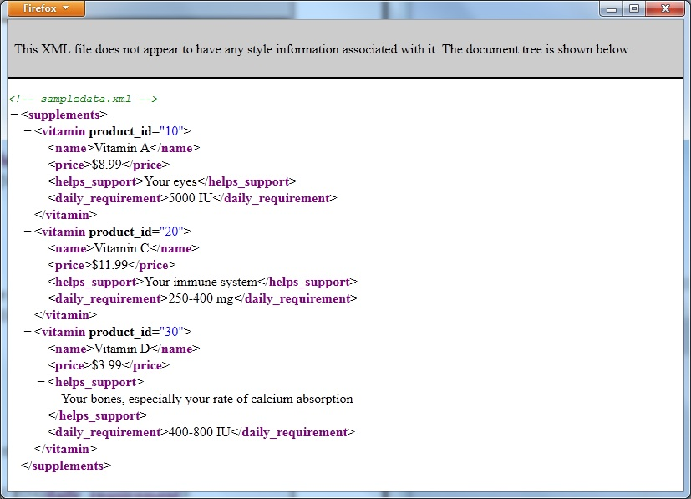
Browser Display of “Raw” Well-Formed XML from sampledata.xml
When displaying the file in your browser, try clicking a minus sign to collapse that section of the display and then the plus sign that appears to expand the section again.

Slide 14
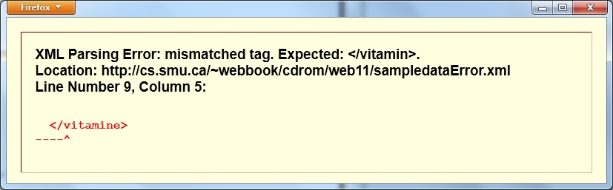
Error Message When Browser Attempts to Display XML That Is Not Well-Formed
Not well-formed because spelling of
closing tag does not match opening tag

Slide 15
What Is a Valid XML Document?
We must be careful to distinguish between a well-formed XML document and a valid XML document:
  A well-formed XML document is one that follows all the rules of XML itself.
  A valid XML document is one that is, first of all, well-formed, and second, follows an additional set of rules that describe what is allowed to be in the document, how many of those things can be there, the order in which they must appear, and so on …
This “additional set of rules” can take two forms:
  A Document Type Definition (DTD)
  An XML Schema

Slide 16
DTD vs. XML Schema
Pros and Cons
DTDs are
  simpler and easier to understand than XML schemas
  not as powerful or flexible as XML schemas
  not themselves XML documents (they have a very different syntax)
XML schemas are
  more powerful, allowing you to specify the data type of your element content, for example
  somewhat daunting to read, understand, and apply
  themselves XML documents, which means that an XML document and its XML schema can both be processed by the same XML parser
DTDs are still very widely used, but will probably ultimately be replaced by XML schemas, especially as more and better tools become available for dealing with those schemas.
We discuss a simple DTD in some detail, but only mention XML schemas briefly later in the chapter.

Slide 17
A Simple DTD: simpledata_with_dtd.dtd
<!-- sampledata_with_dtd.dtd -->
<!ELEMENT supplements (vitamin+)>
<!ELEMENT vitamin (name, price, helps_support,
daily_requirement)>
<!ELEMENT name (#PCDATA)>
<!ELEMENT price (#PCDATA)>
<!ELEMENT helps_support (#PCDATA)>
<!ELEMENT daily_requirement (#PCDATA)>
<!ATTLIST vitamin product_id CDATA #REQUIRED>
This DTD describes the structure our vitamin supplement XML document must have in order to be valid.
It tells us, among other things, what elements must be present, what their order must be, and the required attribute for the vitamin element.

Slide 18
Discussion of the Simple DTD (1 of 4)
DTD comments are the same as HTML and XML comments:
<!-- sampledata_with_dtd.dtd -->
The line
<!ELEMENT supplements (vitamin+)>
is an element definition saying that a valid document (according to this DTD) will have an element called supplements and that nested inside this element can be any number of vitamin elements (but at least one).
Note that:
  The opening <!ELEMENT and the closing > are the required delimiters for an element definition.
  The opening delimiter is followed immediately by the tag name for the given element (supplements, in this case).
  A set of parentheses then encloses a description of the content of this kind of element (one or more vitamin elements, in this case).
  The + in vitamin+ is used as a quantifier in the same way it is used in regular expressions (to indicate “at least one”, or “one or more”).

Slide 19
Discussion of the Simple DTD (2 of 4)
The element definition
<!ELEMENT vitamin (name, price, helps_support,
daily_requirement)>
says that a vitamin element must contain
  a name element
  a price element
  a helps_support element
  a daily_requirement element
There must be only one of each of these four nested elements, and they must appear in the given order.
That is the meaning of a comma-separated list within the set of parentheses containing the description of an element’s content.

Slide 20
Discussion of the Simple DTD (3 of 4)
The element definition
<!ELEMENT name (#PCDATA)>
says that the content of the name element consists of “Parsable Character Data” (#PCDATA).
This is data that is mostly ordinary text but may (or may not) contain XML entities (such as &amp;) that need to be “parsed”.
The definitions of the elements price, helps_support, and daily_requirement show that they also contain #PCDATA content.

Slide 21
Discussion of the Simple DTD (4 of 4)
The line
<!ATTLIST vitamin product_id CDATA #REQUIRED>
is an “attribute list” definition.
Note that:
  The delimiters are the same as for an element definition, except that ATTLIST replaces ELEMENT.
  The opening delimiter is followed immediately by the element tag (vitamin) to which the following attribute applies.
  Next comes the name of the attribute itself (product_id).
  Then comes the kind of data we can use for the value of this attribute: CDATA, in this case (ordinary text that does not have to be parsed).
  The last item in the definition (#REQUIRED) specifies that a vitamin element must have a product_id attribute.

Slide 22
Connecting Our XML Document with Its Corresponding DTD
So, we have an XML document, and a DTD that says what must be in it. How do we connect the two?
The XML document simpledata_with_dtd.xml and the DTD document simpledata_with_dtd.dtd which describes it are connected by the following line in the XML document:
<!DOCTYPE supplements SYSTEM "sampledata_with_dtd.dtd">
Note that:
  This is another DOCTYPE declaration similar to the one we’ve used all along in our HTML documents, and has essentially the same purpose.
  It says that the “root element” of our document is the supplements element. In our HTML documents this was the html element.
  SYSTEM says that our document description (our DTD) is found locally on our own “system”.
  The final item is the name of the file containing our DTD. This could be a URL to some descriptive document out on the Internet.
  Finally, simpledata_with_dtd.xml is just simpledata.xml plus this line.

Slide 23
Validating an XML Document
Against a DTD
Just like HTML and CSS documents, an XML document should be validated.
Browsers are generally not “validating” XML parsers. That is, your browser will (probably) check whether your document is well-formed, but (probably not) whether it’s valid.
The situation is further complicated by the fact that a document may need to be validated against either a DTD or an XML schema, two quite different scenarios.
Exchanger XML Lite (mentioned earlier) will validate for you.
The W3Schools site has an XML validator:
http://www.w3schools.com/xml/xml_validator.asp
Google “XML validator” to find other possibilities.

Slide 24
More DTD Anatomy (1 of 4)
User-defined Entities
Recall that XML has only five pre-defined entities, but … you can define your own.
Example Definition:
<!ENTITY va "Vitamin A">
Example Usage:
I must take some &va;. (I must take some Vitamin A.)
Note that, oddly enough, if you use a DTD with your own entities defined in it, you “lose” the predefined ones, and must re-define them yourself if you wish to use those as well.

Slide 25
More DTD Anatomy (2 of 4)
A Few Other Element and Attribute Data Types
In addition to #PCDATA and CDATA, you can specify the following for element content (you must use an XML schema for more fine-tuned data type specification):
  EMPTY as a data type to indicate that an element contains no data (similar to an HTML img element)
  ANY as a data type to indicate that an element’s content can be most anything
In addition to CDATA, you can also specify ENUMERATED as an attribute data type (a list of possible values separated by the | symbol).

Slide 26
More DTD Anatomy (3 of 4)
Attribute Value Specifiers
#REQUIRED (we saw this one earlier)
Indicates that an attribute must have a value
(of the indicated type).
#FIXED
Indicates that an attribute must have a specific value (supplied as a default value).
#IMPLIED
No default value specified, so the attribute may (or may not) have a value in a given element.

Slide 27
More DTD Anatomy (4 of 4)
Numerical Qualifiers
Numerical qualifiers are similar to those used in regular expressions:
  + means “one or more”
  * means “zero or more”
  ? means “zero or one”
Also, a comma-separated list means that the things in the list must appear in the list order, while a vertical-bar- separated list means “choose one”, and parentheses, as usual, are used for grouping.
Example:
<!ELEMENT person (parent+, spouse?, child*, (brother|sister)*)>
is interpreted to mean that a person has one or more parents, possibly a spouse, zero or more children, and any number of brothers and/or sisters, listed in that order.

Slide 28
CDATA Sections in an XML Document
CDATA is not parsed.
So … if your XML document contains many symbols (like < or &) that would have to appear as entities, you may want to put it in a “CDATA section”.
Example:
<![CDATA[
A section like this can contain things like << or >>, as well as & if we wish to use it for "and". This is convenient, since we don't have to use entities like &lt;, &gt; and &amp;.
]]>

Slide 29
How Does a Browser Know
How to Display XML?
Answer: It doesn’t, and that’s why it uses the “stylized”, or “outline-like” way we saw earlier.
So, if we want to display the information in our XML files with a little more pizzazz, what to do?
To the rescue come two possibilities:
  Our old friend, CSS
  XSLT (eXtensible Sheet Language Transformations, for which stay tuned)

Slide 30
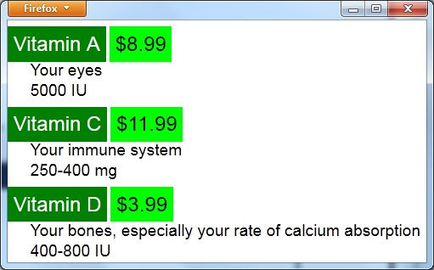
Browser Display of XML Styled with CSS simpledata_with_css.xml
(and see the following three slides)

Slide 31
How Do We Connect An XML Document to the CSS File Used to Style It?
We “link” the XML file to the CSS file with the following line in the XML file:
<?xml-stylesheet type="text/css" href="supplements.css"?>
This line from simpledata_with_css.xml is analogous to a link element in an HTML file linking it to an external CSS file.
Now see the next two slides for the contents of supplements.css.

Slide 32
CSS Used to Style Vitamin Data (1 of 2) from supplements.css
/*supplements.css*/
supplements
{
background-color: #ffffff;
width: 100%;
font-family: Arial, sans-serif;
}
vitamin
{
display: block;
margin-top: 10pt;
margin-left:0pt;
}
name
{
background-color: green;
color: #FFFFFF;
font-size: 1.5em;
padding: 5pt;
margin-bottom:3pt;
margin-right:0;
}

Slide 33
CSS Used to Style Vitamin Data (2 of 2) from supplements.css
price
{
background-color: lime;
color: #000000;
font-size: 1.5em;
padding:5pt;
margin-bottom:3pt;
margin-left:0
}
helps_support
{
display: block;
color: #000000;
font-size: 1.2em;
padding-top: 3pt;
margin-left: 20pt;
}
daily_requirement
{
display: block;
color: #000000;
font-size: 1.2em;
margin-left: 20pt;
}

Slide 34
XML Namespaces
Since XML is used to describe data, many organizations have developed their own tag sets to describe their data.
The holy grail of software development is “code reuse”, so many people will want to use one or more tag sets from one or more sources.
Problem: Same tag is used for a different purpose in different tag sets (table as used by the HTML folks, and by the furniture-making folks, for example).
Solution: Every tag set that might be used by others should be placed in its own namespace.
Example:
<html xmlns="http://www.w3.org/1999/xhtml">
Here xmlns stands for “XML namespace”, and this opening tag would appear in an XHTML page, specifying the namespace containing all XHTML tags to be used on an XHTML web page. Fortunately, when using HTML5, we no longer need this rather complicated attribute on our opening html tag.

Slide 35
Other XML Technologies
XML schemas are a more flexible and powerful way than DTDs for specifying the permitted contents of an XML file.
XSL (eXtensible Style Language) and XSLT (eXtensible Style Language Transformations) together allow one XML document to be “transformed” from one form to another.
XSL-FO (eXtensible Stylesheet Language Formatting Objects) is a language for formatting XML data for output to screen, paper or other media.
XPath is used to navigate through elements and attributes of an XML document.

Slide 36
Transforming XML to HTML
XSLT can transform an XML document to many different forms.
One of those forms is an HTML document for display in a browser.
XSLT is a vast subject which we do not pursue in depth in this text.
So, we end with an example that simply shows a browser display of the same data we have been using all along, but this time styled using XSLT rather than CSS.
The next slide shows the display, and the final slide shows the XSL file that produced the display (as usual, the XSL file must be linked with the XML file).

Slide 37
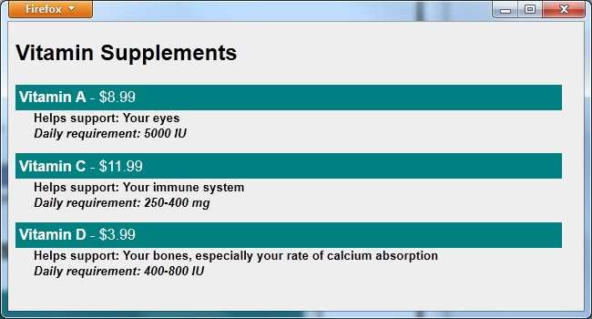
Browser Display of XML Styled with XSLT: sampledata_with_xsl.xml

Slide 38
XSL File for Display of Previous Slide: supplements.xsl
<!-- supplements.xsl -->
<xsl:stylesheet version="1.0"
xmlns:xsl="http://www.w3.org/1999/XSL/Transform"
xmlns="http://www.w3.org/1999/xhtml">
<xsl:output method="html"/>
<xsl:template match="supplements">
<html>
<head>
<title>Vitamin Supplements</title>
</head>
<body style="width:600px;font-family:Arial;font-size:12pt;background-color:#EEEEEE">
<h2>Vitamin Supplements</h2>
<xsl:for-each select="vitamin">
<div style="background-color:teal;color:white;padding:4px">
<span style="font-weight:bold"><xsl:value-of select="name"/></span>
- <xsl:value-of select="price"/>
</div>
<div style="margin-left:20px;margin-bottom:1em;font-size:10pt;font-weight:bold">
Helps support: <xsl:value-of select="helps_support"/><br />
<span style="font-style:italic">
Daily requirement: <xsl:value-of select="daily_requirement"/>
</span>
</div>
</xsl:for-each>
</body>
</html>
</xsl:template>
</xsl:stylesheet>

