Slide 1
PHP and MySQL for Client-Server Database Interaction
Chapter 10

Slide 2
Overview and Objectives:
New Functionality
Browse through our product catalog without registering (that is, “anonymously”)
Open an account by registering with our website
Log in to our website as a registered user, and later log out
Browse through our product catalog as a registered user, and manage a shopping cart
by adding and/or deleting items
Check out and “purchase” the shopping cart items

Slide 3
Skills That Will Be Learned
How a PHP script connects to a MySQL database
How a PHP script issues queries (requests for information) to a MySQL database and then receives and processes the replies
How to use a PHP session to keep track of a user’s activity during a visit to our website
More about PHP arrays will be helpful, so we begin with a sequence of slides on that topic.

Slide 4
More on PHP Arrays (Part 1 of 9)
php > //The following command creates a one-element array:
php > $a[] = "Hello";
php > //We omitted the subscript so the next available
php > //subscript is used, which is 0 in this case.
php > //The echo command can print an array element.
php > echo $a[0];
Hello

Slide 5
More on PHP Arrays (Part 2 of 9)
php > //Next we add a number of elements to our array.
php > $a[] = "World";
php > $a[-90] = "This is wild";
php > $a[90] = "This is wild";
php > $a[70] = "This is wild";
php > $a["name"] = "Pawan";

Slide 6
More on PHP Arrays (Part 3 of 9)
php > //Use the print_r() function to print an entire array.
php > print_r($a);
Array
(
[0] => Hello
[1] => World
[-90] => This is wild
[90] => This is wild
[70] => This is wild
[name] => Pawan
)
php > //As we can see, the indices are not ordered as you would have
php > //expected, since -90 comes after 1, and 70 comes after 90.

Slide 7
More on PHP Arrays (Part 4 of 9)
php > //If we do not specify the index, it will be one
php > //more than the highest current index, i.e., 90+1 = 91.
php > $a[] = "What is the index?";
php > print_r($a);
Array
(
[0] => Hello
[1] => World
[90] => This is wild
[70] => This is wild
[name] => Lingras
[91] => What is the index?
)

Slide 8
More on PHP Arrays (Part 5 of 9)
php > //You can get numeric indices properly ordered
php > //by using the function array_values().
php > $b = array_values($a);
php > print_r($b);
Array
(
[0] => Hello
[1] => World
[2] => This is wild
[3] => This is wild
[4] => This is wild
[5] => Lingras
[6] => What is the index?
)

Slide 9
More on PHP Arrays (Part 6 of 9)
php > //You can delete an element using the function unset.
php > unset($a[-90]);
php > print_r($a);
Array
(
[0] => Hello
[1] => World
[90] => This is wild
[70] => This is wild
[name] => Lingras
[91] => What is the index?
)

Slide 10
More on PHP Arrays (Part 7 of 9)
php > //The count() function gives you the size of an array.
php > echo count($a);
6

Slide 11
More on PHP Arrays (Part 8 of 9)
php > //The "construct" array() (not a function) can be used
php > //to create an entire array.
php > $a = array("This", "is", "different", 5, 6, 7);
php > print_r($a);
Array
(
[0] => This
[1] => is
[2] => different
[3] => 5
[4] => 6
[5] => 7
)

Slide 12
More on PHP Arrays (Part 9 of 9)
php > //The construct array() also allows you to specify the indices.
php > //Note the secondary prompt "php (".
php > $a=array(7=>"This", 0=>"is", 8=>"different",
php ( "five"=>5, 6=>6, "eight"=>7);
php > print_r($a);
Array
(
[7] => This
[0] => is
[8] => different
[five] => 5
[6] => 6
[eight] => 7
)

Slide 13
PHP Arrays: Summary
A PHP array index is really just a means of accessing a particular element in an array. It does not necessarily suggest an ordering. That is why we can use -90 as an index, which is stored in the array after the index 1.
If we do not use a specific index to place a value in an array, the index used is first numeric index that is greater than the largest already-used numeric index.
Array elements can be displayed using echo, but you need to use the built-in function print_r() to print an entire array.
A function called count() gives us the size of an array.
An entire array can be created by using the array() construct.
If we want values with conventionally ordered numeric indices from an associative array, we can use the function array_values().

Slide 14
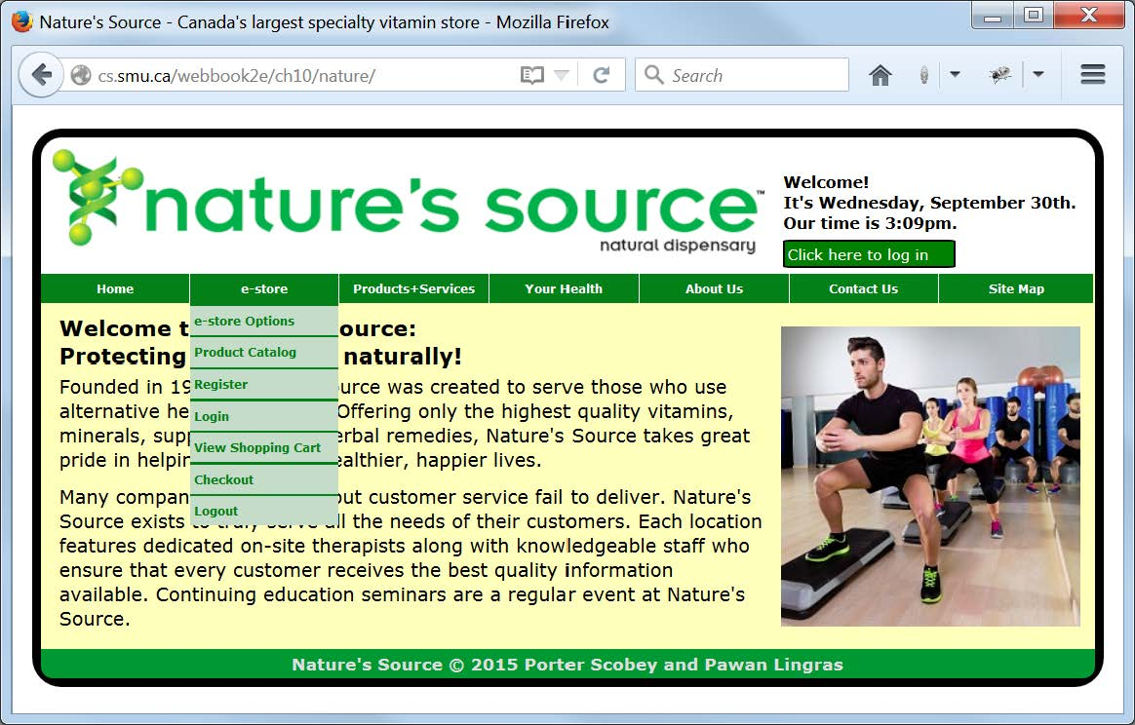
Current State of Our Website

Slide 15
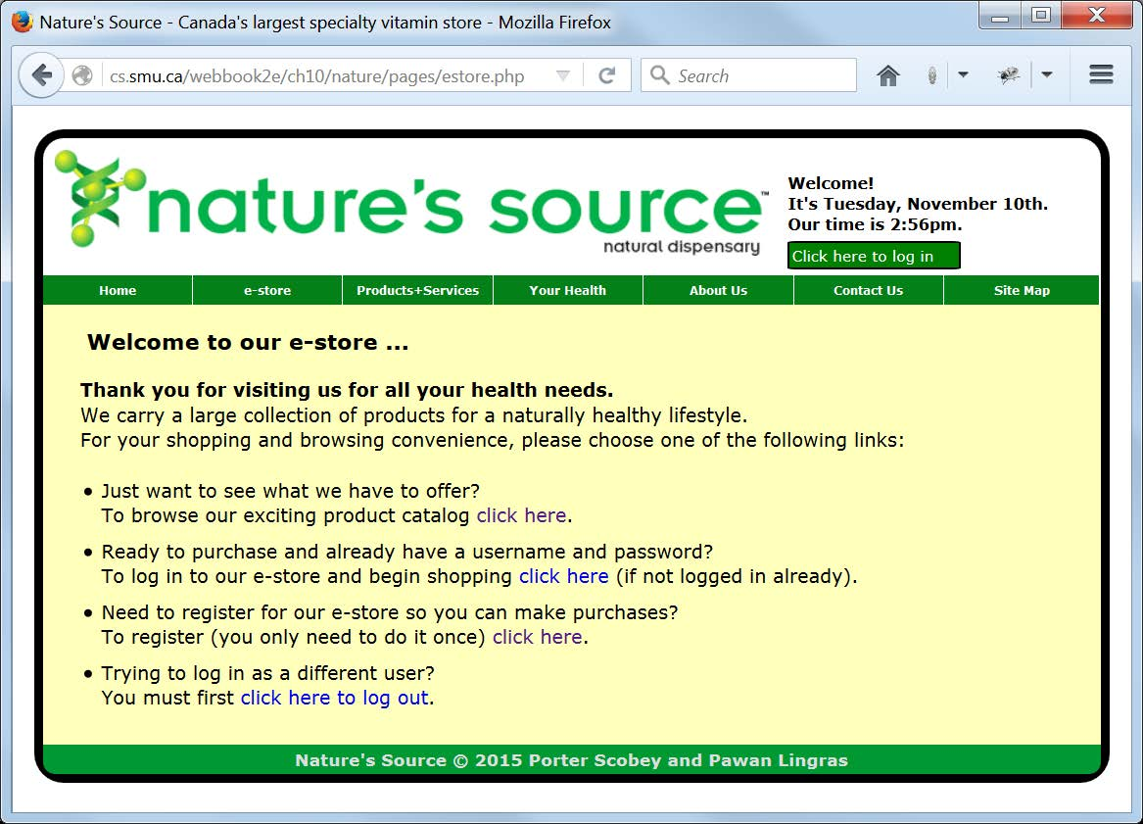
Bird's-Eye View of e-store Functionality

Slide 16
PHP Code for Connecting to MySQL
Content of the database.inc file:
<?php
$dbLocation = "localhost"; //Location of the MySQL server
$dbUsername = "webbook2e"; //The user’s MySQL username
$dbPassword = "secret_password"; //Not really ☺
$dbName = "webbook2e"; //The name of the database
?>
Partial content of the connectToDatabase.php file:
$db = mysqli_connect($dbLocation,
$dbUsername,
$dbPassword,
$dbName);
if (mysqli_connect_errno() || ($db == null))
{
printf("Database connection failed: %s<br>
Connection script now terminating.",
mysqli_connect_error());
exit(0);
}

Slide 17
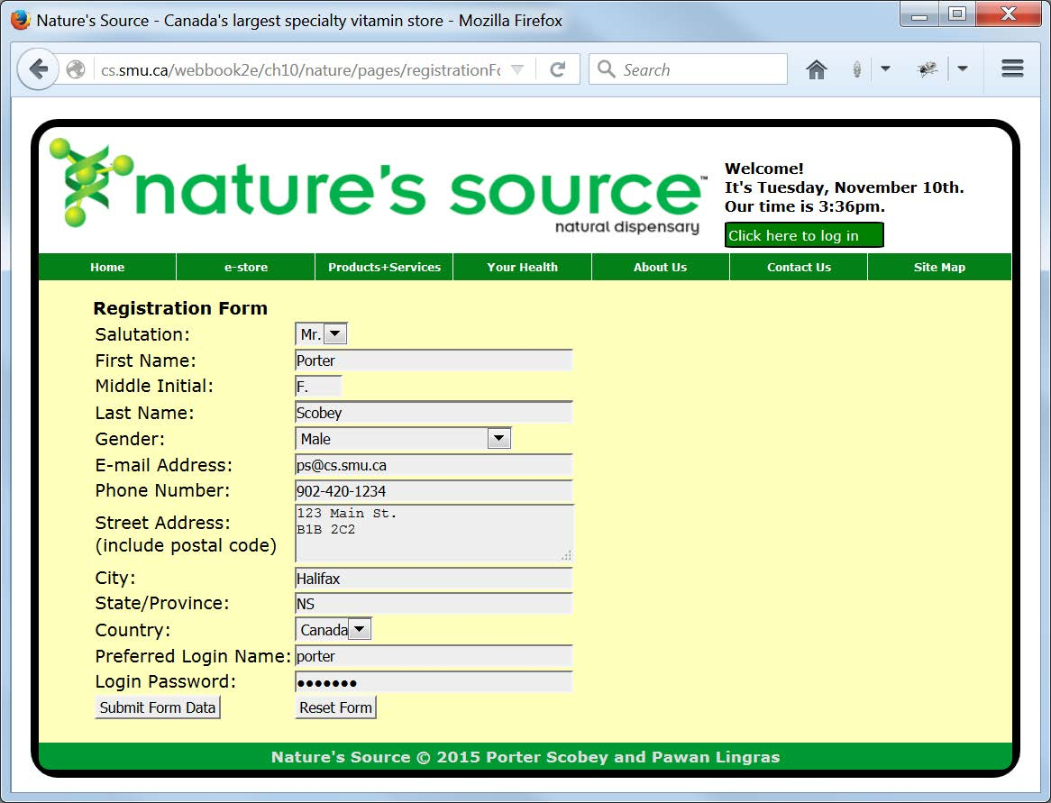
Registering for Our Web Site

Slide 18
Possible Registration Scenarios
During the registration process we must be prepared to deal with at least the following possible scenarios:
  the user enters data that causes no problem and simply completes a successful registration
  the user enters something on the form that does not pass JavaScript validation on the client side
  a user has already registered but has perhaps forgotten about it, which will be recognized when that user is discovered to be in the database already
  the user attempts to register by choosing a login name that is already in use by a previously-registered customer

Slide 19
HTML Markup Excerpt from registrationForm.php
<main>
<article class="Registration">
<h4>Registration Form</h4>
<form id="registrationForm"
onsubmit="return registrationFormValidate();"
action="scripts/registrationFormResponse.php"
method="post">
<table>
<tr>
<td>Salutation:</td>
<td><select name="salute">
<option>&nbsp;</option>
<option>Mrs.</option>
<option>Ms.</option>
<option>Mr.</option>
<option>Dr.</option>
</select></td>
</tr>
<tr>
<td>First Name:</td>
<td><input required type="text" name="firstName" size="40"
title="Initial capital, then lowercase and no spaces"
pattern="^[A-Z][a-z]*$"></td>
</tr>
Notes
registrationFormValidate() just ensures that a blank form is not submitted. This is redundant here since we also use the required attribute on our form controls.
Most of our validation is done via the pattern attribute, with popup “tooltip” suggestions from the value of the title attribute.
The form is processed by the script in the file registrationFormResponse.php, which in turn will include another script, registrationFormProcess.php.

Slide 20
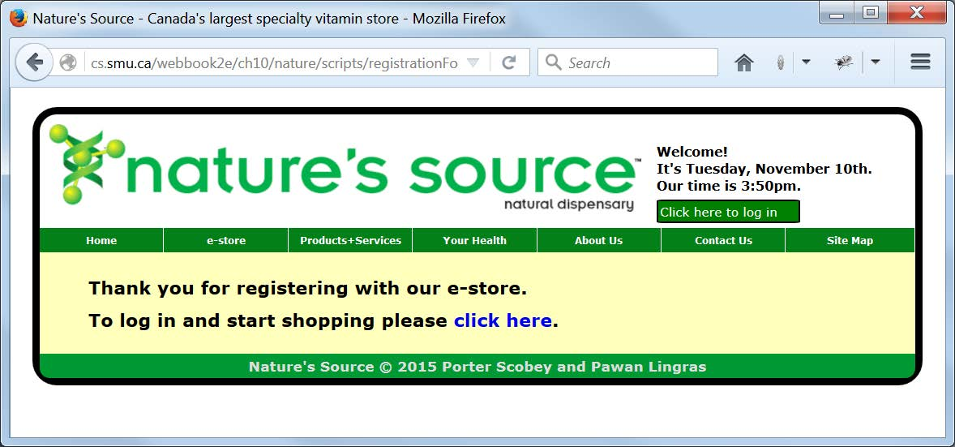
A New User Registers Successfully

Slide 21
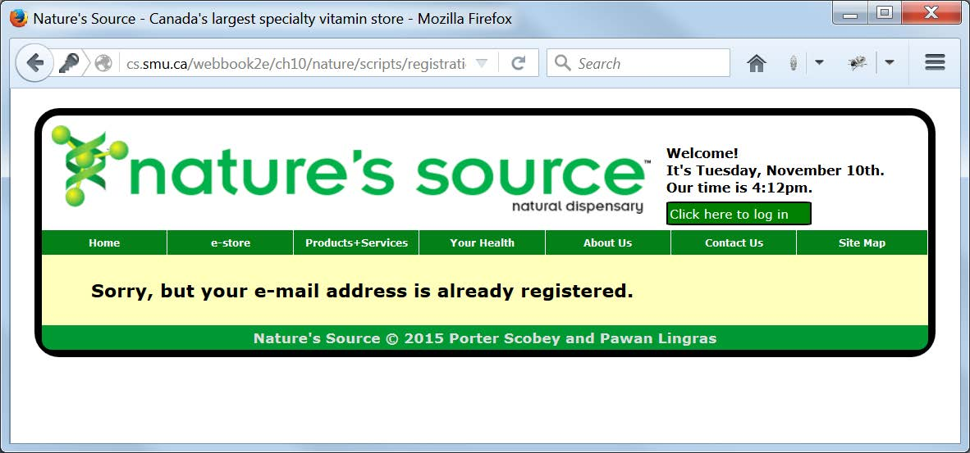
Email Address Already in Database

Slide 22
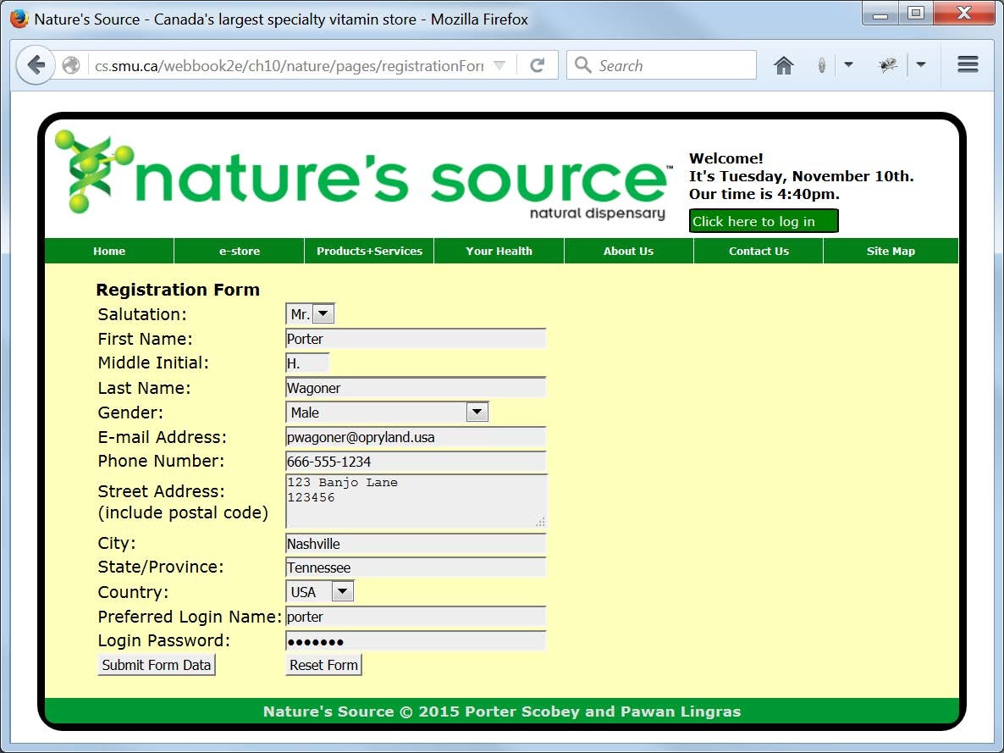
Re-registering for the Site with Different Email Address but Same Username

Slide 23
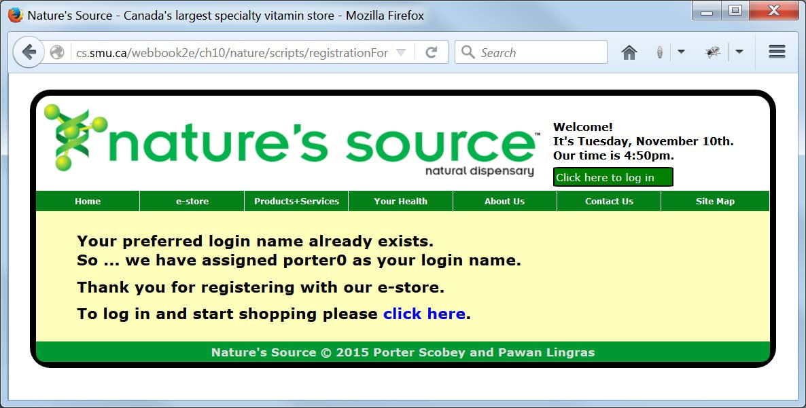
Username Duplication Avoided

Slide 24
registrationFormResponse.php
<?php
//registrationFormResponse.php
include("../common/document_head.html");
?>
<body>
<header>
<?php
include("../common/banner.php");
include("../common/menus.html");
include("../scripts/connectToDatabase.php");
?>
</header>
<main>
<article class="Registration">
<?php
include("../scripts/registrationFormProcess.php");
?>
</article>
</main>
<footer>
<?php
include("../common/footer_content.html");
?>
</footer>
</body>
</html>

Slide 25
Part 1 (of 2) of Main Part of Script from registrationFormProcess.php
//========== main script begins here
if (isset($_POST['gender']) && ($_POST['gender'] == "Female"))
$gender = "F";
else if (isset($_POST['gender']) && ($_POST['gender'] == "Male"))
$gender = "M";
else $gender = "O"; //for "Other"
if (emailAlreadyExists($db, $_POST['email']))
{
echo "<h3>Sorry, but your e-mail
address is already registered.</h3>";
}
else
{
$unique_login = getUniqueID($db, $_POST['loginName']);
if ($unique_login != $_POST['loginName'])
{
echo "<h3>Your preferred login name already exists.<br>So ...
we have assigned $unique_login as your login name.</h3>";
}

Slide 26
Part 2 (of 2) of Main Part of Script from registrationFormProcess.php
$query = "INSERT INTO Customers(
customer_id,
salutation,
customer_first_name, customer_middle_initial, customer_last_name,
gender,
email_address,
login_name, login_password,
phone_number,
address, town_city, county, country
)
VALUES (
NULL,
'$_POST[salute]',
'$_POST[firstName]', '$_POST[middleInitial]', '$_POST[lastName]',
'$_POST[gender]',
'$_POST[email]',
'$unique_login', '$_POST[loginPassword]',
'$_POST[phone]',
'$_POST[address]', '$_POST[city]', '$_POST[state]', '$_POST[country]'
);";
$success = mysqli_query($db, $query);
echo "<h3>Thank you for registering with our e-store.</h3>";
echo "<h3>To log in and start shopping please
<a href='pages/loginForm.php'
class='NoDecoration'>click here</a>.</h3>";
}
mysqli_close($db);

Slide 27
First of Two Helper Functions from registrationFormProcess.php
function emailAlreadyExists($db, $email)
{
$query =
"SELECT *
FROM Customers
WHERE email_address = '$email'";
$customers = mysqli_query($db, $query);
$numRecords = mysqli_num_rows($customers);
return ($numRecords > 0) ? true : false;
}

Slide 28
Second of Two Helper Functions from registrationFormProcess.php
function getUniqueID($db, $loginName)
{
$unique_login = $loginName;
$query =
"SELECT *
FROM Customers
WHERE login_name = '$unique_login'";
$customers = mysqli_query($db, $query);
$numRecords = mysqli_num_rows($customers);
if ($numRecords != 0)
{
//Try appending non-negative integers 0, 1, 2 ...
//till you get a unique login name
$i = -1;
do
{
$i++;
$unique_login = $loginName.$i;
$query =
"SELECT *
FROM Customers
WHERE login_name = '$unique_login'";
$customers = mysqli_query($db, $query);
$numRecords = mysqli_num_rows($customers);
}
while ($numRecords != 0);
}
return $unique_login;
}

Slide 29
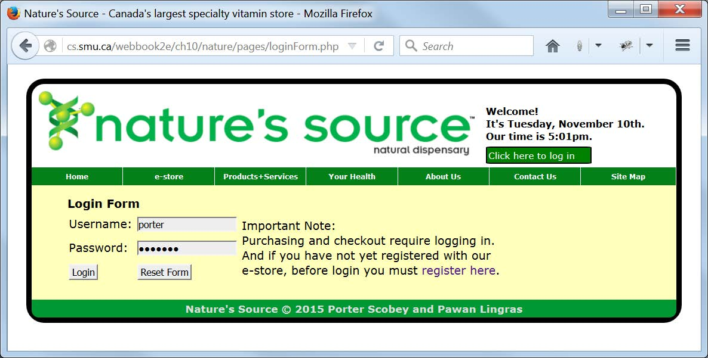
Logging In to the e-store

Slide 30
Part 1 (of 3) of loginForm.php
<?php
//loginForm.php
session_start();
if (isset($_SESSION['customer_id'])) header('Location: estore.php');
$retrying = isset($_GET['retrying']) ? true : false;
include("../common/document_head.html");
?>
<body>
<header>
<?php
include("../common/banner.php");
include("../common/menus.html");
?>
</header>
<main>
<article class="Login">
<h4>Login Form</h4>
<form id="loginForm"
onsubmit="return loginFormValidate();"
action="scripts/loginFormProcess.php"
method="post">
Notes
This time the validation function loginFormValidate() again just ensures that a blank form is not submitted but this time it is actually necessary since (for variety) we’ve left the required attribute off of our form controls.

Slide 31
Part 2 (of 3) of loginForm.php
<table class="TableCellSpacer">
<tr>
<td>Username:</td>
<td><input name="loginName"
type="text" size="20"
title="Must be at least 6 letters and or digits"
pattern="^\w{6,}$"></td>
<td rowspan="3">
Important Note:
<br>Purchasing and checkout require logging in.
<br>And if you have not yet registered with our
<br>e-store, before login you must
<a href="pages/registrationForm.php"
class="NoDecoration">register here</a>.
</td>
</tr>
<tr>
<td>Password:</td>
<td><input name="loginPassword"
type="password" size="20"
title="Must be at least 6 letters and or digits"
pattern="^\w{6,}$"></td>
</tr>

Slide 32
Part 3 (of 3) of loginForm.php
<tr>
<td><input type="submit" value="Login"></td>
<td><input type="reset" value="Reset Form"></td>
</tr>
<?php if ($retrying) { ?>
<tr>
<td colspan="2" class="ErrorMessage">
Sorry, but your login procedure failed.
<br>An invalid username or password was entered.
<br>Please try again to enter correct login information.
</td>
</tr>
<?php } ?>
</table>
</form>
</article>
</main>
<footer>
<?php
include("../common/footer_content.html");
?>
</footer>
</body>
</html>

Slide 33
loginFormProcess.php
(Part 1 of 2)
session_start();
if (isset($_SESSION['customer_id']))
header("Location: ../pages/estore.php");
include("connectToDatabase.php");
$query = "SELECT * FROM Customers
WHERE login_name = '$_POST[loginName]'";
$rowsWithMatchingLoginName = mysqli_query($db, $query);
$numRecords = mysqli_num_rows($rowsWithMatchingLoginName);
if ($numRecords == 0)
{
//No records were retrieved, so ...
header("Location: ../pages/loginForm.php?retrying=true");
}

Slide 34
loginFormProcess.php
(Part 2 of 2)
if ($numRecords == 1)
{
$row = mysqli_fetch_array($rowsWithMatchingLoginName, MYSQLI_ASSOC);
if ($_POST['loginPassword'] == $row['login_password'])
{
$_SESSION['customer_id'] = $row['customer_id'];
$_SESSION['salutation'] = $row['salutation'];
$_SESSION['customer_first_name'] = $row['customer_first_name'];
$_SESSION['customer_middle_initial'] =
$row['customer_middle_initial'];
$_SESSION['customer_last_name'] = $row['customer_last_name'];
$productID = $_SESSION['purchasePending'];
if ($productID != "")
{
unset($_SESSION['purchasePending']);
$destination =
"../pages/shoppingCart.php?productID=$productID";
$goto = "Location: $destination";
}
else
{
$destination = getenv('HTTP_REFERER');
$goto = "Location: ".$destination;
}
header($goto);
}
else
{
//The password entered did not match the database
//password for the login name entered, so ...
header("Location: ../pages/loginForm.php?retrying=true");
}
}
mysqli_close($db);

Slide 35
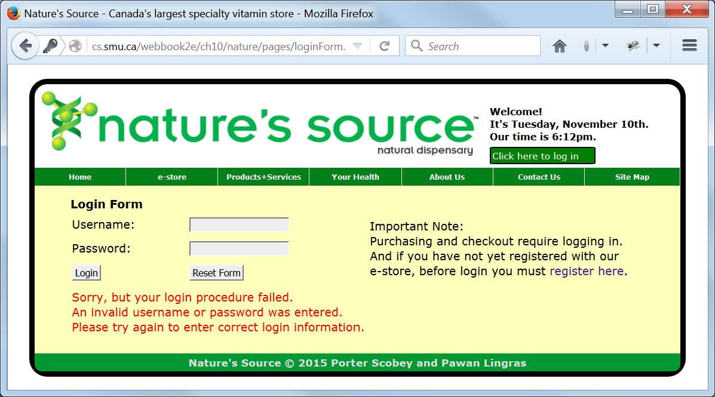
Request For a User to Try Again after a Failed Login

Slide 36
Passing Key/Value Pairs in a URL
$goto = "Location: ../purchase.php?productID=$prodID";
header('Location: ../login.php?retrying=true');
At the end of each of these lines we see a ? separating a key/value pair in which the key and value are themselves separated by an equals sign
The value half of the pair can be provided as a literal value (true) or as a variable ($prod).
More than one key/value pair can be passed along in this way, in which case an & separates the key/value pairs:
login.php?retrying=true&otherKey=otherValue

Slide 37
logout.php
(Part 1 of 3)
<?php
//logout.php
session_start();
$needToUseLoggedInMessage = isset($_SESSION['customer_id']) ? true : false;
if (isset($_SESSION['customer_id']))
{
$customerID = $_SESSION['customer_id'];
include("../scripts/connectToDatabase.php");
include("../scripts/logoutProcess.php");
//Doing this ...
session_unset();
session_destroy();
//... requires that banner.php check to make sure
//that $_SESSION values are set before using them.
}
include("../common/document_head.html");
?>

Slide 38
logout.php
(Part 2 of 3)
<body>
<header>
<?php
include("../common/banner.php");
include("../common/menus.html");
?>
</header>
<main>
<article class="Logout">
<h4>Logout</h4>
<?php if ($needToUseLoggedInMessage) { ?>
<p><br>Thank you for visiting our e-store.<br>
You have successfully logged out.</p>
<p>If you wish to log back in,
<a href="pages/loginForm.php"
class="NoDecoration">click here</a>.</p>
<p>To browse our product catalog,
<a href="pages/catalog.php"
class="NoDecoration">click here</a>.</p>
<?php } else { ?>

Slide 39
logout.php
(Part 3 of 3)
<?php } else { ?>
<p><br>Thank you for visiting Nature's Source.<br>
You have not yet logged in.</p>
<p>If you do wish to log in,
<a href="pages/loginForm.php"
class="NoDecoration">click here</a>.</p>
<p>Or, just to browse our product catalog,
<a href="pages/catalog.php"
class="NoDecoration">click here</a>.</p>
<?php } ?>
</article>
</main>
<footer>
<?php
include("../common/footer_content.html");
?>
</footer>
</body>
</html>

Slide 40
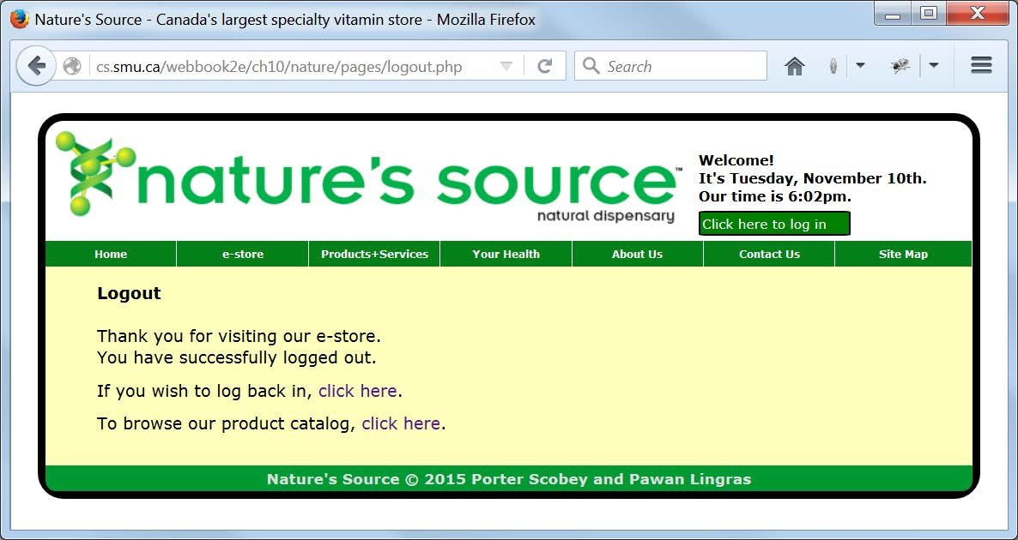
Display Indicating a Successful Logout

Slide 41
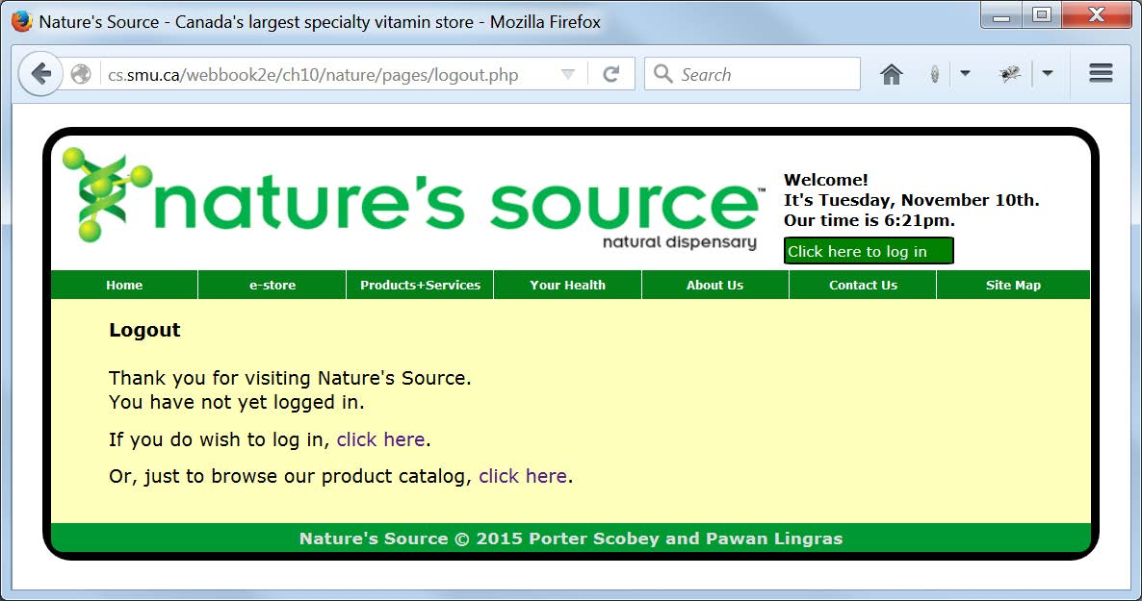
Display When an Attempt is Made to Log Out Without Having Logged In

Slide 42
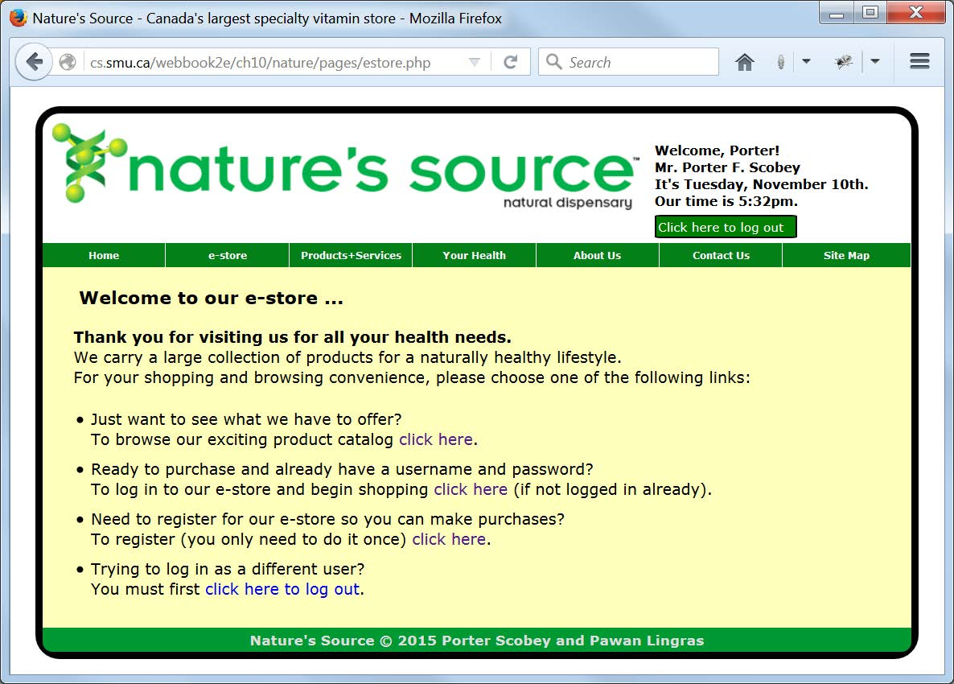
e-store After a Successful Login

Slide 43
Revised banner.php (Part 1 of 4)
/*banner.php
This file handles the "banner display" of our Nature's Source
website, which includes the logo and welcome message. The logo
is just HTML. A PHP script displays a Welcome and the current
date and time, including a personal Welcome if the user has
logged in. And finally, a JavaScript script uses AJAX and a
second PHP script to update the date and time every 60 seconds.
*/
?>
<div id="logo">
<img src="images/naturelogo.gif"
alt="Nature's Source"
width="608" height="90">
</div>
<div id="welcome">
<?php
//Ensure that session_start() is called at the
//beginning of any file that includes this script
//and needs to make use of the $_SESSION array.
//Also because logout.php destroys the session
//before its final display it is necessary here
//to check that the $_SESSION values are actually
//set and available before using them.

Slide 44
Revised banner.php (Part 2 of 4)
$loggedIn = isset($_SESSION['customer_id']) ? true : false;
if (isset($_SESSION['customer_id']))
$customerID = $_SESSION['customer_id'];
if (isset($_SESSION['salutation']))
$salutation = $_SESSION['salutation'];
if (isset($_SESSION['customer_first_name']))
$customerFirstName = $_SESSION['customer_first_name'];
if (isset($_SESSION['customer_middle_initial']))
$customerMiddleInitial = $_SESSION['customer_middle_initial'];
if (isset($_SESSION['customer_last_name']))
$customerLastName = $_SESSION['customer_last_name'];
if (!$loggedIn)
{
echo "<h5>Welcome!<br>";
}
else
{
echo "<h5>Welcome, $customerFirstName!<br>
$salutation $customerFirstName
$customerMiddleInitial $customerLastName<br>";
}

Slide 45
Revised banner.php (Part 3 of 4)
$date = date("l, F jS");
$time = date("g:ia");
echo "<span id='datetime'>It's $date.<br>";
echo "Our time is $time.</span>";
if ($loggedIn)
{
echo "</h5><a class='LongerButton'
href='pages/logout.php'>
Click here to log out</a>";
}
else
{
echo "</h5><a class='LongerButton'
href='pages/loginForm.php'>
Click here to log in</a>";
}
?>
</div>

Slide 46
Revised banner.php (Part 4 of 4)
<script>
//This script sets up the AJAX infrastructure for
//requesting date and time updates from the server.
var request = null;
function getCurrentTime()
{
request = new XMLHttpRequest();
var url = "common/time.php";
request.open("GET", url, true);
request.onreadystatechange = updatePage;
request.send(null);
}
function updatePage()
{
if (request.readyState == 4)
{
var dateDisplay = document.getElementById("datetime");
dateDisplay.innerHTML = request.responseText;
}
}
getCurrentTime();
setInterval('getCurrentTime()', 60000)
</script>

Slide 47
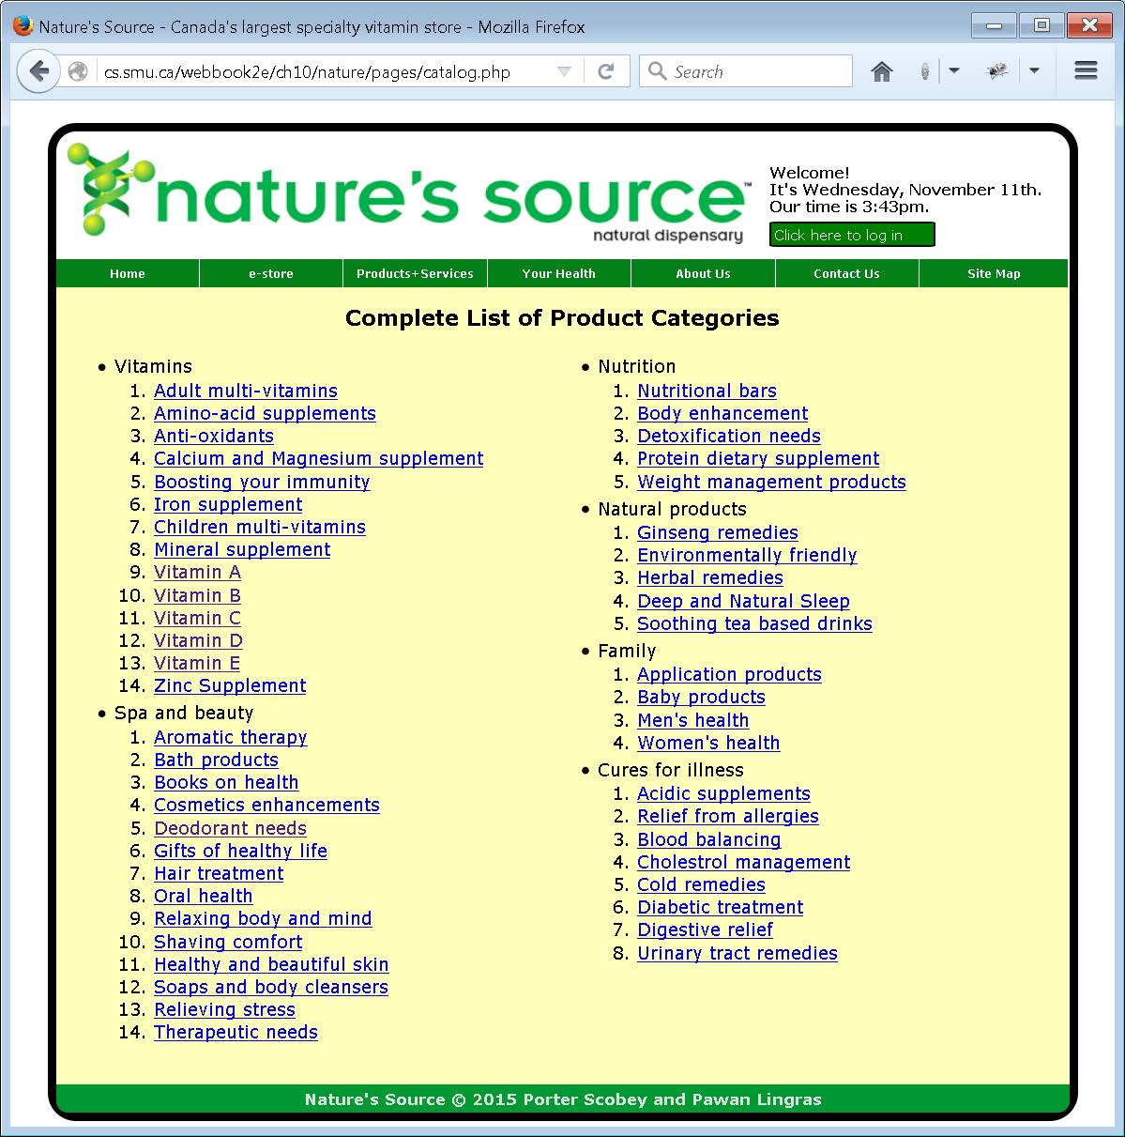
Listing of the Departments and Product Categories in Our e-store

Slide 48
PHP Code for Displaying Departments and Product Categories (Part 1 of 2)
<?php
/*displayListOfCategories.php
Included in catalog.php
This script assumes a connection has already been made
to the database, from which it loads and displays all
product categories.
*/
$query = "SELECT * FROM Ref_Product_Categories
ORDER BY department_name DESC";
$categories = mysqli_query($db, $query);
$numRecords = mysqli_num_rows($categories);
$categoryCount = 0;
$currentDepartment = "";
echo
"<table><tr><td><ul>";

Slide 49
PHP Code for Displaying Departments
and Product Categories (Part 2 of 2)
for ($i=1; $i<=$numRecords; $i++)
{
$row = mysqli_fetch_array($categories, MYSQLI_ASSOC);
if ($currentDepartment != $row['department_name'])
{
if ($currentDepartment != "") echo "</ol></li>";
if ($categoryCount > $numRecords/2)
{
echo "</ul></td>\r\n<td class='AlignToTop'><ul>";
$categoryCount = 0;
}
$currentDepartment = $row['department_name'];
echo "<li>$currentDepartment<ol>";
}
$prodCatCode = urlencode($row['product_category_code']);
$prodCatDesc = $row['product_category_description'];
$categoryURL = "pages/category.php?categoryCode=$prodCatCode";
echo "<li><a href='$categoryURL'>$prodCatDesc</a></li>\r\n";
$categoryCount++;
}
echo
"</ol></li></ul></td></tr></table>";
mysqli_close($db);
?>

Slide 50
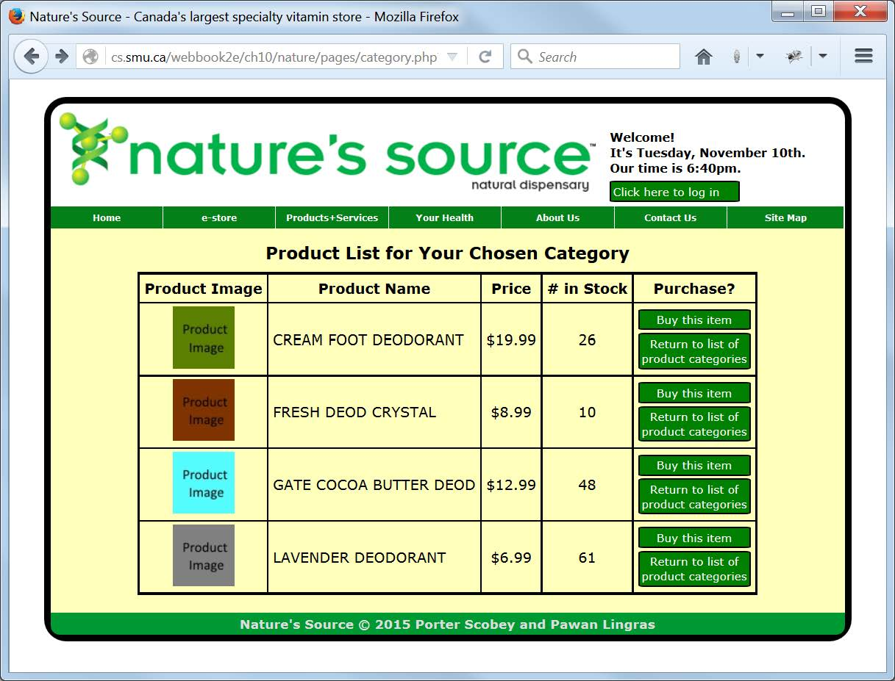
A listing of the Individual Products in a Category

Slide 51
PHP Code for Displaying Products in a Category (Part 1 of 3)
<?php
/*displayOneCategoryItems.php
This script is called when all product categories have
been displayed and the user clicks on a link to see all
prodcuts in a particular category.
*/
$categoryCode = $_GET['categoryCode'];
$query = "SELECT * FROM Products
WHERE product_category_code = '$categoryCode'
ORDER BY product_name ASC";
$category = mysqli_query($db, $query);
$numRecords = mysqli_num_rows($category);
echo
"<table>
<tr>
<th>Product Image</th>
<th>Product Name</th>
<th>Price</th>
<th># in Stock</th>
<th>Purchase?</th>
</tr>";

Slide 52
PHP Code for Displaying Products in a Category (Part 2 of 3)
for ($i=1; $i<=$numRecords; $i++)
{
$row = mysqli_fetch_array($category, MYSQLI_ASSOC);
$productImageURL = $row['product_image_url'];
$productName = $row['product_name'];
$productPrice = $row['product_price'];
$productPriceAsString = sprintf("$%.2f", $productPrice);
$productInventory = $row['product_inventory'];
$productID = $row['product_id'];
$shoppingCartURL = "pages/shoppingCart.php?productID=$productID";
$catalogURL = "pages/catalog.php";

Slide 53
PHP Code for Displaying Products in a Category (Part 3 of 3)
echo
"<tr>
<td>
<img height='70' width='70'
src='$productImageURL'
alt='Product Image'>
</td><td style='text-align: left;'>
$productName
</td><td>
$productPriceAsString
</td><td>
$productInventory
</td><td>
<a class='Button' href='$shoppingCartURL'>Buy this item</a>
<a class='Button' href='$catalogURL'>Return to list of
product categories</a>
</td></tr>";
}
echo
"</table>";
mysqli_close($db);
?>

Slide 54
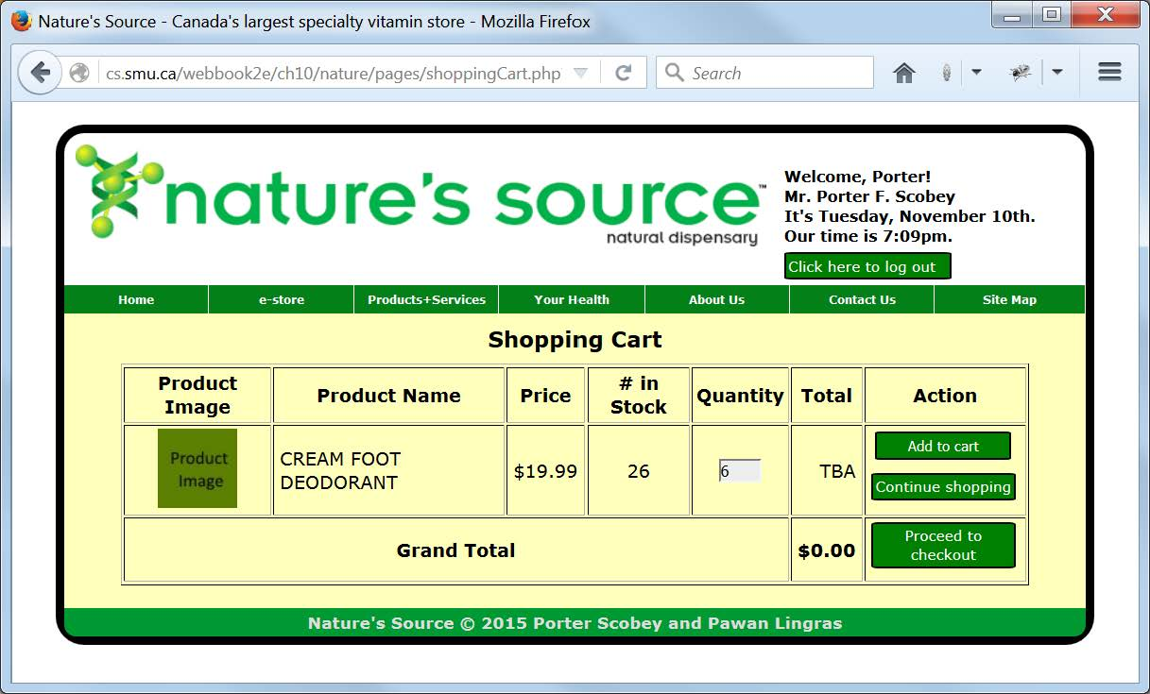
Purchasing a First Product

Slide 55
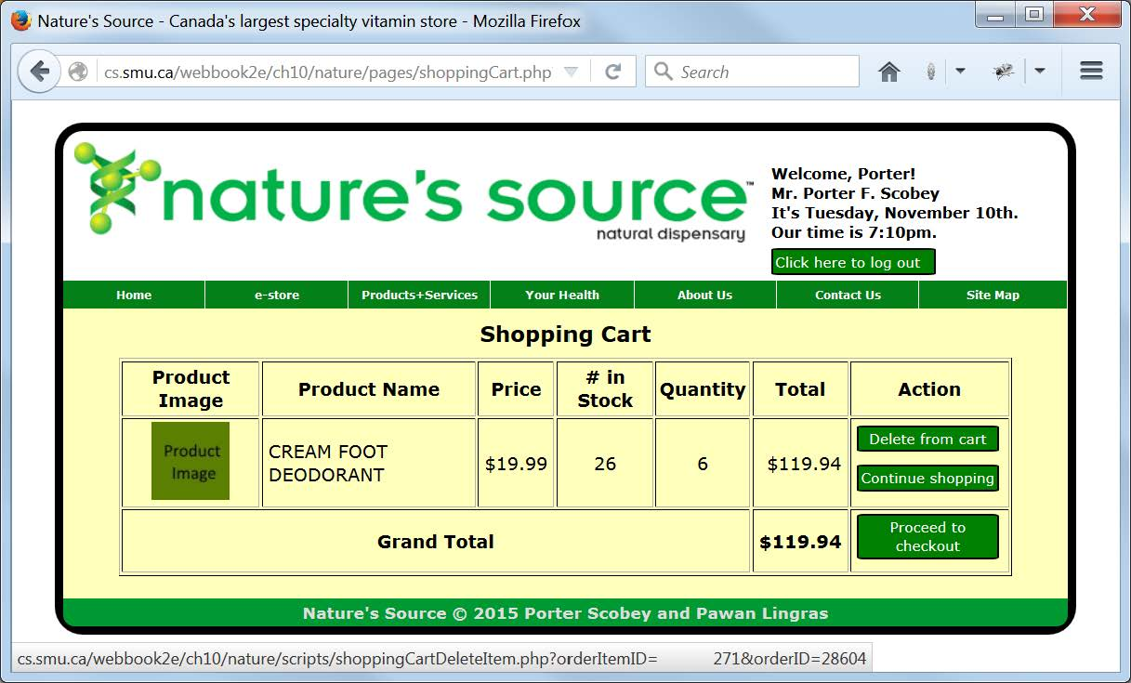
Follow-up Display after
Adding Product to Shopping Cart

Slide 56
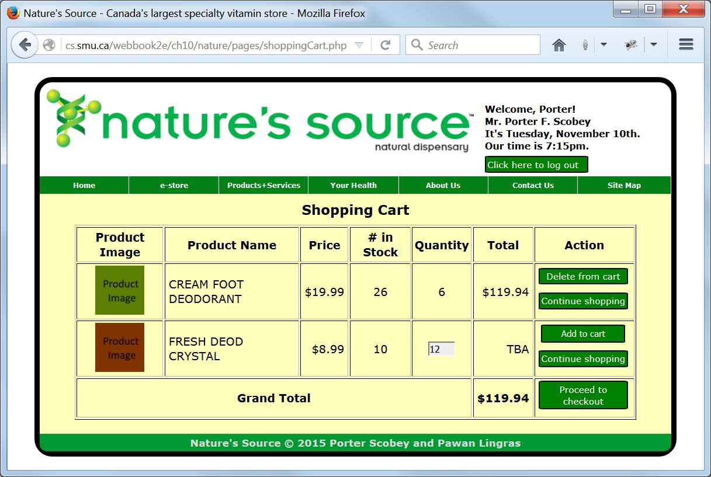
Purchasing Additional Products:
Trying to Buy More than Available

Slide 57
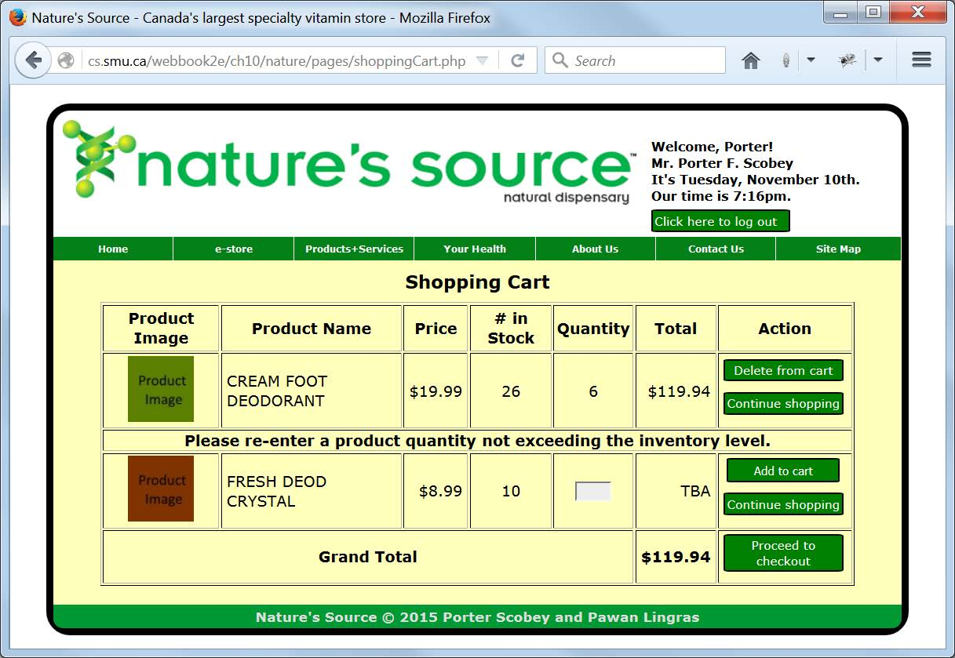
Try Again: Do not Request
More than Available

Slide 58
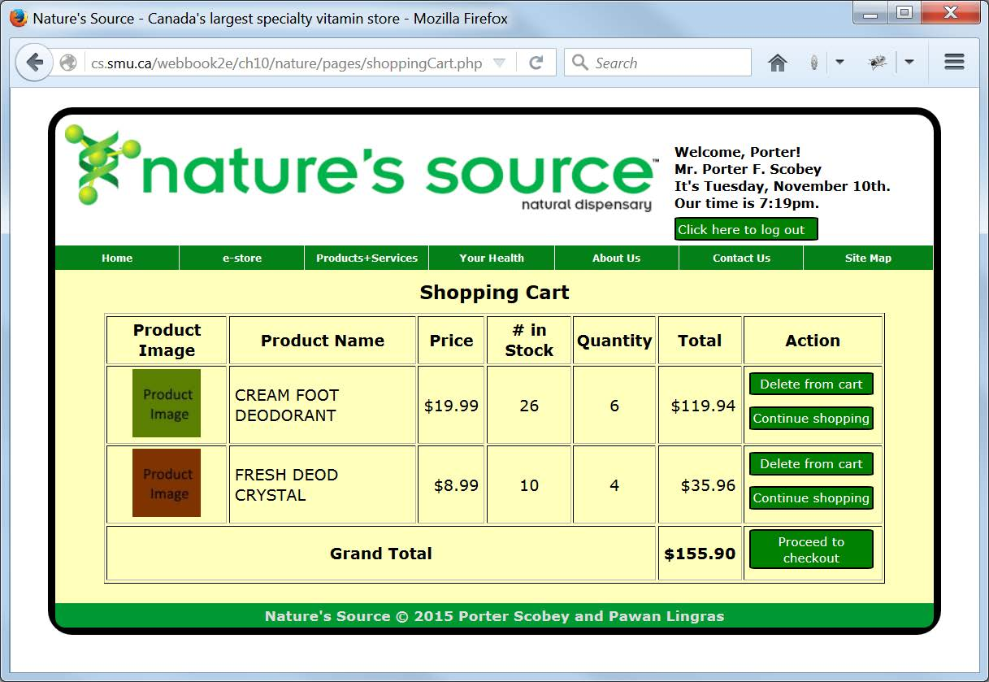
Viewing the Shopping Cart with
Two Items: Ready for Checkout

Slide 59
The High-Level Shopping Cart
Processing Page (Part 1 of 2)
<?php
/*shoppingCart.php
This page provides the "high-level" shopping cart view, if in
fact the visitor has a shopping cart. Otherwise the visitor is
redirected to the login page.
*/
session_start();
$customerID = isset($_SESSION['customer_id'])
? $_SESSION['customer_id'] : "";
$productID = $_GET['productID'];
if ($customerID == "")
{
$_SESSION['purchasePending'] = $productID;
header("Location: loginForm.php");
}
include("../common/document_head.html");
?>

Slide 60
The High-Level Shopping Cart
Processing Page (Part 2 of 2)
<body>
<header>
<?php
include("../common/banner.php");
include("../common/menus.html");
include("../scripts/connectToDatabase.php");
?>
</header>
<main>
<article class="ShoppingCart">
<h4 class="ShoppingCartHeader">Shopping Cart</h4>
<?php
include("../scripts/shoppingCartProcess.php");
?>
</article>
</main>
<footer>
<?php
include("../common/footer_content.html");
?>
</footer>
</body>
</html>

Slide 61
PHP Code for Main Part of the PHP Script for Shopping Cart Processing (Part 1 of 3)
<?php
/*shoppingCartProcess.php
Handles interaction between the user and the database
for Shopping Cart transactions.
Included by pages/shoppingCart.php.
Calls these functions (defined below):
getExistingOrder()
createOrder()
displayHeader()
displayExistingItemColumns()
displayNewItemColumns()
displayFooter()
*/
//========== main script begins here
$retrying = isset($_GET['retrying']) ? true : false;
$items = getExistingOrder($db, $customerID);
$numRecords = mysqli_num_rows($items);
if ($numRecords == 0 && $productID == 'view')
{
echo
"<p class='Notification'>Your shopping cart is empty.</p>
<p class='Notification'>To continue shopping, please
<a class='NoDecoration' href='pages/catalog.php'>click here</a>.</p>";
}

Slide 62
PHP Code for Main Part of the PHP Script for Shopping Cart Processing (Part 2 of 3)
else
{
displayHeader();
$grandTotal = 0;
if ($numRecords == 0) //Shopping cart is empty
{
createOrder($db, $customerID);
}
else //Shopping cart contains one or more items to display
{
for ($i=1; $i<=$numRecords; $i++)
{
$grandTotal += displayExistingItemColumns($db, $items);
}
}

Slide 63
PHP Code for Main Part of the PHP Script for Shopping Cart Processing (Part 3 of 3)
if ($productID != 'view') //Display entry row for new item
{
if ($retrying)
{
echo
"<tr>
<td class='Notification' colspan='7'>Please re-enter a
product quantity not exceeding the inventory level.
</td>
</tr>";
}
displayNewItemColumns($db, $productID);
}
displayFooter($grandTotal);
}
mysqli_close($db);
//========== main script ends here

Slide 64
PHP Function for Retrieving Product Information for an Order-in-progress
/*getExistingOrder()
Retrieves from the database the items in an existing order,
that is, items currently in the shopping cart that have not
been purchased by going through checkout.
*/
function getExistingOrder($db, $customerID)
{
$query =
"SELECT
Orders.order_id,
Orders.customer_id,
Orders.order_status_code,
Order_Items.*
FROM
Order_Items, Orders
WHERE
Orders.order_id = Order_Items.order_id and
Orders.order_status_code = 'IP' and
Orders.customer_id = $customerID";
$items = mysqli_query($db, $query);
return $items;
}

Slide 65
PHP Function for Creating a New Order
/*createOrder()
Creates a new order, to which items may be added for purchase.
*/
function createOrder($db, $customerID)
{
$query = "INSERT INTO Orders
(
customer_id,
order_status_code,
date_order_placed,
order_details
)
VALUES
(
'$customerID',
'IP',
CURDATE(),
NULL
)";
$success = mysqli_query($db, $query);
}

Slide 66
PHP Function for Displaying the Table Header for the Shopping Cart Display
/*displayHeader()
Displays headers for the seven columns of the shopping cart table.
*/
function displayHeader()
{
echo
"<form id='orderForm'
onsubmit='return shoppingCartAddItemFormValidate();'
action='scripts/shoppingCartAddItem.php'>
<table border='1px'>
<tr>
<th>Product Image</th>
<th>Product Name</th>
<th>Price</th>
<th># in Stock</th>
<th>Quantity</th>
<th>Total</th>
<th>Action</th>
</tr>";
}

Slide 67
PHP Function for Displaying the First Four Table Columns for a Product
/*displayFirstFourColumns()
Displays the first four columns of a row of the shopping cart
table. The contents of the last three columns of a row of the
table will be different, depending on whether the row contains
information for an item that's already in the shopping cart,
or an item that has been chosen for adding to the cart but is
not yet in it.
*/
function displayFirstFourColumns($db, $productID)
{
$query = "SELECT * FROM Products WHERE product_id='$productID'";
$product = mysqli_query($db, $query);
$row = mysqli_fetch_array($product, MYSQLI_ASSOC);
$productPrice = sprintf("$%1.2f", $row['product_price']);
echo
"<tr>
<td>
<img height='70' width='70'
src='$row[product_image_url]' alt='Product Image'>
</td><td style='text-align: left;'>
$row[product_name]
</td><td style='text-align: right;'>
$productPrice
</td><td>
$row[product_inventory]
</td>";
}

Slide 68
PHP Function for Displaying the Last Three Columns for Each Existing Item
/*displayExistingItemColumns()
Displays the last three columns of information for an item that
is alreay in the shopping cart. This information includes the
quantity ordered, the total price, and buttons to allow the
deletion of the item or continuing to shop by transferring
back to the product catalog.
*/
function displayExistingItemColumns($db, $items)
{
$row = mysqli_fetch_array($items, MYSQLI_ASSOC);
$productID = $row['product_id'];
displayFirstFourColumns($db, $productID);
$total = $row['order_item_quantity'] * $row['order_item_price'];
$totalAsString = sprintf("$%1.2f", $total);
echo
"<td>
$row[order_item_quantity]
</td><td style='text-align: right;'>
$totalAsString
</td><td>
<p><a class='Button'
href='scripts/shoppingCartDeleteItem.php?orderItemID=
$row[order_item_id]&orderID=$row[order_id]'>
Delete from cart</a></p>
<p><a class='Button' href='pages/catalog.php'>
Continue shopping</a></p>
</td>
</tr>";
return $total;
}

Slide 69
PHP Function for Displaying the Last Three Columns for Each New Item
/*displayNewItemColumns()
Displays the last three columns of information for an new item
that has been chosen for purchase but has not yet been added to
the shopping cart. This information includes a box for entering
the quantity desired, TBA in the total price spot, and buttons
to allow the addition of the item to the shopping cart or just
continuing to shop by transferring back to the product catalog,
thereby ignoring the given item.
*/
function displayNewItemColumns($db, $productID)
{
displayFirstFourColumns($db, $productID);
echo
"<td>
<input type='hidden' id='productID' name='productID' value=$productID>
<input type='text' id='quantity' name='quantity' size='3'>
</td><td style='text-align: right;'>
TBA
</td><td>
<p class='Centered' style='font-size:100%'>
<input class='Button' type='submit' value='Add to cart'></p>
<p><a class='Button' href='pages/catalog.php'>
Continue shopping</a></p>
</td>
</tr>";
}

Slide 70
PHP Function for Displaying the Table Footer for the Shopping Cart Display
/*displayFooter()
Displays the final row of the shopping cart table, including
the grand total cost of items to be purchased and button to
permit proceeding to checkout.
*/
function displayFooter($grandTotal)
{
$grandTotalAsString = sprintf("$%1.2f", $grandTotal);
echo
"<tr>
<td class='Notification' colspan='5'>
Grand Total
</td><td class='RightAligned'>
<strong>$grandTotalAsString</strong>
</td><td>
<p><a class='Button' href='pages/checkout.php'>
Proceed to checkout</a></p>
</td>
</tr>
</table>
</form>";
}

Slide 71
PHP Code for Adding a New Item to the Cart (Part 1 of 3)
<?php
/*shoppingCartAddItem.php
Adds an item to the user's shopping cart, and redisplays the cart.
*/
session_start();
include("connectToDatabase.php");
//========== main script begins here
$customerID = $_SESSION['customer_id'];
$productID = $_GET['productID'];
//Get the order ID for the current order in progress
$query =
"SELECT
Orders.order_id,
Orders.order_status_code,
Orders.customer_id
FROM Orders
WHERE
Orders.order_status_code = 'IP' and
Orders.customer_id = $customerID";
$order = mysqli_query($db, $query);
$row = mysqli_fetch_array($order, MYSQLI_ASSOC);
$orderID = $row['order_id'];

Slide 72
PHP Code for Adding a New Item to the Cart (Part 2 of 3)
//Get the quantity in inventory of the requested product
$query =
"SELECT *
FROM Products
WHERE product_id = '$productID'";
$product = mysqli_query($db, $query);
$row = mysqli_fetch_array($product, MYSQLI_ASSOC);
$productInventory = $row['product_inventory'];
$quantityRequested = $_GET['quantity'];
if ($quantityRequested > $productInventory)
{
$gotoRetry = "../pages/shoppingCart.php?
productID=$productID&retrying=true";
header("Location: $gotoRetry");
}

Slide 73
PHP Code for Adding a New Item to the Cart (Part 3 of 3)
else
{
$productPrice = $row['product_price'];
$query = "INSERT INTO Order_Items
(
order_item_status_code,
order_id,
product_id,
order_item_quantity,
order_item_price,
other_order_item_details
)
VALUES
(
'IP',
'$orderID',
'$productID',
'$quantityRequested',
'$productPrice',
NULL
)";
$success = mysqli_query($db, $query);
header("Location: ../pages/shoppingCart.php?productID=view");
}

Slide 74
PHP Code for Deleting an Item from the Shopping Cart
<?php
/*shoppingCartDeleteItem.php
Deletes an item from the user's shopping cart, and
redisplays the cart.
*/
session_start();
include("connectToDatabase.php");
$orderItemID = $_GET['orderItemID'];
$orderID = $_GET['orderID'];
$query = "DELETE FROM Order_Items WHERE order_item_id='$orderItemID'";
$success = mysqli_query($db, $query);
$query = "SELECT COUNT(*) AS numItemsStillInOrder
FROM Order_Items WHERE order_id='$orderID'";
$return_value = mysqli_query($db, $query);
$row = mysqli_fetch_array($return_value, MYSQLI_ASSOC);
if ($row[numItemsStillInOrder] == 0)
{
$query = "DELETE FROM Orders
WHERE order_id='$orderID'";
$success = mysqli_query($db, $query);
}
header("Location: ../pages/shoppingCart.php?productID=view");
?>

Slide 75
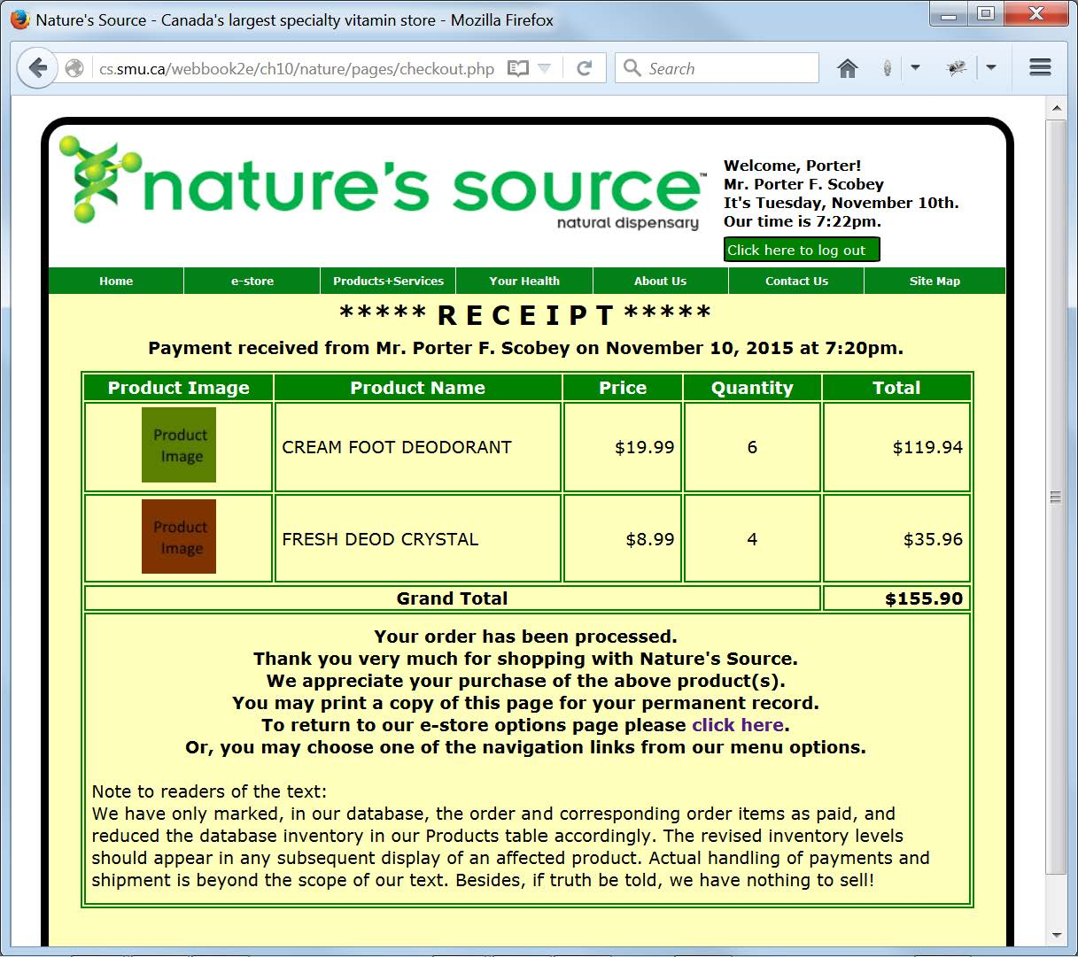
Receipt Displayed upon Completion of the Checkout Process

Slide 76
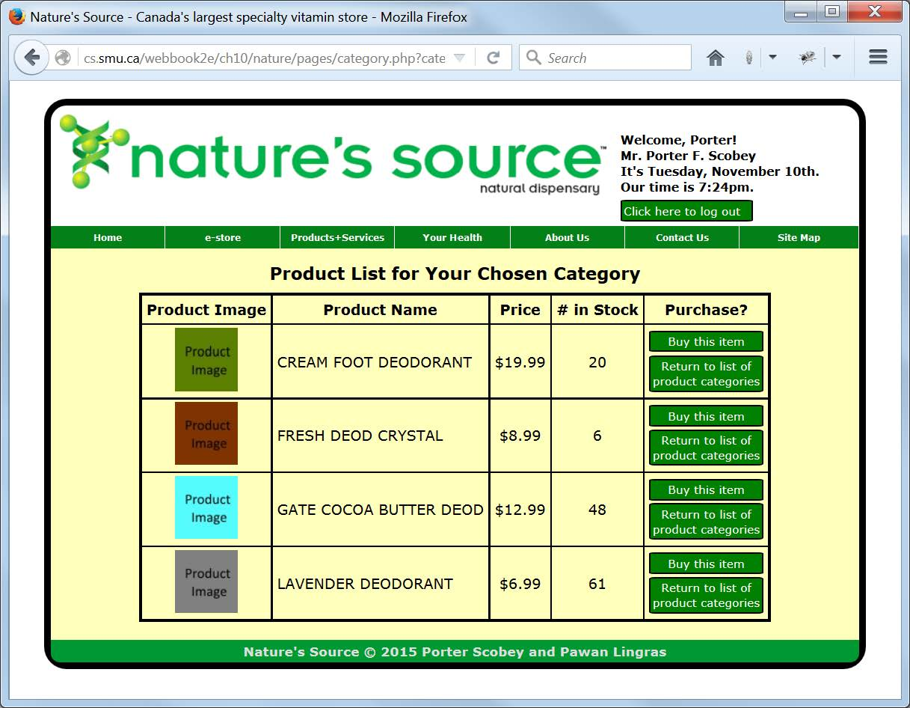
Confirming the Reduction in Inventory after Purchase

Slide 77
The High-Level Checkout and Payment Processing Page (Part 1 of 2)
<?php
/*checkout.php
This page handles the user's checkout process at the highest-level,
if that user has come here from his or her shopping cart, and
otherwise the user is redirected to a view of the current status
of the user's shopping cart.
*/
session_start();
if (!preg_match('/shoppingCart.php/', $_SERVER['HTTP_REFERER']))
header("Location: shoppingCart.php?productID=view");
$customerID = $_SESSION['customer_id'];
include("../common/document_head.html");
?>

Slide 78
The High-Level Checkout and Payment Processing Page (Part 2 of 2)
<body>
<header>
<?php
include("../common/banner.php");
include("../common/menus.html");
include("../scripts/connectToDatabase.php");
?>
</header>
<main>
<article class="Receipt">
<?php
include("../scripts/checkoutProcess.php");
?>
</article>
</main>
<footer>
<?php
include("../common/footer_content.html");
?>
</footer>
</body>
</html>

Slide 79
PHP Code for Main Part of Script for
Processing a Payment and Checkout (Part 1 of 2)
<?php
/*checkoutProcess.php
Displays a receipt to confirm the client's purchase(s)
and adjusts the database inventory levels accordingly.
Has a very short main driver, but uses eight helper
functions, all of which are defined below.
Calls displayReceipt() once, which in turn calls
--getExistingOrder() once
--displayReceiptHeader() once
--displayItemAndReturnTotalPrice() once for each item in the order
--displayReceiptFooter() once
Calls markOrderPaid() once
Calls markOrderItemsPaid() once, which in turn calls
--reduceInventory() once for each item in the order
*/
//error_reporting(E_ALL);
//========== main script begins here
displayReceipt($db, $customerID);

Slide 80
PHP Code for Main Part of Script for
Processing a Payment and Checkout (Part 2 of 2)
//Get the order ID for the order in progress
$query =
"SELECT
Orders.order_id,
Orders.customer_id,
Orders.order_status_code,
Order_Items.*
FROM
Order_Items, Orders
WHERE
Orders.order_id = Order_Items.order_id and
Orders.order_status_code = 'IP' and
Orders.customer_id = $customerID";
$orderInProgress = mysqli_query($db, $query);
$orderInProgressArray = mysqli_fetch_array($orderInProgress);
$orderID = $orderInProgressArray[0];
//Now mark as paid both the order itself and its order items
markOrderPaid($db, $customerID, $orderID);
markOrderItemsPaid($db, $orderID);
mysqli_close($db);
//========== main script ends here

Slide 81
High-Level PHP Function for Displaying Receipt
/*displayReceipt()
The "driver" routine for preparing and displaying a receipt
for the items purchased in the current order being checked out.
*/
function displayReceipt($db, $customerID)
{
$items = getExistingOrder($db, $customerID);
$numRecords = mysqli_num_rows($items);
if($numRecords == 0)
{
echo
"<h4 class='ShoppingCartHeader'>Shopping Cart</h4>
<p class='Notification'>Your shopping cart is empty.</p>
<p class='Notification'>To continue shopping, please
<a class='NoDecoration' href='pages/catalog.php'>click
here</a>.</p>";
exit(0);
}
else
{
displayReceiptHeader();
$grandTotal = 0;
for($i=1; $i<=$numRecords; $i++)
{
$row = mysqli_fetch_array($items, MYSQLI_ASSOC);
$grandTotal += displayItemAndReturnTotalPrice($db, $row);
}
displayReceiptFooter($grandTotal);
}
}

Slide 82
PHP Function for Displaying Receipt Header
/*displayReceiptHeader()
Displays user information and the date, as well as column
headers for the table of purchased items.
*/
function displayReceiptHeader()
{
$date = date("F j, Y");
$time = date('g:ia');
echo
"<p class='ReceiptTitle'>***** R E C E I P T *****</p>
<p class='Notification'>
Payment received from
$_SESSION[salutation]
$_SESSION[customer_first_name]
$_SESSION[customer_middle_initial]
$_SESSION[customer_last_name] on $date at $time.
</p>";
echo
"<table class='Receipt'>
<tr>
<th>Product Image</th>
<th>Product Name</th>
<th>Price</th>
<th>Quantity</th>
<th>Total</th>
</tr>";
}

Slide 83
PHP Function for Getting Purchased-Item Info
/*getExistingOrder()
Gets and returns the purchased items in the order
being checked out.
*/
function getExistingOrder($db, $customerID)
{
$query =
"SELECT
Orders.order_id,
Orders.customer_id,
Orders.order_status_code,
Order_Items.*
FROM
Order_Items, Orders
WHERE
Orders.order_id = Order_Items.order_id and
Orders.order_status_code = 'IP' and
Orders.customer_id = '$customerID'";
$items = mysqli_query($db, $query);
return $items;
}

Slide 84
PHP Function for Displaying One Product-Info Row of Receipt (Part 1 of 2)
/*displayItemAndReturnTotalPrice()
Displays one table row containing the information for
one purchased item.
*/
function displayItemAndReturnTotalPrice($db, $row)
{
$productID = $row['product_id'];
$query = "SELECT * FROM Products WHERE product_id ='$productID'";
$product = mysqli_query($db, $query);
$rowProd = mysqli_fetch_array($product, MYSQLI_ASSOC);
$productPrice = $rowProd['product_price'];
$productPriceAsString = sprintf("$%1.2f", $productPrice);
$totalPrice = $row['order_item_quantity'] * $row['order_item_price'];
$totalPriceAsString = sprintf("$%1.2f", $totalPrice);
$imageLocation = $rowProd['product_image_url'];

Slide 85
PHP Function for Displaying One Product-Info Row of Receipt (Part 2 of 2)
echo
"<tr>
<td class='Centered'>
<img height='70' width='70'
src='$imageLocation' alt='Product Image'>
</td><td class='LeftAligned'>
$rowProd[product_name]
</td><td class='RightAligned'>
$productPriceAsString
</td><td class='Centered'>
$row[order_item_quantity]
</td><td class='RightAligned'>
$totalPriceAsString
</td>
</tr>";
return $totalPrice;
}

Slide 86
PHP Function for Displaying Receipt Footer
/*displayReceiptFooter()
Displays the total amount of the purchase and additional
information in the footer of the receipt.
*/
function displayReceiptFooter($grandTotal)
{
$grandTotalAsString = sprintf("$%1.2f", $grandTotal);
echo
"<tr>
<td class='Notification' colspan='4'>
Grand Total
</td><td class='RightAligned'>
<strong>$grandTotalAsString</strong>
</td>
</tr><tr>
<td colspan='5'>
<p class='Notification'>Your order has been processed.
<br>Thank you very much for shopping with Nature's Source.
<br>We appreciate your purchase of the above product(s).
<br>You may print a copy of this page for your permanent record.
<br>To return to our e-store options page please
<a href='pages/estore.php' class='NoDecoration'>click here</a>.
<br>Or, you may choose one of the navigation links from our
menu options.</p>
<p class='LeftAligned'>Note to readers of the text:<br>
We have only marked, in our database, the order and corresponding
order items as paid, and reduced the database inventory in our
Products table accordingly. The revised inventory levels should
appear in any subsequent display of an affected product. Actual
handling of payments and shipment is beyond the scope of our text.
Besides, if truth be told, we have nothing to sell!</p>
</td>
</tr>
</table>";
}

Slide 87
PHP Function for
Marking an Order as Paid
/*markOrderPaid()
Changes the status in the database of the order being checked
out from IP (in progress) to PD (paid).
*/
function markOrderPaid($db, $customerID, $orderID)
{
$query =
"UPDATE Orders
SET order_status_code = 'PD'
WHERE customer_id = '$customerID' and
order_id ='$orderID'";
$success = mysqli_query($db, $query);
}

Slide 88
PHP Function for Marking
Individual Order Items as Paid
/*markOrderItemsPaid()
Changes the status in the database of each item purchased
from IP (in progress) to PD (paid).
*/
function markOrderItemsPaid($db, $orderID)
{
$query =
"SELECT *
FROM Order_Items
WHERE order_id = '$orderID'";
$orderItems = mysqli_query($db, $query);
$numRecords = mysqli_num_rows($orderItems);
for($i=1; $i<=$numRecords; $i++)
{
$row = mysqli_fetch_array($orderItems, MYSQLI_ASSOC);
$query =
"UPDATE Order_Items
SET order_item_status_code = 'PD'
WHERE order_item_id = $row[order_item_id] and
order_id = $row[order_id]";
mysqli_query($db, $query);
reduceInventory($db, $row['product_id'],
$row['order_item_quantity']);
}
}

Slide 89
PHP Function for Reducing the Inventory Level After Payment
/*reduceInventory()
Reduces the inventory level in the database of the product
purchased by the amount purchased.
*/
function reduceInventory($db, $productID, $quantityPurchased)
{
$query = "SELECT * FROM Products WHERE product_id = '$productID'";
$product = mysqli_query($db, $query);
$row = mysqli_fetch_array($product, MYSQLI_ASSOC);
$row['product_inventory'] -= $quantityPurchased;
$query =
"UPDATE Products
SET product_inventory = $row[product_inventory]
WHERE product_id = $row[product_id]";
mysqli_query($db, $query);
}

Slide 90
Logout/Clean-up Script (Part 1 of 4)
<?php
/*logoutProcess.php
Handles "clean up" by deleting any orders that
have been created by users who have tried to buy
items without being registered and logging in,
or by users who have logged in and started to
buy one or more items but changed their mind.
*/
//error_reporting(E_ALL);
//First delete all "orphaned" orders created
//by not-logged-in customers who tried to buy
//an item, but did not follow up when they
//discovered registration and login were
//required ...
$query =
"DELETE FROM Orders
WHERE
customer_id = 0 and
order_status_code = 'IP'";
$success = mysqli_query($db, $query);

Slide 91
Logout/Clean-up Script (Part 2 of 4)
//Next, see if there is an order "in progress"
$query =
"SELECT
Orders.order_id,
Orders.customer_id,
Orders.order_status_code,
Order_Items.*
FROM
Order_Items, Orders
WHERE
Orders.order_id = Order_Items.order_id and
Orders.order_status_code = 'IP' and
Orders.customer_id = $customerID";
$items = mysqli_query($db, $query);
if ($items != null)
$numRecords = mysqli_num_rows($items);
//If $numRecords is non-zero (actually, 1) there is
//an order in progress; if it is 0, there is no order
//in progress, but there may be any number of orders
//that were created by a logged-in user choosing to
//"Buy this item" but not actually buying it, and doing
//this one or more times before actually starting an
//order, thus creating one or more orders without any
//corresponding order items,
//so ...

Slide 92
Logout/Clean-up Script (Part 3 of 4)
if ($numRecords == 0)
//If there are "orphaned" orders for which there are no
//corresponding order items, find them and delete them ...
{
$query =
"SELECT
order_id,
customer_id,
order_status_code
FROM Orders
WHERE
order_status_code = 'IP' and
customer_id = $customerID";
$orphanedOrders = mysqli_query($db, $query);

Slide 93
Logout/Clean-up Script (Part 4 of 4)
if ($orphanedOrders != null)
{
$numRecords = mysqli_num_rows($orphanedOrders);
if ($numRecords != 0)
{
for ($i=0; $i<$numRecords; $i++)
{
$orphanedOrdersArray =
mysqli_fetch_array($orphanedOrders, MYSQLI_ASSOC);
$orphanedOrderID = $orphanedOrdersArray['order_id'];
$query =
"DELETE FROM Orders
WHERE
order_id = '$orphanedOrderID' and
order_status_code = 'IP' and
customer_id = '$customerID'";
$success = mysqli_query($db, $query);
}
}
}
}
mysqli_close($db);
?>

Slide 94
Possibly Useful “Utility” SQL Scripts
(Part 1 of 2)
#get_me.sql
#Replace 'Scobey' with 'your_name'
#---------------------------------
SELECT customer_id as id,
salutation as sal,
customer_first_name as first,
customer_middle_initial as mid,
customer_last_name as last,
gender as sex,
email_address as email,
login_name as username,
login_password as password
FROM Customers
WHERE customer_last_name='Scobey';
SELECT phone_number, address, town_city, county, country
FROM Customers
WHERE customer_last_name='Scobey';
#delete_me.sql
#Replace 'Scobey' with 'your_name'
#---------------------------------
DELETE FROM Customers
WHERE customer_last_name='Scobey';

Slide 95
Possibly Useful “Utility” SQL Scripts
(Part 2 of 2)
#get_orders.sql
#--------------
SELECT order_id as id,
customer_id as cust,
order_status_code as status,
date_order_placed as date,
order_details as details
FROM Orders;
SELECT order_item_id as id,
order_item_status_code as status,
order_id,
product_id,
order_item_quantity as quant,
order_item_price as price,
other_order_item_details as details
FROM Order_Items;
#delete_orders.sql
#-----------------
DELETE FROM Orders;
DELETE FROM Order_Items;
#get_table_sizes.sql
#Replace 'webbook2e' with 'your_database_name'
#---------------------------------------------
SELECT TABLE_NAME, TABLE_ROWS
FROM information_schema.tables
WHERE table_schema='webbook2e';

