Slide 1
JavaScript for Client-Side
Content Behavior
Chapter 7

Slide 2
Overview and Objectives
Create a rotating sequence of images (a “slide show”) on the home page for our website
Use a JavaScript function as the value of the onload attribute of the body element to trigger the rotation
Discuss additional JavaScript language features: the switch-statement, the for-loop and more on arrays
Create a dropdown menu for our pages with appropriate use of CSS and JavaScript
Use the onmouseover and onmouseout event attributes to activate and deactivate our dropdown menus

Slide 3
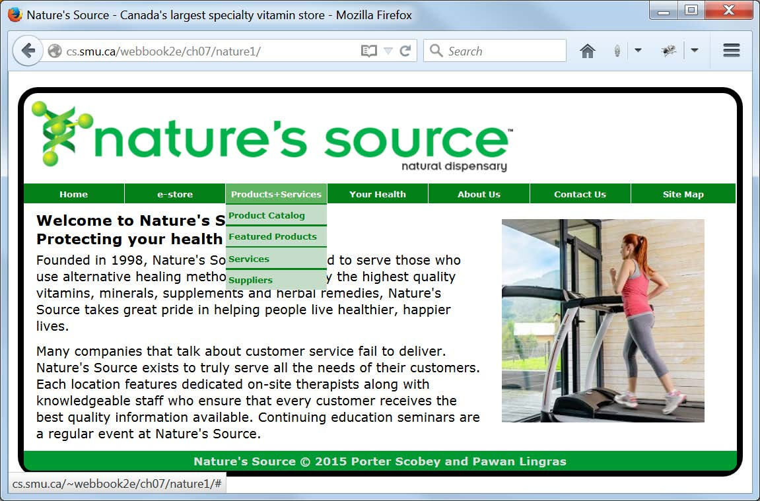
Display of Our Revised index.html Showing Rotating Images and Dropdown Menus

Slide 4
Some Comments on Our Revised index.html
The same index.html is used for both nature1 and nature2 versions of our website in this chapter.
The file includes links to two JavaScript scripts in its head element: one to rotate the images and one for the dropdown menus.
The body element has an onload event attribute whose value is a JavaScript function to start the image rotation.
The src attribute of the img element is initially empty but will be given the paths to the various images as the image rotation progresses.

Slide 5
The Relevant Parts of Our Revised index.html (after loading)
<head>
<meta charset="utf-8">
<meta name="viewport" content="width=device-width">
<base href="http://cs.smu.ca/webbook2e/ch07/nature1/">
<link rel="stylesheet" href="css/desktop.css">
<link rel="stylesheet" href="css/tablet.css"
media="screen and (max-width: 900px)">
<script src="scripts/rotate.js"></script>
<script src="scripts/menus.js"></script>
<title>Nature's Source - Canada's largest ... store</title>
</head>
...
<body onload="startRotation()">
...
<div id="image">
<img id="placeholder" src=""
alt="Healthy Lifestyle"
width="256" height="256">
</div>

Slide 6
How We Rotate the Images:
A High-Level View
First, we have two groups of images:
  A first group of indoor images, which we show if it’s a week day (Monday to Thursday)
  A second group of outdoor images, which we show if it’s a weekend day (Friday, Saturday, or Sunday)
Second, we check the day of the week and load the appropriate group of images into a JavaScript array.
Third, a visitor to our website loads our index.html page and causes our startRotation() function to be called.
Fourth, the startRotation() function sets an initial image and then arranges for the the rotate() function to be called every two seconds.
Fifth, every time the rotate() function is called, it causes the next image from the image array to be displayed, and “wraps around” to the first image at the beginning of the array upon reaching the array’s end.
Next we look at the details by studying the code in rotate.js.

Slide 7
rotate.js (1 of 2)
//rotate.js
//Handles the image rotation seen on the website's home page
//Put all of today's information into a JavaScript Date object
var today = new Date();
//Build the appropriate prefix for filenames, depending on whether
//today is a weekday (indoor images) or the weekend (outdoor images)
var prefix = "images/";
switch (today.getDay())
{
case 0:
case 5:
case 6:
prefix += "outdoor";
break;
default:
prefix += "indoor";
}
//Use that prefix to put the proper sequence of image filenames into an array
var imageArray = new Array(6);
for (i=0; i<imageArray.length; i++)
imageArray[i] = prefix + (i+1) + ".jpg";

Slide 8
rotate.js (2 of 2)
//Perform a "cicular rotation" of the images in the array
var imageCounter = 0;
function rotate()
{
var imageObject = document.getElementById('placeholder');
imageObject.src = imageArray[imageCounter];
++imageCounter;
if (imageCounter == 6) imageCounter = 0;
}
//Called as soon as home page has loaded, to start image rotation
function startRotation()
{
document.getElementById('placeholder').src=imageArray[5];
setInterval('rotate()', 2000);
}

Slide 9
Discussion of rotate.js (1 of 5)
The code in the first part of the script is run as soon as the script is loaded.
The two functions, however, are just defined when the script is loaded, and not run till later.
The first thing we do is create a JavaScript Date object representing today’s date:
var today = new Date();
We need this so we can decide what images we should rotate.

Slide 10
The JavaScript Date Object
Method | Return value
Date() | A Date object containing today’s date and time
getDate() | day of the month (1-31)
getDay() | day of the week (0-6) (0 is Sunday) [the one we need in rotate.js]
getFullYear() | year (a four-digit number)
getHours() | hour (0-23)
getMilliseconds() | milliseconds (0-999)
getMinutes() | minutes (0-59)
getMonth() | month (0-11)
getSeconds() | seconds (0-59)

Slide 11
Discussion of rotate.js (2 of 5)
All images are in the images subdirectory, so we first initialize prefix to "images/".
Next we use a JavaScript switch-statement to check the return-value of the getToday() method of the today object.
If the value corresponds to a week day, we add the suffix indoor to prefix; otherwise we add the suffix outdoor.
We use the operator += to “concatenate” two strings (add a second string to a first string).

Slide 12
The JavaScript switch-statement
switch (expression)
{
case value_1:
statements;
break;
case value_2:
statements;
break;
...
case value_n:
statements;
break;
default:
statements;
break;
}
If the value of expression matches value_1, value_ 2, … the corresponding statements are executed; otherwise, the statements following default are executed.
Several “case labels” can be combined (as in rotate.js) and if expression matches any one of them, the correpsonding statements will be executed.

Slide 13
Discussion of rotate.js (3 of 5)
Next, a JavaScript array of six elements is created to hold the six (indoor or outdoor) images:
var imageArray = new Array(6);
Then a JavaScript for-loop puts the required images into this array:
for (i=0; i<imageArray.length; i++)
imageArray[i] = prefix + (i+1) + ".jpg";
Our six images are placed into imageArray in locations with indexes 0, 1, … 5.
Note that we can combine strings (prefix, ".jpg") with an integer (i+1) to get the required file name as a string.
Note as well (carefully) that the expression i+1 needs the parentheses around it because we want the addition to take place and then have the result placed into the string.
The size of the array, available from the length property of the array object as imageArray.length, determines how many times the
for-loop executes.

Slide 14
More on JavaScript Arrays
Create a new array of a given size like this:
myArray = new Array(size);
The positions where we can store something in this array have indexes 0, 1, 2, … size-1.
We access these positions for either reading or writing using myArray[i], where i is one of the index values.
We can put values of whatever kind we want into the array.
The size of the array is always available to us as myArray.length.
length is a property of the array object, and it also has several methods you may wish to investigate if you wish to manipulate an array in some way. See here for further info:
http://www.w3schools.com/jsref/jsref_obj_array.asp

Slide 15
The JavaScript for-loop
The generic form of a JavaScript for-loop looks like this:
for (initialization; condition; update)
{
statements; //loop "body"
}
initialization happens only once, before the loop begins.
Then condition is checked and if true, the loop body is executed; otherwise the loop terminates and execution continues with the first statement following the loop.
Next, update is performed and condition is checked again to see if the loop body is re-executed, or if the loop should terminate.

Slide 16
Discussion of rotate.js (4 of 5)
The startRotation() function does two things:
  For the reason we see in the next slide it chooses the last image in the array (the one with index 5) to display first:
  document.getElementById('placeholder').src=imageArray[5];
  It instructs the rotate() function to execute every 2 seconds with this call to the setInterval() function:
  setInterval('rotate()', 2000);
The setInterval() function is a built-in JavaScript function which takes two parameters:
  A string containing code to execute (usually just a function to call)
  A time interval (in milliseconds, so 2000 milliseconds is 2 seconds) indicating how often the code is to be executed

Slide 17
Discussion of rotate.js (5 of 5)
The rotate() function does two things every time it is called:
  First, it displays the next image in the sequence:
  var imageObject = document.getElementById('placeholder');
imageObject.src = imageArray[imageCounter];
  Second, it increments the image counter, then checks to see if it has passed the end of the array and resets to the beginning if this is the case:
  ++imageCounter;
  if (imageCounter == 6) imageCounter = 0;
Note that imageCounter is a “global” variable (in the script. but outside any function) and is initialized to 0, so that the first time it is used (during the first call to the rotate() function), it will cause the first image in the sequence to be displayed.
By making the startRotation() function display the last image in the sequence, the calls to rotate() will begin with the first image.

Slide 18
Our Dropdown Menus:
An Overview
There are two aspects to our dropdown menus:
  How they look, a question of HTML markup and the CSS used to style that markup
  How they work, a question of JavaScript code working to make that markup and styling do the right thing at the appropriate time
Thus we need to do the following:
  Modify our menu markup, now located in common/menus.html
  Add some styles to our desktop.css (these need not be overridden when tablet.css is in effect)
  Create a new JavaScript script, which we will store in a file called menus.js in our scripts subdirectory

Slide 19
Partial Markup from nature1/common/menus.html
<!-- menus.html -->
<nav onmouseout="hide()">
<ul class="Links">
<li><a href="#" onmouseover="show('m1')">Home</a></li>
<li><a href="#" onmouseover="show('m2')">e-store</a></li>
<li>
<a href="#" onmouseover="show('m3')">Products+Services</a>
<div id="m3" onmouseover="show('m3')">
<a href="#">Product Catalog</a>
<a href="#">Featured Products</a>
<a href="#">Services</a>
<a href="#">Suppliers</a>
</div>
</li>

Slide 20
Discussion of (Partial) Markup from menus.html
First, note that we use an unordered list for the menu items, so we will use CSS to give our menu its appearance.
Second, we see two new event attributes:
  onmouseout, whose value is the function hide(), called to “hide” any dropdown menu that might be showing, as the mouse moves away from the menu
  onmouseover, whose value is the function show(), which takes a single parameter (m3, for example) indicating which dropdown menu should be shown this time
Third, notice that all links have the form href="#", which is a “dummy” link going nowhere, since this is the menu from nature1 which illustrates the dropdown menu but has no active links. The nature2 version simply replaces each # with the relevant link.
Finally, notice that the first two list items do not contain a nested div, since those menu items have no dropdown options. The third list item (shown in the previous slide) and the rest of the list items (not shown in the slide but present in the file) do have the nested div, except the last.

Slide 21
The Complete CSS for Our Menus,
Including the Dropdown Menus (1 of 4)
/**********************************************************
global settings to remove any default padding and margins */
* {
padding: 0;
margin: 0;
}
This is just a “mini-CSS reset” to get us started (lines 4–10).
Getting a menu to look just right inevitably involves some trial and error, and we don’t want any browser defaults to cause us any confusion.
Note that this is a “global reset” for padding and margin.

Slide 22
The Complete CSS for Our Menus,
Including the Dropdown Menus (2 of 4)
/* for the always-visible main menu options */
.Links li {
float: left; /*float list elements up to horizontal line*/
width: 127px;
border-right: 1px solid #FFF;
font-weight: bold;
font-size: .7em;
text-align: center;
list-style: none; /*Remove bullets*/
}
.Links li:last-child {
width: 132px;
border-right-width: 0;
}

Slide 23
The Complete CSS for Our Menus,
Including the Dropdown Menus (3 of 4)
/* for all links for all menu options */
.Links li a {
display: block;
height: 25px;
line-height: 25px;
background-color: #048018;
color: #FFF;
text-decoration: none;
}
.Links li a:hover {
background-color: #5FB361;
color: #FFF;
}

Slide 24
The Complete CSS for Our Menus,
Including the Dropdown Menus (4 of 4)
/* for the dropdown menu options */
.Links div {
position: absolute; /*Takes dropdown menus out of the "normal flow"*/
background-color: #048018;
visibility: hidden; /*Adjusted by calls to show() and hide()*/
}
.Links div a {
display: block; /*Lets us specify a width; can’t specify inline element width*/
width: 124px;
margin-top: 2px;
padding-left: 3px;
background-color: #C5DCC9;
color: #048018;
text-align: left;
}

Slide 25
Some Observations/Suggestions for the CSS of Our Dropdown Menus
Many items in the previous three slides that are marked in red involve measurements or color choices that will always involve some trial and error.
You should go to your copy of the nature1 subdirectory, comment out each of the individual styles in css/desktop.css relating to the menus (one at a time), and reload the index.html file after inserting each comment.
Be sure to understand what you see in the display with the “missing” style, and how that relates to the style you have deactivated.

Slide 26
The JavaScript Code from menus.js
//menus.js
//Handles the dropdown menus that "drop down"
//(really "appear" and "disappear") from the
//main menu on each page of the website
//Flag to indicate if a dropdown menu is visible
var isShowing = false;
//Reference to the current dropdown menu
var dropdownMenu = null;
//Show the drop-down menu with the given id, if it exists, and set flag
function show(id)
{
hide(); /* First hide any previously showing dropdown menu */
dropdownMenu = document.getElementById(id);
if (dropdownMenu != null)
{
dropdownMenu.style.visibility = 'visible';
isShowing = true;
}
}
//Hide the currently visible dropdown menu and set flag
function hide()
{
if (isShowing) dropdownMenu.style.visibility = 'hidden';
isShowing = false;
}

Slide 27
Discussion of menus.js
The script contains two global variables:
  isShowing, a boolean “flag” variable indicating whether a dropdown menu is showing (that is, in a “dropped-down” state)
  dropdownMenu, for holding a reference to a particular dropdown menu so that it can be manipulated
The function show() does three things:
  Calls hide() to make sure any previously dropped-down menu is hidden
  Gets a reference to the menu item passed in as the parameter, and sets its visibility property to visible
  Updates the global flag to indicate there is a menu in a dropped-down state
The function hide() simply checks the global flag to see if a dropdown menu is showing, hides it if it is, and updates the flag accordingly.

Slide 28
BMI and Feedback Form Enhancements
The remaining slides illustrate some of the enhancements we’ve made to our BMI Form
and our feedback form:
The moment the user tries to choose the BMI
email reply option a warning appears, and no email can be entered.
Empty or problematic boxes on our feedback form are highlighted in red if we try to submit, and this is accomplished with HTML5, not with JavaScript.

Slide 29
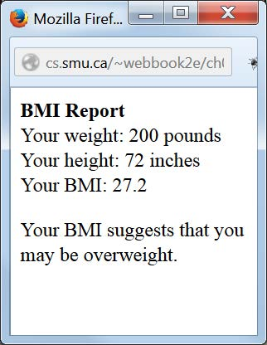
BMI Report Now a Web Page,
Not a Popup

Slide 30
Displaying a BMI Report to the User
As you know, we previously had this popup (in bmiCalculate.js):
alert(text);
Now we have a new window generated as follows (in bmiCalculate.js):
var bmiDisplay = window.open("", "",
"width=200, height=200, top=300, left=300");
bmiDisplay.document.write(textToDisplay);
The first parameter of open() is the URL to load into the window. It’s the empty string because we don’t want to load any page into our window; instead we will place our BMI report into the window.
The second parameter of open() is also the empty string, which gives us the default behavior of opening a new window for our BMI report. As an alternative you could use the value "_self" to place the BMI report in the current window.
The remaining parameters give the width, height, and the position of the top left corner of the window.

Slide 31
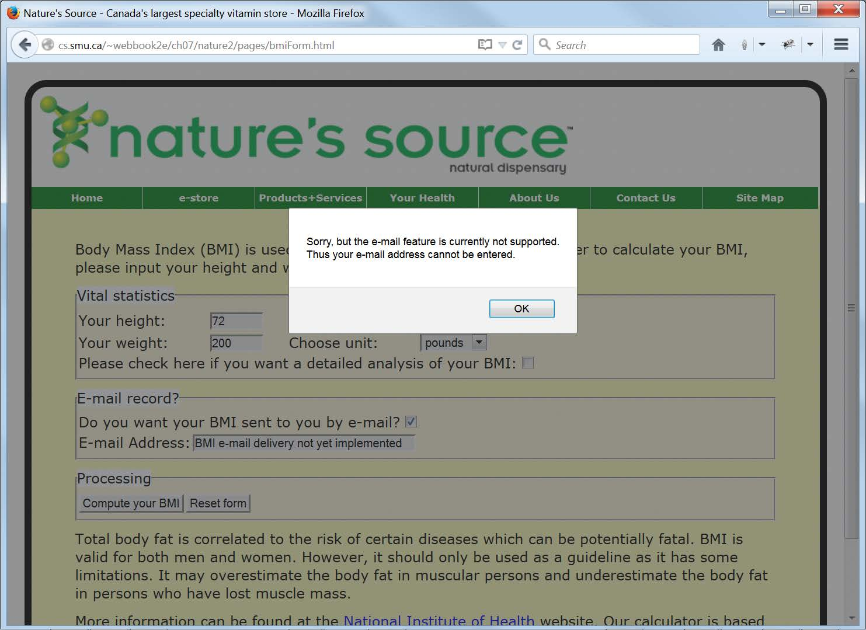
Now The User Cannot Even Enter an E-mail Address

Slide 32
E-mail Excerpt from bmiForm.html
<fieldset class="SectionBackground">
<legend class="LegendBackground">E-mail record?</legend>
<table>
<tr>
<td colspan="2"><label for="wantMail">Do you want your
BMI sent to you by e-mail?</label>
<input id="wantMail" type="checkbox"
name="wantMail" value="yes"
onchange="handleBMIEmailRequest()"></td>
</tr>
<tr>
<td><label for="email">E-mail Address:</label></td>
<td><input id="email" type="text"
name="email" size="40"
value="BMI e-mail delivery not yet implemented"
readonly></td>
</tr>
</table>
</fieldset>

Slide 33
The E-mail Request Handler from bmiFormValidate.js
function handleBMIEmailRequest()
{
var bmiFormObj = document.getElementById("bmiForm");
if (bmiFormObj.wantMail.checked)
{
alert("Sorry, but the e-mail feature is currently not supported."
+ "\nThus your e-mail address cannot be entered.");
}
bmiFormObj.wantMail.checked = false;

Slide 34
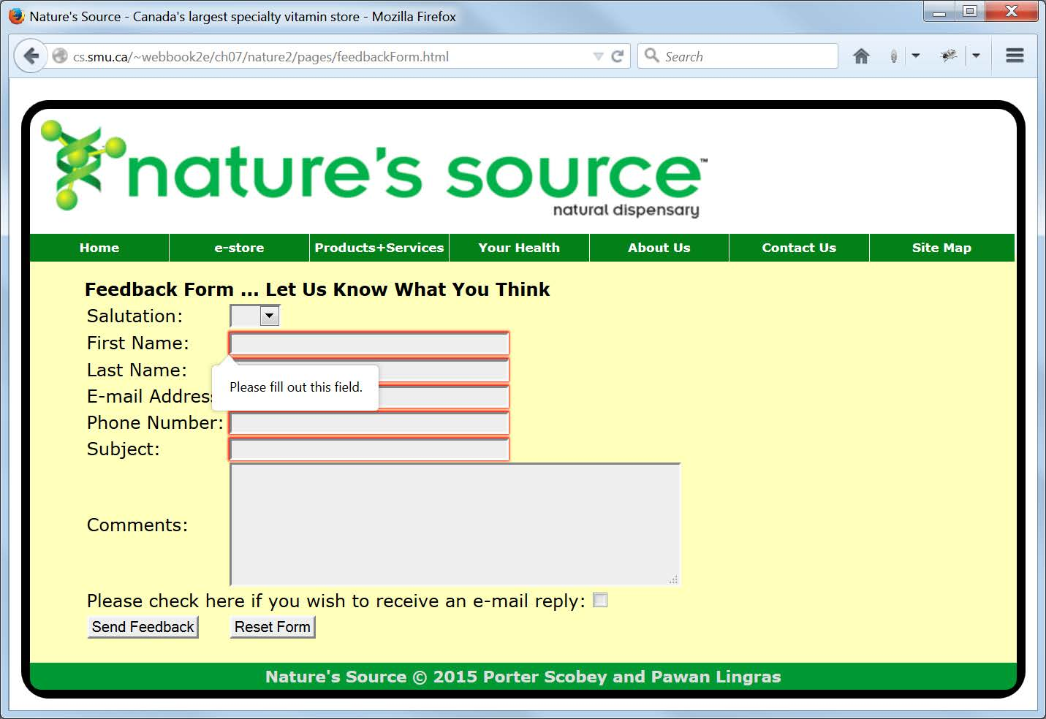
Trying to Submit an Empty Feedback Form

Slide 35
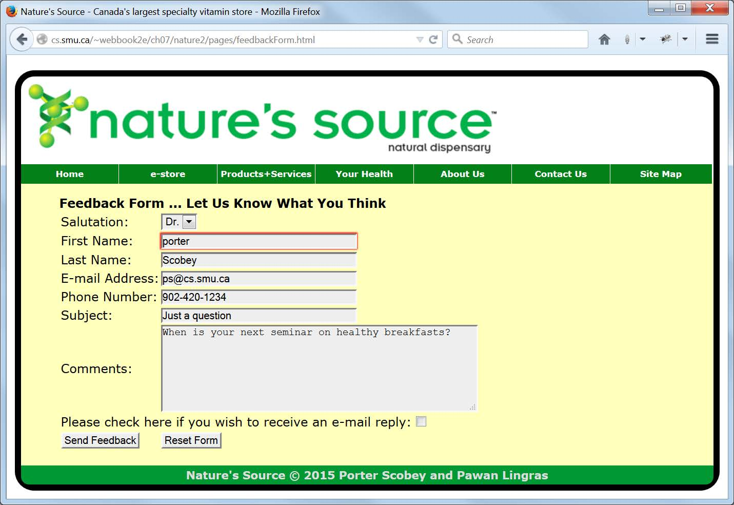
HTML5 Error Detection
Without JavaScript

Slide 36
Excerpt from feedbackForm.html
<tr>
<td>Last Name:</td>
<td>
<input type="text" name="lastName" size="40"
title="Initial capital, then lowercase and no spaces"
pattern="^[A-Z][a-z]*$" required></td>
</tr>
The title attribute pops up a reminder of what should go in the textbox.
The value of the new HTML5 pattern attribute is a regular expression describing what valid input to the textbox looks like.
The required attribute says the textbox cannot be empty.

