Slide 1
JavaScript for Client-Side
Computation and Form Data Validation
Chapter 6

Slide 2
Overview and Objectives
Discuss the importance of keeping web page content behavior separate from content structure and content presentation, both conceptually and physically.
Present an overview of JavaScript as a programming language, including a brief history, its limitations, and how we will use it.
Show how to write to a web page for user notification via JavaScript.
Distinguish between external and embedded JavaScript code.
Discuss the Document Object Model (DOM) and JavaScript access to it.
Discuss JavaScript data types and variables, functions (both built-in and programmer-defined), expressions, control statements, arrays, and built-in objects.
Discuss the importance of website security and how JavaScript can help to achieve it.
Introduce regular expressions and their use in JavaScript.
Update our BMI calculator form and our feedback form to incorporate validation of user input.

Slide 3
Directory Structure Used in This Book
(typically for each nature? subdirectory)
Subdirectories with names like nature, or nature1 and nature2, for the version or versions of our website.
An index.html file in each of these nature? subdirectories.
A subdirectory called pages containing other HTML files for other pages on the current version of our website.
A subdirectory called images containing any image files required by our HTML files.
A subdirectory called css containing any Cascading Style Sheet files that describe presentation details for those HTML files.
  This may be a single file called default.css or if the current version of our website has a responsive design, one file called desktop.css and a second called tablet.css.
And now, a subdirectory called scripts containing any scripts (programs) used by those HTML files. For the moment these will be JavaScript scripts, but later there will also be PHP scripts.
If you are using SSI to hold “common” markup files, then you would also want to use a common subdirectory.

Slide 4
Another Important Distinction: Structure vs. Presentation vs. Behavior
Earlier we saw a distinction between structure vs. presentation of a web page.
Now we will make our web pages interactive using JavaScript.
This introduces a new aspect of web pages: web page behavior.
Although we can place JavaScript code directly on our HTML markup pages, the best practice is (once again) to separate behavior from presentation and content by keeping JavaScript
code in a separate file.
If we follow this best practice, we will achieve separation between these three things:
  the content of each HTML page and its structure
  the CSS file that determines page layout and presentation style
  the JavaScript code that determines page behavior

Slide 5
What is JavaScript? (It's not Java!)
In the mid-1990s Netscape began development of a language called LiveScript for adding lively animations to web pages.
Brendan Eich is credited with much of the early work during his famous “ten days in May” of 1995.
Sun Microsystems' Java programming language was fast gaining importance on the Internet due to these factors:
  its portability across different computing platforms
  its ability to provide users with interactivity on web pages via Java applets
Netscape and Sun agreed to change the name LiveScript to JavaScript.
Other than similarity in name, there is no obvious relationship between Java and JavaScript.
Both languages share similar programming constructs, but those can be traced back to the popular C programming language.

Slide 6
JavaScript History
Date | Version | Notes
May, 1995 | Livescript | Brenda Eich, working at Netscape, writes the first version of what was first called Mocha, then Livescript, during the famous “10 days in May”.
September, 1995 | JavaScript | The language name was changed after an agreement with Sun Microsystems, to capitalize on the then current popularity of Java.
1996–1997 | JavaScript (ECMA-262) | ECMA (European Computer Manufacturers Association) takes over the standardization process and produces the first standard; so JavaScript becomes one of several implementations of the ECMAScript language standard.
1998 | JavaScript 2 | ECMAScript 2
1999 | JavaScript 3 | ECMAScript 3
2000–2004 |  | Microsoft went their own way, and development stalled.
2005 |  | Jesse James Garrett recognizes and points out to the rest of us that a JavaScript-based technique which he called AJAX could be used to make web-based applications behave much more like desktop applications, giving rise to a JavaScript renaissance.
December, 2009 | JavaScript 5 | ECMAScript 5 (version 4 never completed)
June, 2015 | JavaScript 6 | ECMAScript 6

Slide 7
JavaScript is Interpreted, Not Compiled
Programs in high-level languages need to be translated into machine language prior to execution.
There are two types of translators:
  Compilers translate an entire program into an executable machine language version that can be executed many times, after this one-time translation.
  Interpreters translate a program one statement at a time to its machine language equivalent, just prior to the execution of that statement, and do this every time the program is run.
Interpreted languages are simpler and more portable to different hardware and software platforms.
The translation overhead of interpreted languages makes them generally less efficient than compiled languages.

Slide 8
Just a Few JavaScript Language Facts
(especially relevant for those coming from Java or C++)
JavaScript is case-sensitive and has both // and /*..*/ comments.
JavaScript is another “curly bracket language” so if, if..else, switch, while, do..while and for behave as you might expect.
JavaScript has all the “usual” arithmetic, relational, logical and conditional operators:
+, -, *, /, %, <, <=, >, >=, ==, !=, &&, ||, !, ? :
JavaScript arrays and strings start at index 0.

Slide 9
But … a Few JavaScript Language Gotchas
(especially relevant for those coming from Java or C++)
JavaScript has dynamic typing, so a variable takes on the type of any value assigned to it.
Variables must be declared with a preceding var keyword if you want them to be local to a function.
JavaScript has Number, String and Boolean as basic types.
Number has only double-precision floating point values, so (for example) JavaScript does not have “integer division”.
JavaScript strings can use double or single quotes.
=== and !== are preferred over == and != because they check both value and type.

Slide 10
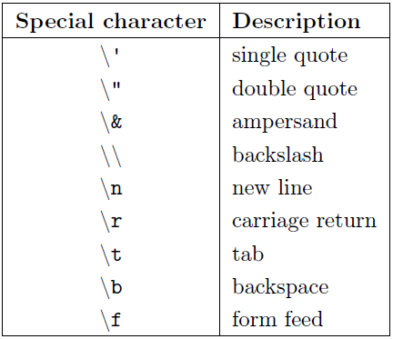
List of Special Characters Available for Use in JavaScript Strings

Slide 11
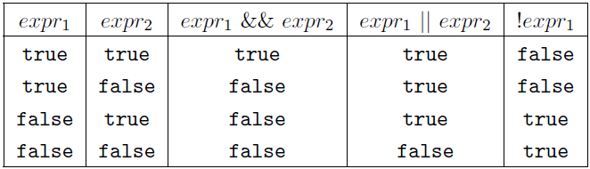
Logical Operators in JavaScript

Slide 12
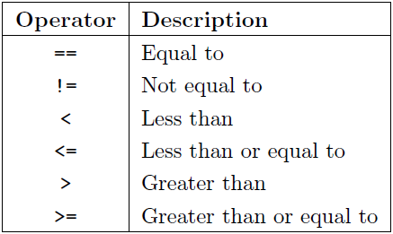
Comparison Operators in JavaScript

Slide 13
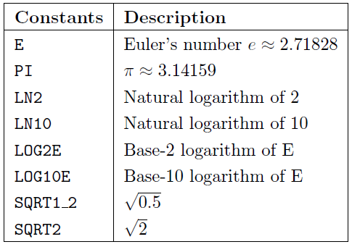
Some Constants from the
JavaScript Math object

Slide 14
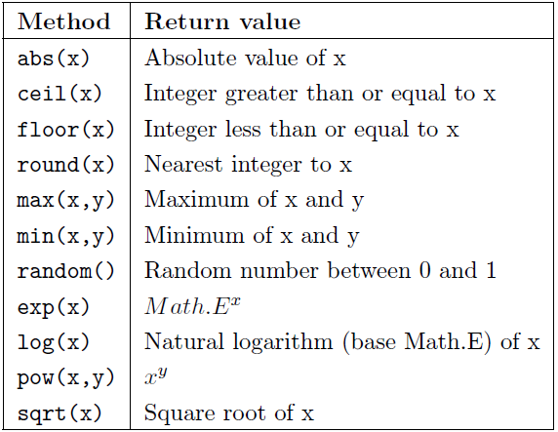
Some Methods of the
JavaScript Math object

Slide 15
JavaScript and Client-Side Computing
JavaScript can be used on both the client side (more common) and the server side (less common, but becoming more common with the appearance of libraries like Node.js).
Common server-side languages:
  PHP and Python (open-source)
  CGI programming using Perl (open-source)
  Java Server Pages™(JSP) technology (open-source)
  Active Server Pages (ASP) (proprietary)

Slide 16
Typical Uses of JavaScript
Computations based on user input (this chapter)
Validation of data entered by the user, before that data is sent to the server for processing (this chapter)
Dynamically adding HTML elements to a web page, or changing HTML elements already on a web page (next chapter)
Changing the look and feel of a web page as the user’s mouse pointer interacts with the web page (next chapter)

Slide 17
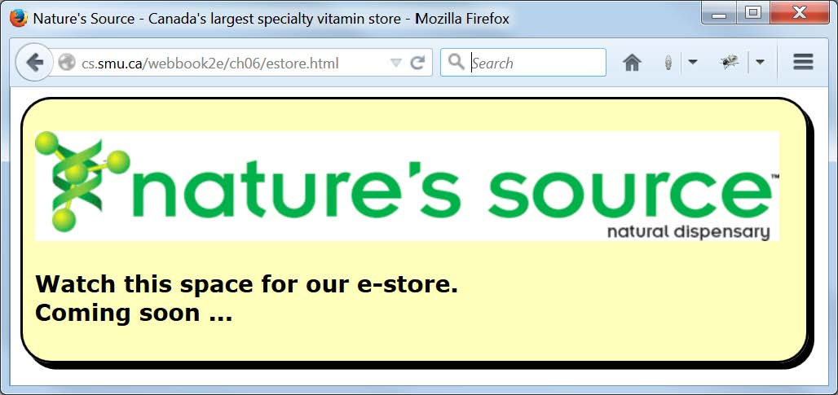
Browser Display of estore.html (and also estoreEmbedded.htm and estoreExternal.html)

Slide 18
estoreEmbedded.html Contains a Simple Embedded JavaScript Script with Two Output Statements
<!DOCTYPE html>
<!-- estoreEmbedded.html -->
<html lang="en">
<head>
<meta charset="utf-8">
<link rel="stylesheet" href="css/default.css">
<title>Nature's Source - Canada's largest specialty
vitamin store</title>
</head>
<body>
<main class="Narrow">
<p><img src="images/naturelogo.gif" alt="Nature's Source"></p>
<h3>
<script>
document.write("Watch this space for our e-store.<br>");
document.write("Coming soon ...");
</script>
</h3>
</main>
</body>
</html>

Slide 19
Some Notes on the Previous Slide
JavaScript code embedded in HTML markup must appear as the content of a script element.
Since JavaScript is the default scripting language, the script element no longer needs the type attribute type="text/javascript″ to indicate the language used in the script, but you will often see it.
The content of the script element is a sequence of JavaScript programming language statements to be executed when the browser reaches the script element during its processing of the page (two such statements in this case).
Each JavaScript statement is terminated by a semicolon (;).
In a JavaScript script, document refers to the HTML document containing the script, that is, to the top-level element in the DOM (Document Object Model).
write() is a method (or function) “belonging to” document that can be used to write text information into the document for display. That information is the string (text enclosed in quotes) within the parentheses of write().
In JavaScript you will see and use many statements that “look like” this and have the generic form object.method(list_of_input_parameters).
Note the parallels between a script element containing JavaScript code and a style element containing CSS.

Slide 20
The h3 Elementof estoreExternal.html Containing the Script Element that Provides Access to the JavaScript Code
Stored in the External File estoreExternal.js
<!-- estoreExternal.html -->
...
<body>
<main class="Narrow">
<p><img src="images/naturelogo.gif" alt="Nature's Source"></p>
<h3>
<script src="scripts/estoreExternal.js"></script>&nbsp;
<!-- Without something other than whitespace and the script
element in the content of the h3 element, the HTML 5 validator
issues an "empty heading" warning. -->
</h3>
</main>
</body>

Slide 21
And here is the file estoreExternal.js
//estoreExternal.js
document.write("Watch this space for our e-store.<br>");
document.write("Coming soon ...");
Note that there are no script tags is this file.
And remember to contrast this with the analogous situation in PHP when we get there.

Slide 22
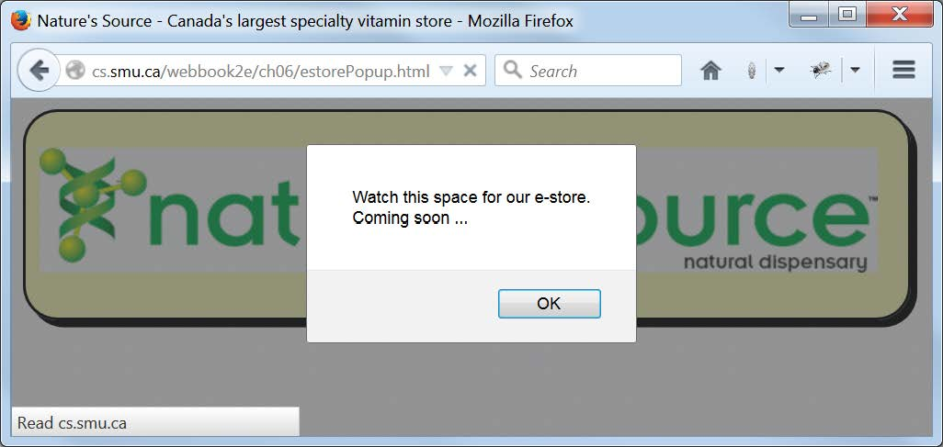
The Initial Firefox Browser Display of estorePopup.html

Slide 23
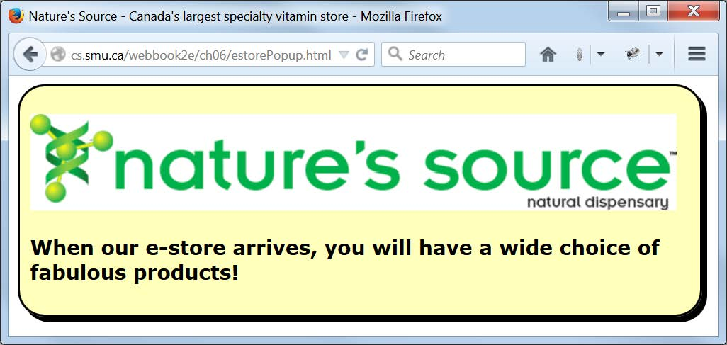
The Final Firefox Browser Display of estorePopup.html

Slide 24
The Body of estorePopup.html, Showing the Script Element that Provides Access to the JavaScript Code
Stored in the External File estorePopup.js
<p><img src="images/naturelogo.gif" alt="Nature's Source"></p>
<h3>
<script src="scripts/estorePopup.js"></script>&nbsp;
<!-- Without something other than whitespace and the script
element in the content of the h3 element, the HTML 5 validator
issues an "empty heading" warning. -->
</h3>
//estorePopup.js
alert("Watch this space for our e-store.\n" + "Coming soon ...");
document.write("When our e-store arrives, you will have a wide "
+ "choice of fabulous products!");

Slide 25
The Document Object Model
(continued from Chapter 4 Intro Discussion
The Document Object Model (DOM) is a W3C-defined standard Application Programming Interface (API) that programming languages like JavaScript can use to gain access to, and modify, parts of a web page.
The DOM views every web page (document) as a hierarchical structure (model) of its elements (objects), determined by the nesting of those elements.
The html element object is at the top, the head and body element objects are at the next level, and so on.
When we use document.write() in a JavaScript script, we are using the write() method of the document property of the window object in the DOM for our web page.
On an upcoming slide we give a list of some common DOM objects, more of which we will see in the next chapter.
In the meantime, you should Google “document object model images” and look at some of the many examples shown.

Slide 26
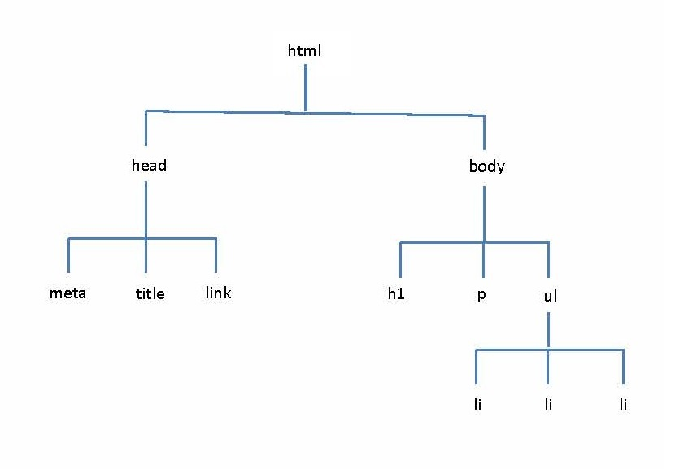
DOM View of a Simple Web Page

Slide 27
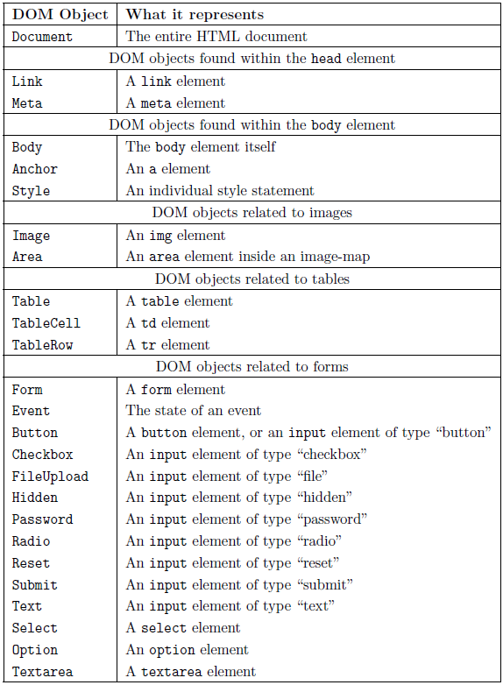

Slide 28
How JavaScript (typically) Gets Access to DOM Elements
Here we illustrate one way (the preferred way) that JavaScript gets access to a particular page element and does something with it.
Sample markup:
<p id=″par″>A paragraph.</p>
Sample JavaScript
var thePar =
document.getElementByID(″par″);
thePar.innerHTML =″Hello World!″;

Slide 29
Form Element from bmiForm.html Processed by
JavaScript Function bmiFormProcess() (1 of 2)
<form id="bmiForm" onsubmit="bmiFormProcess()">
<fieldset class="SectionBackground">
<legend class="LegendBackground">Vital statistics</legend>
<table>
<tr>
<td><label for="height">Your height:</label></td>
<td><input id="height" type="text" name="height" size="7"></td>
<td><label for="heightUnit">Choose unit:</label></td>
<td><select id="heightUnit" name="heightUnit">
<option>inches</option>
<option>centimeters</option>
</select></td>
</tr>
<tr>
<td><label for="weight">Your weight:</label></td>
<td><input id="weight" type="text" name="weight" size="7"></td>
<td><label for="weightUnit">Choose unit:</label></td>
<td><select id="weightUnit" name="weightUnit">
<option>pounds</option>
<option>kilograms</option>
</select></td>
</tr>
<tr>
<td colspan="4"><label for="details">Please check here if you
want a detailed analysis of your BMI:</label>
<input id="details" type="checkbox"
name="details" value="yes"></td>
</tr>
</table>
</fieldset>

Slide 30
Form Element from bmiForm.html Processed by
JavaScript Function bmiFormProcess() (2 of 2)
<fieldset class="SectionBackground">
<legend class="LegendBackground">E-mail record?</legend>
<table>
<tr>
<td colspan="2"><label for="wantMail">Do you want your BMI sent
to you by e-mail?</label> <input id="wantMail" type="checkbox"
name="wantMail" value="yes"></td>
</tr>
<tr>
<td><label for="email">E-mail Address:</label></td>
<td><input id="email" type="text" name="email" size="40"></td>
</tr>
</table>
</fieldset>
<fieldset class="SectionBackground">
<legend class="LegendBackground">Processing</legend>
<table>
<tr>
<td><input type="submit" value="Compute your BMI"></td>
<td><input type="reset" value="Reset form"></td>
</tr>
</table>
</fieldset>
</form>

Slide 31
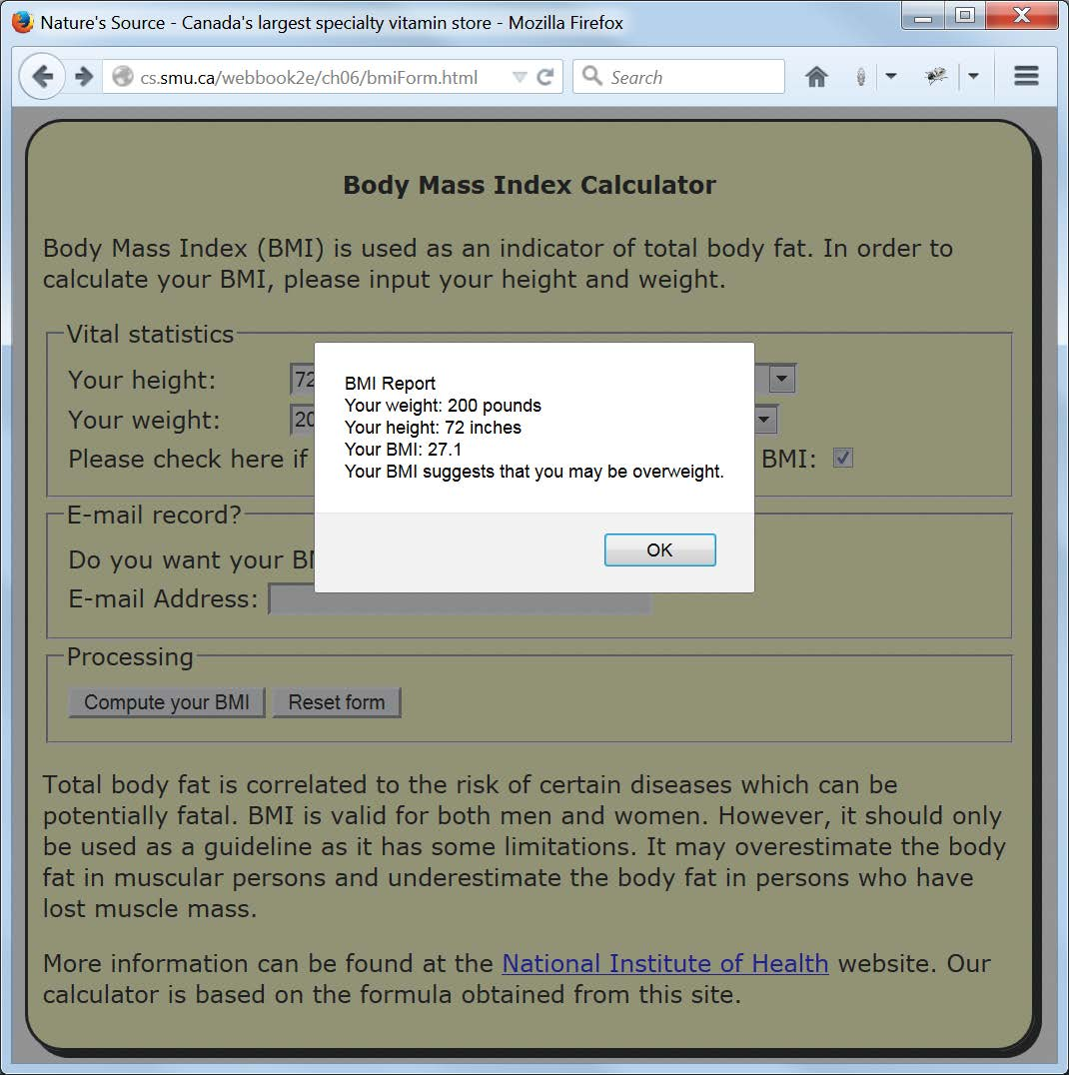
A Typical Detailed BMI Report

Slide 32
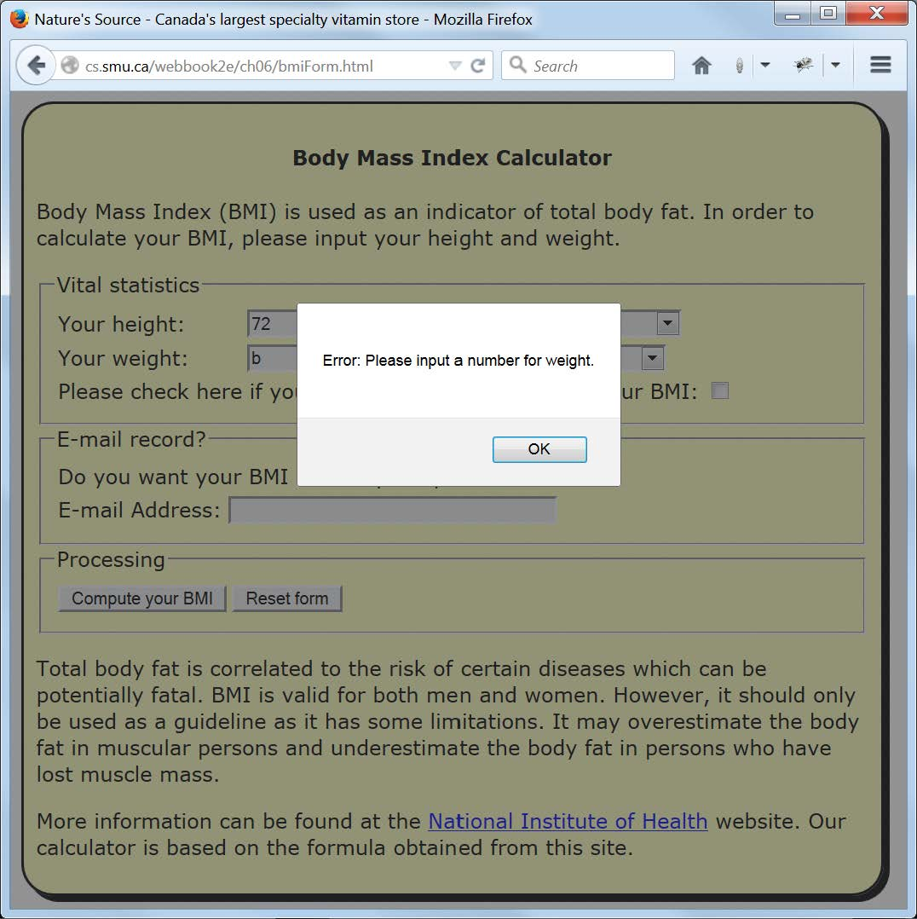
A Typical BMI Form Error Report

Slide 33
The JavaScript function bmiFormProcess() from bmiFormProcess.js
function bmiFormProcess()
{
var bmiFormObj = document.getElementById("bmiForm");
if (bmiFormValidate(bmiFormObj))
{
var bmi = valueOfBMI(bmiFormObj);
if (bmiFormObj.details.checked)
displayDetails(bmiFormObj, bmi);
else
alert("Your BMI: " + valueTo1DecimalPlace(bmi));
}
}

Slide 34
The bmiFormValidateInput() Function from bmiFormValidate.js
(called by processBMIform(), and calls the four functions shown next)
function bmiFormValidate(bmiFormObj)
{
var hUnit = bmiFormObj.heightUnit.
options[bmiFormObj.heightUnit.selectedIndex].text;
var wUnit = bmiFormObj.weightUnit.
options[bmiFormObj.weightUnit.selectedIndex].text;
var height = bmiFormObj.height.value;
var weight = bmiFormObj.weight.value;
var email = bmiFormObj.email.value;
var heightOK, weightOK, emailOK;
if (hUnit == "inches")
heightOK = inchesValid(height);
else
heightOK = centimetresValid(height);
if (wUnit == "pounds")
weightOK = poundsValid(weight);
else
weightOK = kilogramsValid(weight);
if (bmiFormObj.wantMail.checked)
{
emailOK = emailValid(email);
alert("Warning: The e-mail feature is currently not supported.")
}
else
emailOK = true;
return heightOK && weightOK && emailOK;
}

Slide 35
Height Validating Function - Inches
function inchesValid(height)
{
if (height == "" || isNaN(height))
{
alert("Error: Please input a number for height.");
return false;
}
if (height < 0 || height > 100)
{
alert("Error: Height must be in the range 0-100 inches.");
return false;
}
return true;
}

Slide 36
Height Validating Function - Centimeters
function centimetresValid(height)
{
if (height == "" || isNaN(height))
{
alert("Error: Please input a number for height.");
return false;
}
if (height < 0 || height > 300)
{
alert("Error: Height must be in the range 0-300 centimeters.");
return false;
}
return true;
}
Note the different spellings outlined in red: the first is the “international” spelling, the second is
the American spelling. A “best practice” to remember is that the messages your users see should conform to their expectations, in spelling as well as in many other respects, the code not so much.

Slide 37
Weight Validating Function - Pounds
function poundsValid(weight)
{
if (weight == "" || isNaN(weight))
{
alert("Error: Please input a number for weight.");
return false;
}
if (weight < 0 || weight > 1000)
{
alert("Error: Weight must be in the range 0-1000 pounds.");
return false;
}
return true;
}

Slide 38
Weight Validating Function - Kilograms
function kilogramsValid(weight)
{
if (weight == "" || isNaN(weight))
{
alert("Error: Please input a number for weight.");
return false;
}
if (weight <= 0 || weight > 500)
{
alert("Error: Weight must be in the range 0-500 kilograms.");
return false;
}
return true;
}

Slide 39
E-mail Validating Function
Using a Simple Regular Expression
function emailValid(address)
{
var p = address.search(/.+@.+/);
if (p == 0)
return true;
else
{
alert("Error: Invalid e-mail address.");
return false;
}
}
Note: Regular expressions will be examined in more detail later. This one simply says, “Look for at least one character followed by @ followed by at least one more character.” So … not a very “robust” check for a valid e-mail!

Slide 40
JavaScript Code Illustrating Numeric Calculations
function valueOfBMI(bmiFormObj)
{
var hUnit = bmiFormObj.heightUnit.
options[bmiFormObj.heightUnit.selectedIndex].text;
var wUnit = bmiFormObj.weightUnit.
options[bmiFormObj.weightUnit.selectedIndex].text;
var height = bmiFormObj.height.value;
var weight = bmiFormObj.weight.value;
if (hUnit == "inches") height = inchesToCentimetres(height);
if (wUnit == "pounds") weight = poundsToKilograms(weight);
height /= 100.0; //Convert height from centimeters to meters
var bmi = weight/(height*height); //kilograms/(meters*meters)
return bmi;
}

Slide 41
More JavaScript Code
Illustrating Numeric Calculations
function inchesToCentimetres(height)
{
var CENTIMETRES_PER_INCH = 2.54;
return height * CENTIMETRES_PER_INCH;
}
function poundsToKilograms(weight)
{
var POUNDS_PER_KILOGRAM = 2.20462;
return weight / POUNDS_PER_KILOGRAM;
}

Slide 42
JavaScript Code Illustrating the Building of a String Object for Output
function displayDetails(bmiFormObj, bmi)
{
var hUnit = bmiFormObj.heightUnit.
options[bmiFormObj.heightUnit.selectedIndex].text;
var wUnit = bmiFormObj.weightUnit.
options[bmiFormObj.weightUnit.selectedIndex].text;
var height = bmiFormObj.height.value;
var weight = bmiFormObj.weight.value;
var text = "BMI Report\n" +
"Your weight: " + weight + " " + wUnit + "\n" +
"Your height: " + height + " " + hUnit + "\n" +
"Your BMI: " + valueTo1DecimalPlace(bmi) + "\n";
if (bmi < 18.5)
text += "Your BMI suggests that you are underweight.\n";
else if (bmi < 25)
text += "Your BMI suggests that you have a reasonable weight.\n";
else if (bmi < 29)
text += "Your BMI suggests that you may be overweight.\n";
else
text += "Your BMI suggests that you may be obese.\n";
alert(text);
}

Slide 43
Supplementary JavaScript Code Illustrating the Building of a String Object for Output
function valueTo1DecimalPlace(num)
{
var intPortion = Math.floor(num);
var decimalPortion = Math.round(num*10)%10;
var text = intPortion + "." + decimalPortion;
return text;
}
This function shows a technique you may find useful here and there, but you should also look up the following JavaScript function and note how it could be used in this situation:
Number.toFixed()

Slide 44
Part of the Form from feedbackForm.html Showing Access to an External JavaScript File and a Form onsubmit Value Which is a Call to a Function Defined in that File
<html lang="en">
<head>
<meta charset="utf-8">
<link rel="stylesheet" href="css/default.css">
<script src="scripts/feedbackFormValidate.js"></script>
<title>Nature's Source - Canada's largest ... store</title>
</head>
<body>
<main class="Feedback">
<h4>Feedback Form ... Let Us Know What You Think</h4>
<form id="contactForm" onsubmit="feedbackFormValidate()">

Slide 45
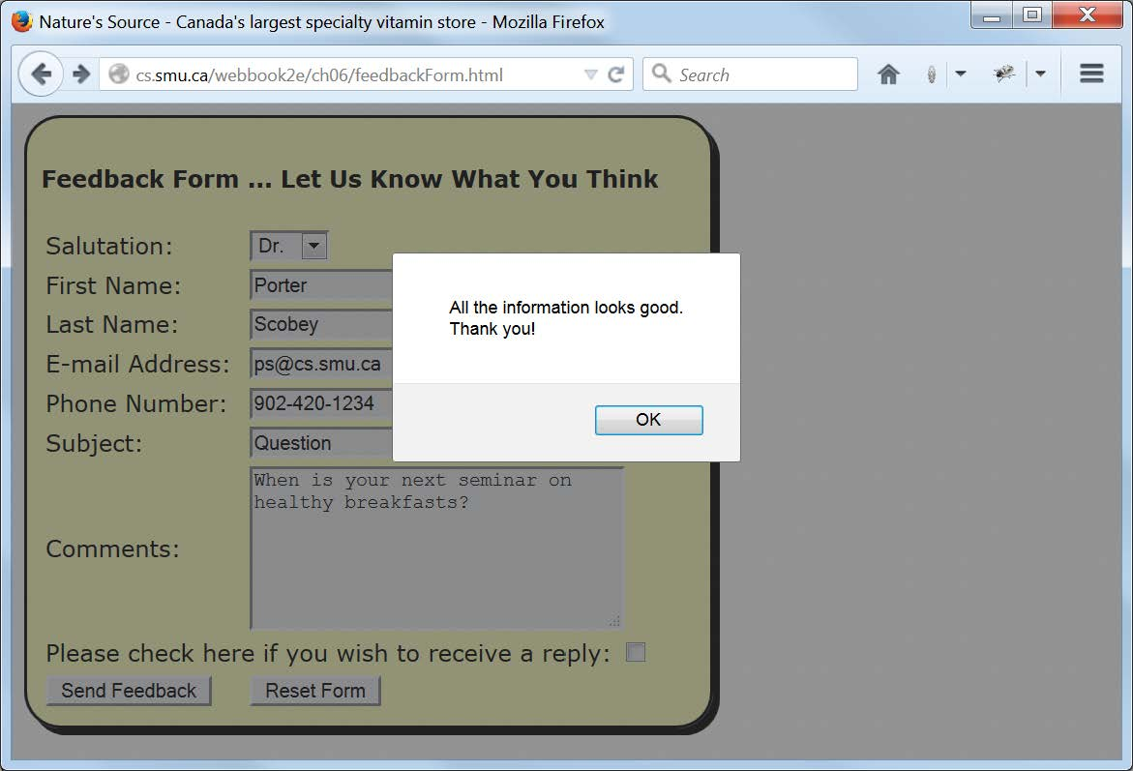
A Typical Succesful Feedback Form Report

Slide 46
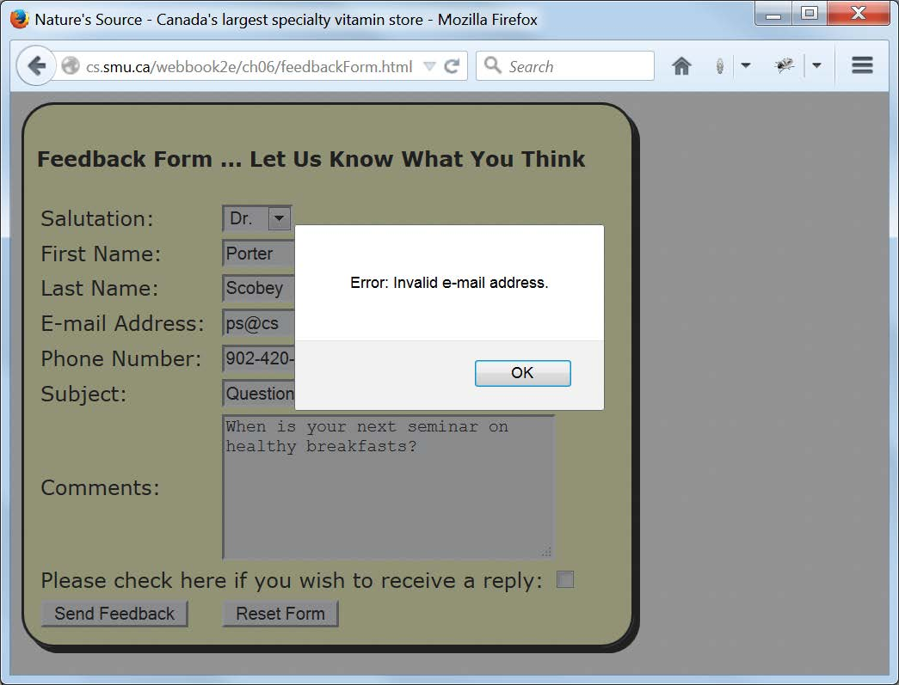
A Typical Feedback Form Error Report

Slide 47
The High-level feedbackFormValidate() Function from feedbackFormValidate.js that Calls Several Other Functions to Validate the Individual Pieces of Data (1 of 2)
function feedbackFormValidate()
{
var contactFormObj = document.getElementById("contactForm");
var firstName = contactFormObj.firstName.value;
var lastName = contactFormObj.lastName.value;
var phone = contactFormObj.phone.value;
var email = contactFormObj.email.value;
var everythingOK = true;
if (!validateName(firstName))
{
alert("Error: Invalid first name.");
everythingOK = false;
}
if (!validateName(lastName))
{
alert("Error: Invalid last name.");
everythingOK = false;
}

Slide 48
The High-level feedbackFormValidate() Function from feedbackFormValidate.js that Calls Several Other Functions to Validate the Individual Pieces of Data (2 of 2)
if (!validatePhone(phone))
{
alert("Error: Invalid phone number.");
everythingOK = false;
}
if (!validateEmail(email))
{
alert("Error: Invalid e-mail address.");
everythingOK = false;
}
if (everythingOK)
{
if (contactFormObj.reply.checked)
alert("Warning: The e-mail feature is currently not supported.")
alert("All the information looks good.\nThank you!");
return true;
}
else
return false;
}

Slide 49
The Lower-level Functions from feedbackFormValidate.js that Validate Names, Phone Numbers and e-mail Addresses via JavaScript Regular Expressions
function validateName(name)
{
var p = name.search(/^[-'\w\s]+$/);
if (p == 0)
return true;
else
return false;
}
function validatePhone(phone)
{
var p1 = phone.search(/^\d{3}[-\s]{0,1}\d{3}[-\s]{0,1}\d{4}$/);
var p2 = phone.search(/^\d{3}[-\s]{0,1}\d{4}$/);
if (p1 == 0 || p2 == 0)
return true;
else
return false;
}
function validateEmail(address)
{
var p = address.search(/^\w+([\.-]?\w+)*@\w+([\.-]?\w+)*(\.\w{2,3})$/);
if (p == 0)
return true;
else
return false;
}

Slide 50
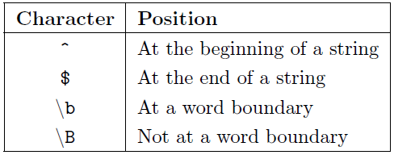
Characters Denoting Positions in JavaScript Regular Expressions

Slide 51
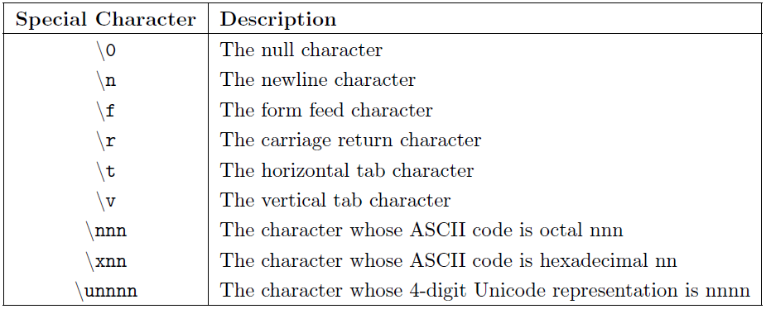
Special Characters that Can Be Used in JavaScript Regular Expressions

Slide 52
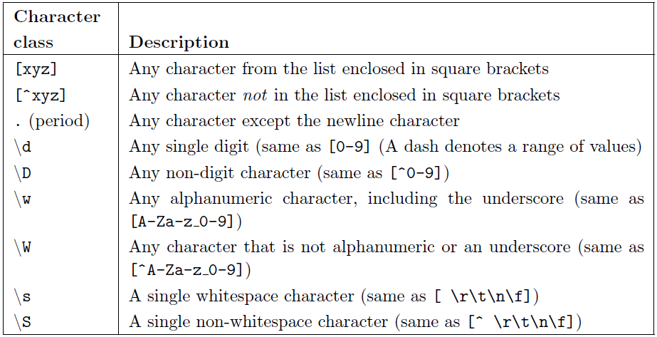
Character Classes that Can Be Used in JavaScript Regular Expressions

Slide 53
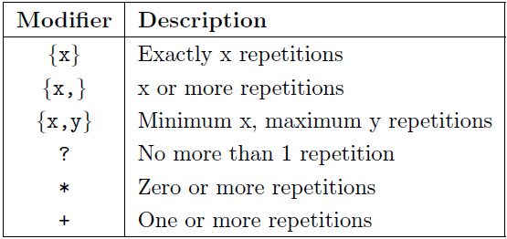
Modifiers that Can Be Placed after a Pattern within a JavaScript Regular Expression to Indicate the Permissible Amount of Repetition of that Pattern

Slide 54
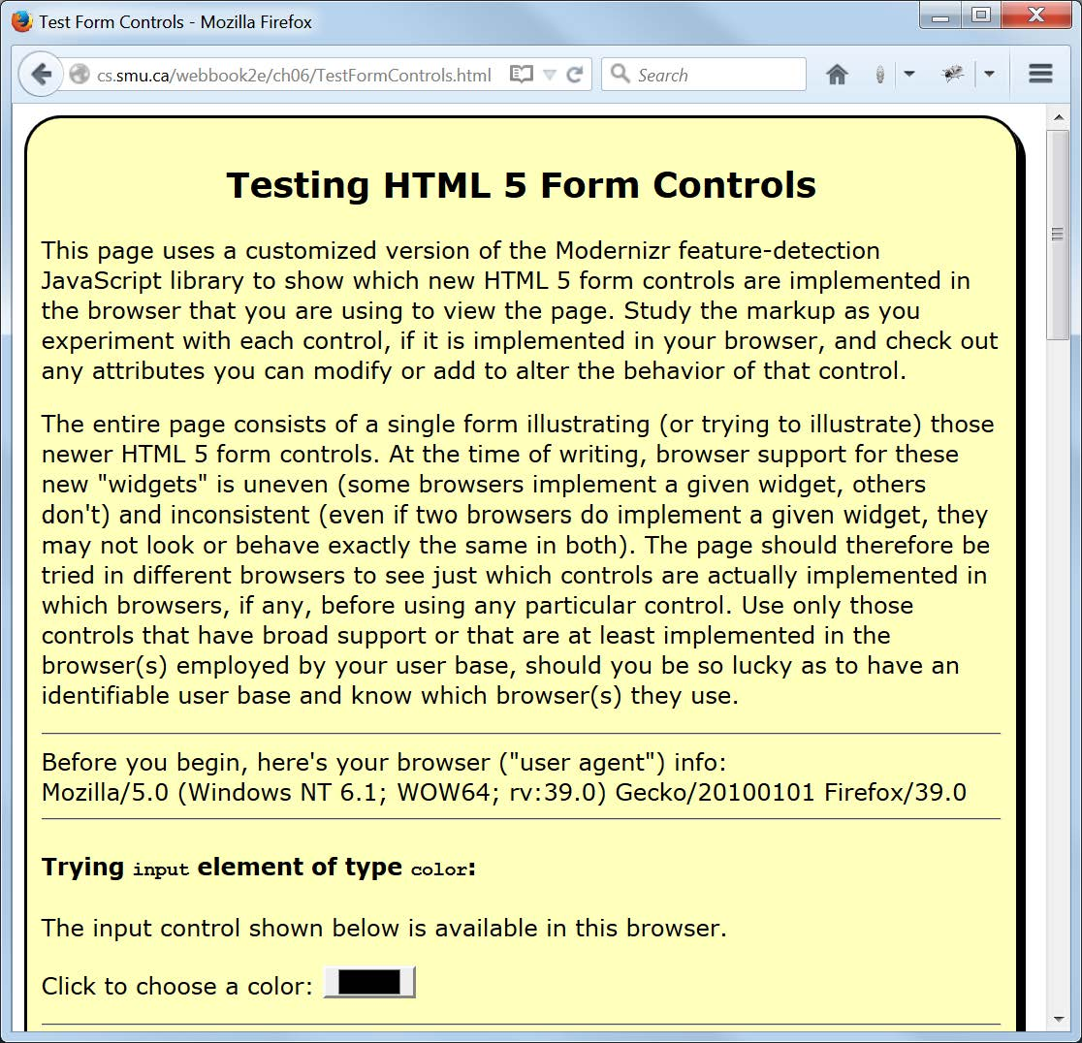
What Form Controls Does Your Browser Support? (Part 1)

Slide 55
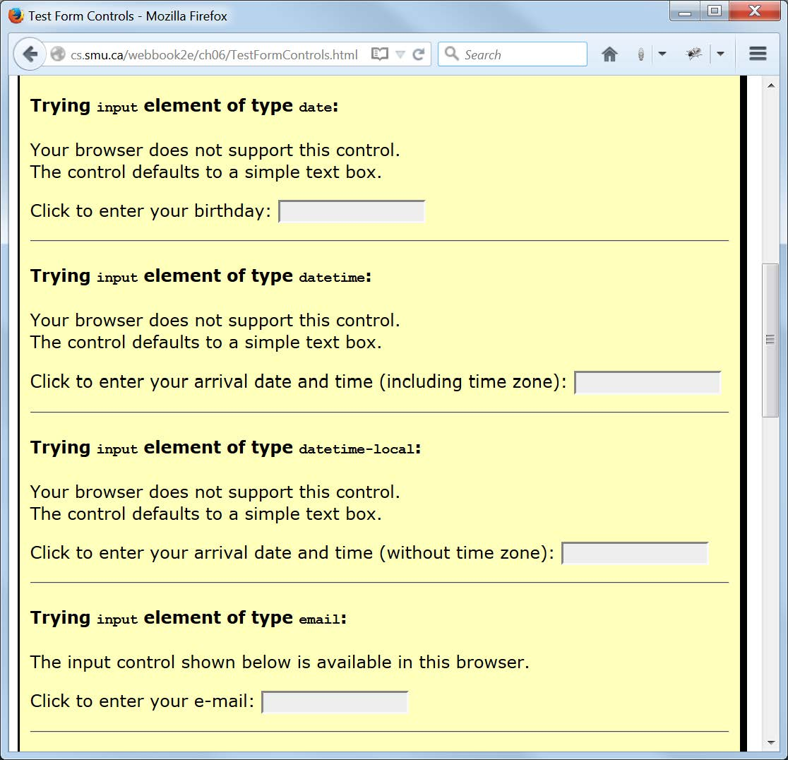
What Form Controls Does Your Browser Support? (Part 2)

