Slide 1
HTML for Content Structure
Chapter 3

Slide 2
Overview and Objectives
Discuss briefly the history of HTML and how we got to HTML5
Stress the importance of maintaining both a conceptual and a physical separation between the structure and presentation of a web page
Discuss HTML tags and elements
Discuss the basic structure of every web page
Discuss the HTML5 DOCTYPE declaration and web page validation
Discuss and illustrate all of the usual basic HTML markup, including headings, paragraphs, line breaks, lists, tables, images, comments, attributes and entities
Discuss multipage websites and the links used to connect them
Discuss the use of Server-Side Includes (SSI) which allow common markup used in many pages to be kept in one location

Slide 3
What is HTML?
A markup language, not a programming language
Uses markers called “tags” to designate the structural elements of a web page, such as:
  headings
  paragraphs
  lists
Derives from SGML (Standard Generalized Markup Language)

Slide 4
Summary of HTML Versions
HTML (1990) Tim Berners-Lee
HTML 2 (1992)
HTML 3.2 (1996)
HTML 4 (1997) and HTML 4.01 (1999)
XHTML 1.0 (2000) and XHTML 1.1 (2001)
XHTML 2.0 (work discontinued by 2010)
HTML5 (Fall, 2014)

Slide 5
HTML for Structure Only
Right up front we need to make these high-level distinctions:
HTML’s job is to describe the structure of a web page
Web page presentation is the job of Cascading Style Sheets (CSS)
Web page behavior is the job of JavaScript

Slide 6
A Typical HTML Tag and Element
Here is an HTML paragraph element:
<p>This is a paragraph.</p>
<p> is the opening tag of the element.
</p> is the closing tag of the element.
This is a paragraph. is the content of the element.
Sometimes we refer to the “tag pair” <p>…</p>.
Sometimes we refer to the “p tag” or simply a “p element”.

Slide 7
Browser Display of HTML Elements
Every browser will have its own default way of displaying any HTML element.
For a paragraph this might include space before and after the text, and the text font.
Browsers also have certain “default behaviors”:
  Reducing multiple spaces between words to a single space and removing leading and trailing spaces from element content
  Wrapping lines as the browser window changes size

Slide 8
Basic Structure of Every Web Page
<html>
<head>
<title>My Title</title>
</head>
<body>
<!--An HTML comment showing where
page content to display will go.-->
</body>
</html>

Slide 9
Some Basic Markup Tags
h1, h2, h3, h4, h5, h6 for headings
p for paragraphs
ul for unordered lists (• marker by default)
ol for ordered lists (numbered 1, 2, 3 … by default)
li for list items in an ordered or unordered list

Slide 10
Basic HTML Markup Illustrated: first.html
<html>
<head>
<title>Nature's Source</title>
</head>
<body>
<h1>
Welcome to the Website of Nature's Source
</h1>
<p>
This is our first foray onto the World Wide Web.
We are a small company dedicated to the health
of our customers through natural remedies.
We have a wide range of products that include:
- books, and multimedia documents that help you get
healthy and stay healthy
- herbal medicines
- equipment for injury free body toning exercises
</p>
</body>
</html>

Slide 11
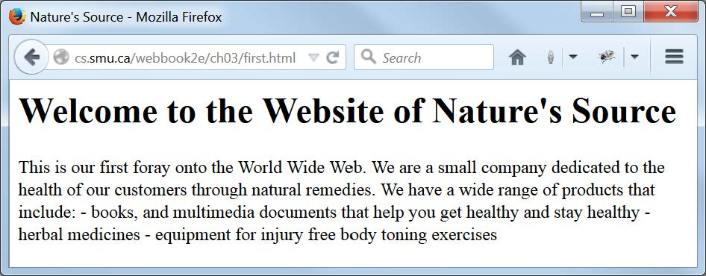
Basic HTML Markup Displayed: first.html
Note how the text from the file loses its formatting when displayed in the browser

Slide 12
Empty Elements: br for Line Breaks and hr for a Horizontal Dividing Line
Not all elements have content.
Elements with no content are called “empty elements” and have a special syntax.
The line break element <br> is one of these.
It causes the following text to appear on the next line but with no additional spacing.
It has just a single tag (that is, an opening tag but no closing tag)

Slide 13
More HTML Markup Illustrated: second.html
<!-- second.html -->
<html>
<head>
<title>Nature's Source</title>
</head>
<body>
<h1>Welcome to the Website of Nature's Source!</h1>
<p>This is our first foray onto the World Wide Web. We are a small
company dedicated to the health of our customers through natural
remedies.
<br>
We have a wide range of products that include:</p>
<ul>
<li>books, and multimedia documents that help you get healthy and
stay healthy</li>
<li>herbal medicines</li>
<li>equipment for injury free body toning exercises</li>
</ul>
</body>
</html>

Slide 14
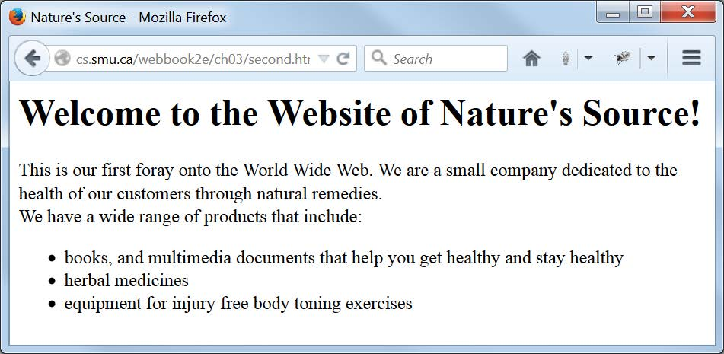
More HTML Markup Displayed: second.html

Slide 15
What is a “valid” web page?
A valid web page is one that conforms to one of several possible standards.
The standard against which the page will be validated is determined by a DOCTYPE declaration in the web page.
We use this (HTML5) DOCTYPE declaration as the first line of a file:
<!DOCTYPE html>

Slide 16
Some HTML “Boilerplate”
The term boilerplate refers to markup that we can use “as is” on every page, and we need some when we attempt to validate a web page.
The first boilerplate item is the DOCTYPE itself.
The second is the attribute of the html tag:
lang="en"
The third is the (empty) meta element within head element:
<meta charset="utf-8">

Slide 17
HTML5 Markup Guidelines
Use lowercase for all tag names.
Ensure all tag pairs are properly nested.
Give any non-empty element both an opening tag and a closing tag.
Use lowercase for attribute names and enclose attribute values in quotes.
Remember: block elements may contain block or inline elements, inline elements only other inline elements.

Slide 18
HTML5 Markup Best Practice
Make sure your page has the HTML5 DOCTYPE and all of these HTML elements in their correct order, properly nested:
  html
  head
  meta
  title
  body
Don’t use any elements that are deprecated by the DOCTYPE against which you are validating.

Slide 19
A Simple Valid Web Page: third.html
<!DOCTYPE html>
<!-- third.html -->
<html lang="en">
<head>
<meta charset="utf-8">
<title>Nature's Source</title>
</head>
<body>
<h1>Welcome to the Website of Nature's Source!</h1>
<p>This is our first foray onto the World Wide Web. We are a small
company dedicated to the health of our customers through natural
remedies.
<br>
We have a wide range of products that include:</p>
<ul>
<li>books, and multimedia documents that help you get healthy and
stay healthy</li>
<li>herbal medicines</li>
<li>equipment for injury free body toning exercises</li>
</ul>
</body>
</html>

Slide 20
How do we validate a web page?
You can find a number of HTML validators on the web. The W3C itself provides this one:
  http://validator.w3.org/
You can enter the URL of the page you want validated directly into the validator and click
on a button to validate it.
Many other ways are possible: For example, the Firefox Web Developer add-on lets you validate the web page you are viewing from a dropdown menu.

Slide 21
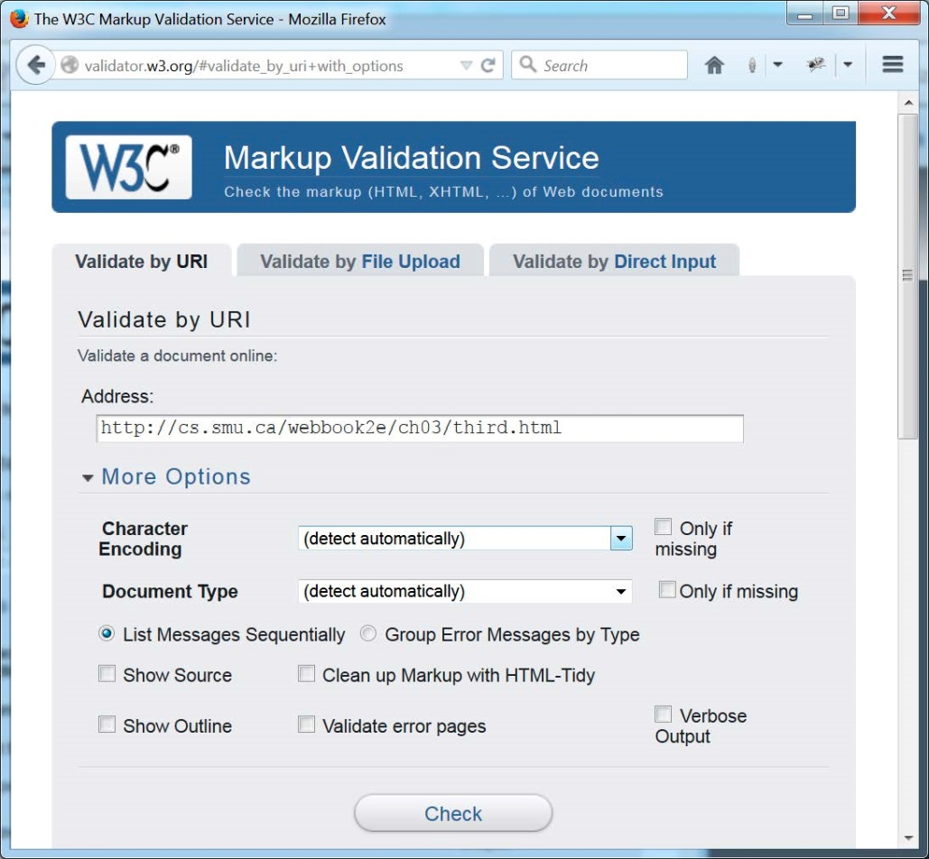
Validating third.html

Slide 22
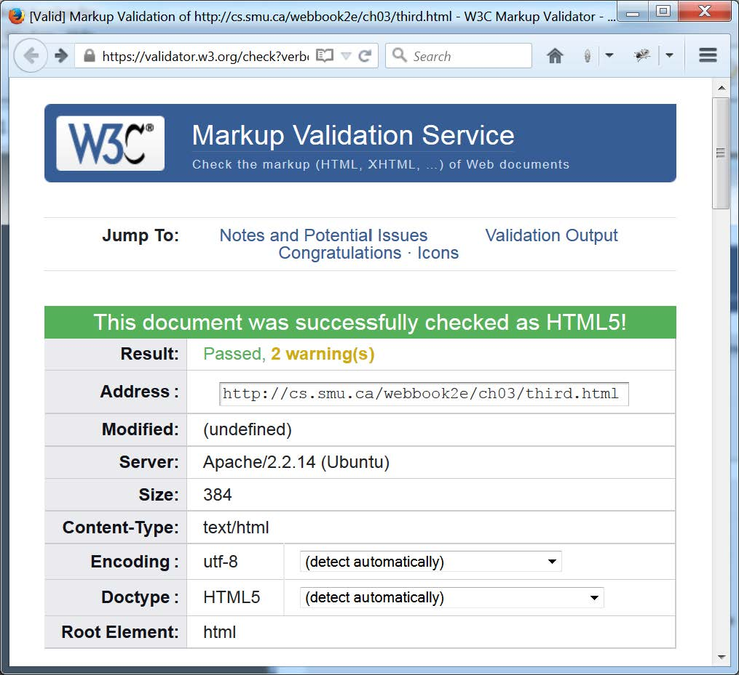
Validation Report for third.html

Slide 23
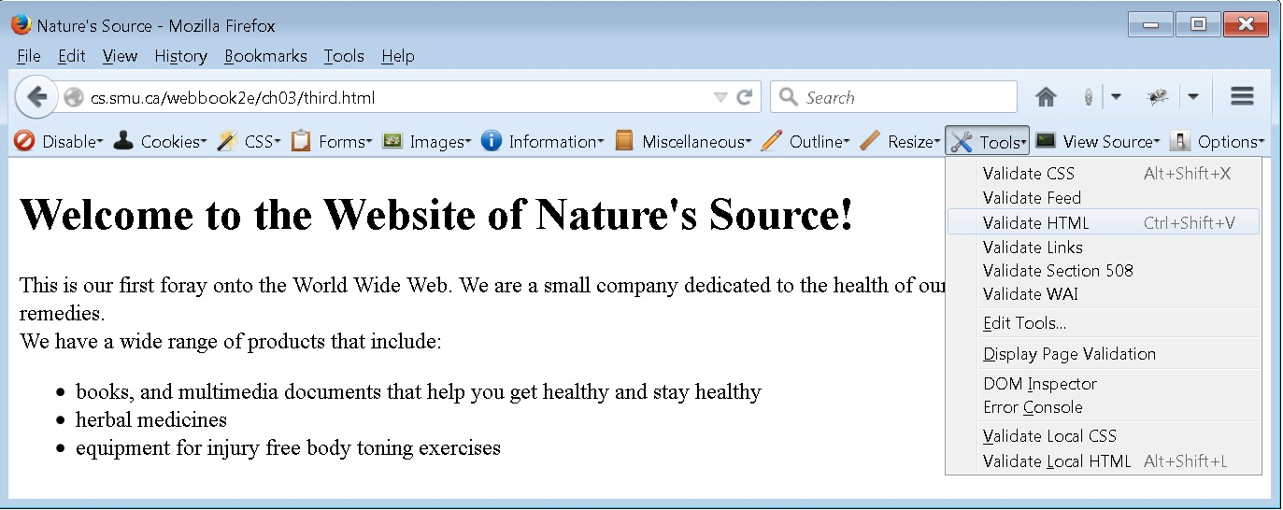
The Web Developer Add-on

Slide 24
The Empty img Element for Images, and Two Required Tag Attributes
The (empty) img element lets us place an image on a web page.
A typical image element:
<img src="images/naturelogo.gif"
alt="Nature′s Source Logo">
src and alt are called attributes.
The value of src is the location of the image file.
The value of alt is the text to display if no image.
Attribute values are enclosed in quotes.

Slide 25
A Best Practice for Images
A pixel is a very small area of illumination on a display screen, one of many from which an image is composed.
The img tag has two optional attributes, width and height, whose values in number of pixels give the size of an image.
A browser will scale the image to that size, but it is better to make the image the size you want in an external program and then specify the exact size in your img tag. Then … no scaling required.

Slide 26
Block Elements vs. Inline Elements
Some HTML elements are block elements, others are inline elements.
Block elements (headings, paragraphs and lists, for example) flow from top to bottom of a web page, with a browser-dependent amount of vertical whitespace before and after the element.
Inline elements (the img element, for example) flow from left to right, wrapping to the next line as necessary, with no horizontal spacing surrounding the element.

Slide 27
Tables in General
Tables have rows and columns.
Tables are best used to display data that lends itself to rows and columns.
Example: A table of 28 temperatures with 4 rows (weeks) and 7 columns (week days)
A table can be used to lay out a very simple web page, but Cascading Style Sheets are much preferred for web page layout.

Slide 28
HTML Basic Table Elements
A table element with two rows and two columns (two table data cells) in each row:
<table summary="A simple table">
<tr>
<td>top-left</td><td>top-right</td>
</tr>
<tr>
<td>top-left</td><td>top-right</td>
</tr>
</table>

Slide 29
Additional Table Features
Content of a td (table data) element is displayed left-justified by default.
Content of a th (table header) element is displayed bold and centered by default.
td and th tags can take have rowspan="n" and colspan="n" attributes to permit one cell to span multiple rows and/or columns
Place a caption element after the opening table tag to give a table a caption

Slide 30
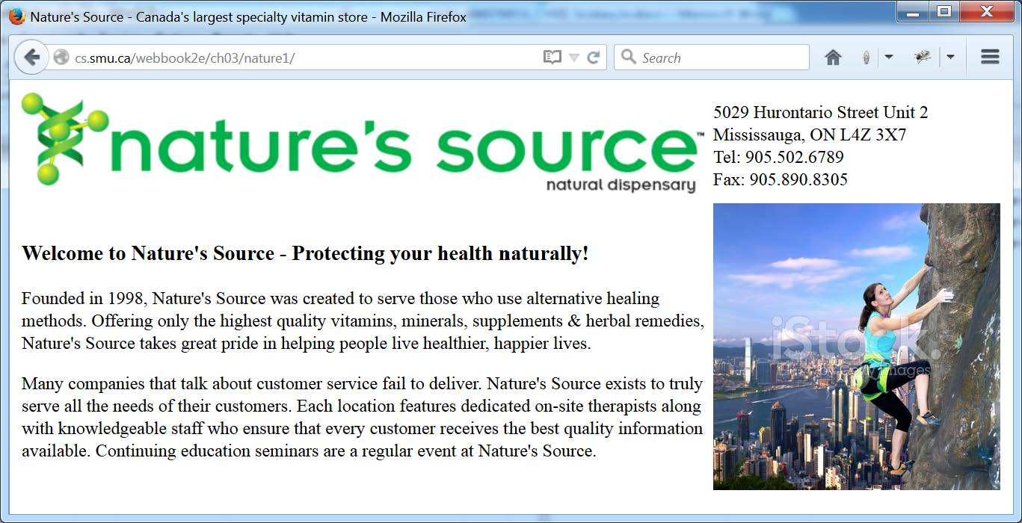
Simple Table Layout in index.html from nature1 (two rows and two columns)

Slide 31
ch03/nature1/index.html
<!DOCTYPE html>
<!-- index.html for ch03/nature1 -->
<html lang="en">
<head>
<meta charset="utf-8">
<title>Nature's Source - Canada's largest specialty vitamin store</title>
</head>
<body>
<table>
<tr>
<td><img src="images/naturelogo.gif" alt="Nature's Source Logo"
width="608" height="90"></td>
<td>5029 Hurontario Street Unit 2<br>
Mississauga, ON L4Z 3X7<br>
Tel: 905.502.6789<br>
Fax: 905.890.8305</td>
</tr>
<tr>
<td>
<h3>Welcome to Nature's Source - Protecting your health
naturally!</h3>
<p>Founded in 1998, Nature's Source was created ... </p>
</td>
<td><img src="images/outdoor4.jpg" alt="Get healthy and stay healthy"
width="256" height="256"></td>
</tr>
</table>
</body>
</html>

Slide 32
What is an HTML Entity?
Some characters have a special meaning in HTML (< starts an opening tag, for example).
So, for example, in small<big, “<big” would be interpreted as the start of the opening <big> tag in a big element.
This problem is solved by this HTML entity:
&lt;
A browser replaces the entity &lt; with the single character <.

Slide 33
Some HTML Entities
Characters that need replacing by entities are often called metacharacters.
Entities can also provide special characters not appearing on keyboards.
Some additional HTML entities:
  &gt; for >
  &amp; for &
  &copy; for © (the copyright symbol)

Slide 34
HTML Hyperlinks
A central idea of the web is that one page can link to one or many others.
The a (anchor) element provides the hyperlink (link).
The value of the (required) href attribute of an a tag is the URL or path to the other page.
A typical a element:
<a href="estore.html">e-store</a>
By default content like e-store appears with blue and underlined text.
The content of an a element can be an img element.

Slide 35
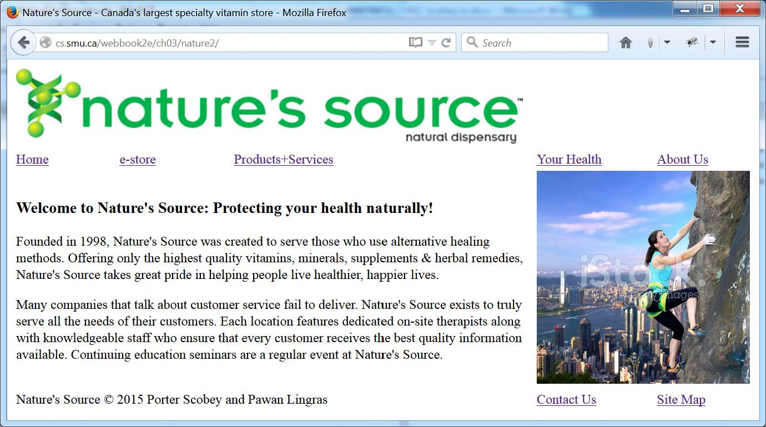
Simple Table Layout in index.html from nature2 (four rows and five columns)
(and now including “menu item” links)

Slide 36
ch03/nature2/index.html
(part 1 of 2)
<!DOCTYPE html>
<!-- index.html for ch03/nature2-->
<html lang="en">
<head>
<meta charset="utf-8">
<title>Nature's Source - Canada's largest specialty vitamin store</title>
</head>
<body>
<table>
<tr>
<td colspan="5">
<img src="images/naturelogo.gif" alt="Nature's Source"
width="608" height="90">
</td>
</tr>
<tr>
<td><a href="index.html">Home</a></td>
<td><a href="pages/estore.html">e-store</a></td>
<td><a href="pages/products.html">Products+Services</a></td>
<td><a href="pages/yourhealth.html">Your Health</a></td>
<td><a href="pages/about.html">About Us</a></td>
</tr>

Slide 37
ch03/nature2/index.html
(part 2 of 2)
<tr>
<td colspan="3">
<h3>Welcome to Nature's Source:
Protecting your health naturally!</h3>
<p>Founded in 1998, Nature's Source was created …</p>
</td>
<td colspan="2">
<img src="images/outdoor4.jpg" alt="Get healthy and stay healthy"
width="256" height="256">
</td>
</tr>
<tr>
<td colspan="3">Nature's Source &copy; 2015 Porter Scobey and Pawan
Lingras</td>
<td><a href="pages/contact.html">Contact Us</a></td>
<td><a href="pages/sitemap.html">Site Map</a></td>
</tr>
</table>
</body>
</html>

Slide 38
Markup Files for Next Two Slides
The next two slides show the display of the About Us link and the Site Map link in nature2.
Compare the displays as seen here with the markup in the online files about.html and sitemap.html.
Look in particular at the table elements that give the sub-menu in the left column of about.html and the footer element with its two-option sub-menu as seen in both displays.

Slide 39
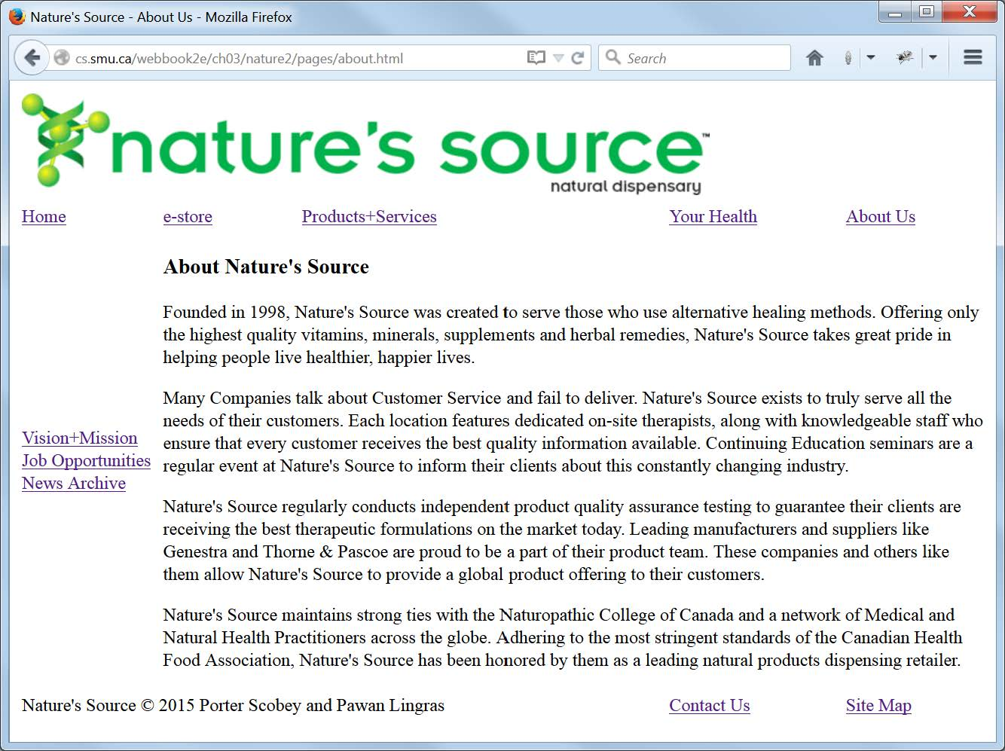
Our “About Us” Page, with Additional Relevant Links

Slide 40
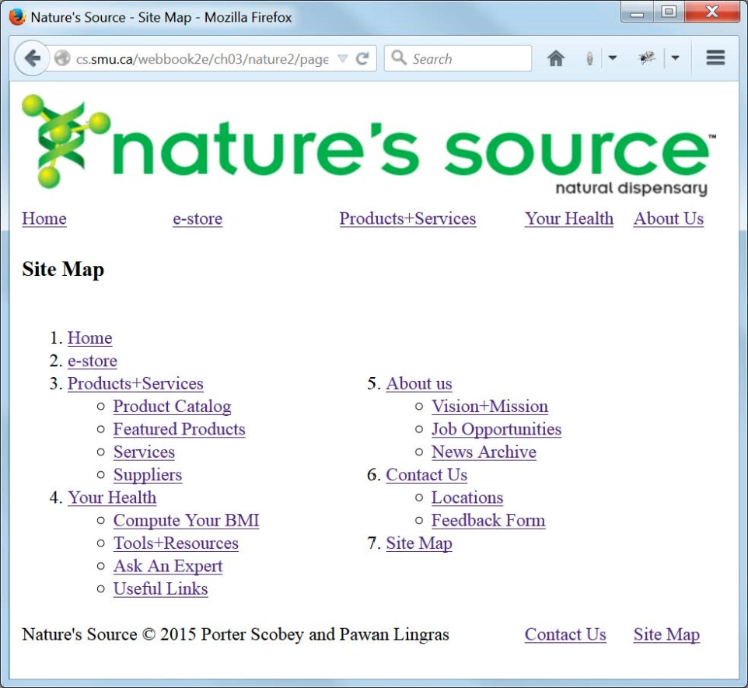
Our “Site Map” Page, with a
(nested) Table Showing Site Map Data

Slide 41
The Classic “Maintenance Nightmare”
You have some (maybe a lot) of material that you want to appear on each page of your website (logo, menu, for example).
The traditional “copy and paste” method of getting the same material in different locations is very “dangerous”.
It’s too easy to change that “common” material in some, but not all, locations.

Slide 42
Server-Side Includes (SSI):
One Way to Avoid the Maintenance Nightmare
Your server must be set up to permit server-side includes (check with your admin for details).
Material you want included in multiple locations goes into a separate file, say common/logo.html.
In each file where you want that material included you place a line like the following:
<!--#include virtual="common/logo.html"-->
The content of logo.html replaces that line.
This works for Apache. Other servers may differ.

Slide 43
Relative Paths vs. Absolute Paths
Here is an absolute path (URL) to a file:
http://mysite.com/index.html
Here is a relative path to the file (from a directory two levels below the file):
../../index.html
Relative paths are often better than absolute paths since they can remain valid if an entire website is moved to a new domain.
Choose carefully between the two when giving paths as values of your href attributes.

Slide 44
Using a base Element
Put a base element within the head element of all pages on your website.
Give its href attribute a URL value which is the absolute path to the document root of your website.
Make all other links on your website relative links, and here’s the important part: Make them relative to the absolute path value in the base element.
Then all your links will work properly, and if you move your entire website to another domain you will only have to change the value of the absolute path in your base element to get things working again.

Slide 45
The Maintenance Nightmare Solution
Use SSI together with a base element.
SSI includes all common parts, some or all of which may contain links, and those links may appear in different files at different levels of the website.
But … the links all work because they are all relative to the absolute URL in the base element.
Study ch03/nature3 for a full example, and see the following slides.

Slide 46
ch03/nature3/index.html
<!--#include virtual="common/document_head.html"-->
<!-- index.html for ch03/nature3 -->
<body>
<table>
<!--#include virtual="common/logo_row.html"-->
<!--#include virtual="common/mainmenu_row.html"-->
<tr>
<td colspan="3">
<h3>Welcome to Nature's Source:
Protecting your health naturally!</h3>
<p>Founded in 1998, Nature's Source was created …</p>
</td>
<td colspan="2">
<img src="images/outdoor4.jpg" alt="Get healthy and stay healthy"
width="256" height="256">
</td>
</tr>
<!--#include virtual="common/footer_row.html"-->
</table>
</body>
</html>

Slide 47
ch03/nature3/common/document_head.html
<!DOCTYPE html>
<!-- document_head.html -->
<html lang="en">
<head>
<meta charset="utf-8">
<title>Nature's Source</title>
<base href="http://cs.smu.ca/webbook2e/ch03/nature3/">
</head>
Note that the href value in the base element is an absolute path, and all other href values on this site should be relative
to this path.

Slide 48
ch03/nature3/common/mainmenu.html
<!-- mainmenu_row.html -->
<tr>
<td><a href="index.html">Home</a></td>
<td><a href="pages/estore.html">e-store</a></td>
<td><a href="pages/products.html">Products+Services</a></td>
<td><a href="pages/yourhealth.html">Your Health</a></td>
<td><a href="pages/about.html">About Us</a></td>
</tr>
Note that these links are relative to the href value in the base element, which is an absolute path, and which allows these menu links to work in any page on the site.

Slide 49
ch03/nature3/pages/estore.html
<!--#include virtual="../common/document_head.html"-->
<!-- estore.html -->
<body>
<table>
<!--#include virtual="../common/logo_row.html"-->
<!--#include virtual="../common/mainmenu_row.html"-->
<tr>
<td colspan="5">
<h3>e-store</h3>
<p>Keep watching this space for our e-store. You will ...</p>
</td>
</tr>
<!--#include virtual="../common/footer_row.html"-->
</table>
</body>
</html>
Compare these highlighted paths with the analogous paths in ch03/nature3/index.html.

