Slide 1
Establishing a Web Presence
Chapter 2

Slide 2
Overview and Objectives
Explain what an Internet Service Provider (ISP) is and what services you can expect from one
Discuss what web development tools you need to get started
Create a simple text-only web page
Test a web page “offline” before going “online”
Put a web page “online” by “uploading” it
Discuss MIME (Multipurpose Internet Mail Extension) types and how browsers use them to determine the kind of document they are being asked to process

Slide 3
Internet Service Provider (ISP)
A business or organization that provides you with an Internet connection
You may have to pay, or it may be free
The connection may be wired, or wireless
Different ISPs provide different levels of service

Slide 4
Some Wired Internet Service Options
Dialup over regular phone lines via a modem
Cable modem (usually from your TV provider)
Integrated Service Digital Network (ISDN)
Asymmetric Digital Subscriber Line (ADSL)
Fibre-to-the-Premises (FTTP)

Slide 5
Some Wireless Internet Service Options
WiFi (at home and at downtown “hot spots”)
Code Division Multiple Access (CDMA) allows bandwidth sharing of different frequencies
Global System for Mobile (GSM), very popular for mobile telephone systems
Worldwide interoperability for Microwave Access (WiMAX) for fixed and mobile Internet access

Slide 6
Some Services Provided by ISPs
E-mail (often several e-mail addresses)
Network data storage
A URL for a personal or business website, but
  Server-side technologies like scripting and database access may or may not be provided
  Available bandwidth (upload and download speeds may vary considerably)
  Cost will vary from one ISP to another
  Bottom line: Be sure to check out the options available and “shop around” before signing up

Slide 7
The Basic Tools for Web Development
A text editor for creating files
A browser for displaying locally those files as they would appear on the web
A file transfer program for uploading your files to your website on the server at your ISP

Slide 8
Some “Gotchas” to Avoid
Be sure to use a text editor, not a word processor, to create your files
Don’t get wedded to a single browser, and always view your web pages in more than one
Use a file transfer program that understands that end-of-line markers in text files are different on different platforms and deals with this “transparently” (most do so nowadays)

Slide 9
Content of the text file first.txt
Welcome to the Website of
Nature's Source
This is our first foray onto the World Wide Web.
We are a small company dedicated to the health
of our customers through natural remedies.
We have a wide range of products that include:
- books, and multimedia documents that help you get
healthy and stay healthy
- herbal medicines
- equipment for injury free body toning exercises

Slide 10
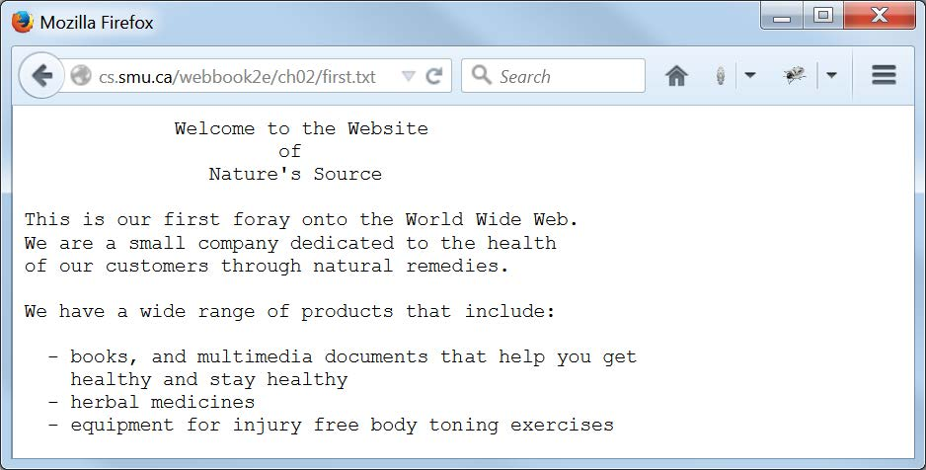
Display of first.txt in Firefox

Slide 11
MIME Types
Question: How does a browser know what to do with a file it has received from a server?
Answer: It uses the MIME type of the file.
MIME = Multipurpose Internet Mail Extension
A file’s MIME type can often be inferred from the file extension:
  txt for a text file
  jpg for an image file

Slide 12
Putting a File on the Web
Once you have a file ready to go “online”, you need to place it in the correct location on your ISP’s server (your ISP will tell you where):
One way: If you have created it on your PC, use a file transfer program to “upload” it to your ISP’s server.
Another way: It may also be possible to create files directly on the server if you have an account there.

Slide 13
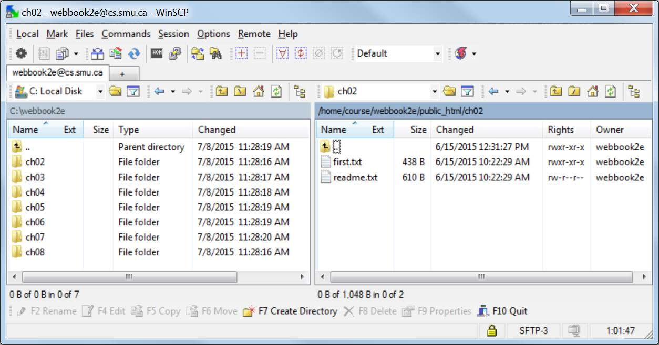
The WinSCP Interface for File Transfer

Slide 14
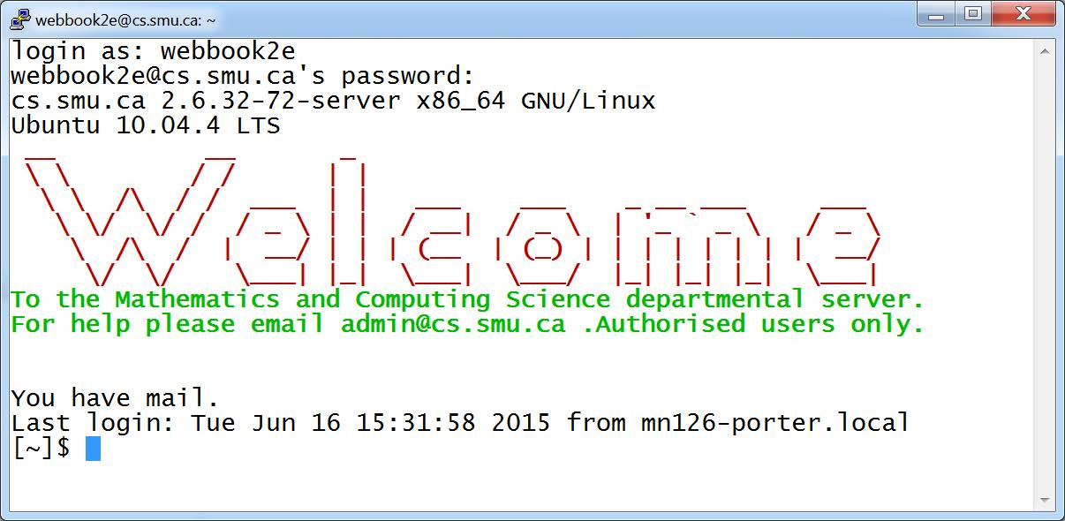
The PuTTY Interface for Direct Access to a Server Account

Slide 15
File Permissions and Web Security
The web is a “dangerous” place.
Assume that people will be trying to “hack” your website.
Plan to thwart their efforts.
The first line of defense is making sure that all the files on your site have the proper “file permissions”.
Your ISP should tell you what these are, and how to set them.

