Slide 1
Setting the Scene
Chapter 1

Slide 2
Overview and Objectives
Distinguish between the Internet and the World Wide Web (WWW) (W3) and provide a very brief history of each
Explain client-server architectures, as illustrated by web browsers and web servers
Discuss how web browsers and web servers communicate
Take a brief look at a real-world e-commerce website
Outline the technologies we will discuss in this text and mention some of the competing technologies

Slide 3
The Internet and the World Wide Web
The Internet
  Think hardware (“connected” computers/devices)
  Originated with ARPANET (late 1960s)
The World Wide Web (WWW) (W3)
  Think software (users communicating over the Internet via software applications)
  Originated with Tim Berners-Lee and HTML, and took off with the first GUI browser, Mosaic

Slide 4
Client-Server Architectures
A “client” makes a request to a “server”
The server’s response may be
  Compliance with the request
  An error message indicating a problem
Example
  A user’s browser requests a web page for display from a particular web site
  The web server at that site sends the web page or an error message (like a page-not-found error)

Slide 5
Web Servers and Web Browsers
The term “server” may refer to a program or the machine it runs on
  Current popular servers are Apache and Microsoft’s Internet Information Services (IIS)
Every browser is a program that can act as the client in a client-server relationship
  Current popular browsers include Internet Explorer, Firefox, Chrome, Safari and Opera

Slide 6
A Communication Protocol:
Person-to-Person via Telephone
Telephone rings
Callee answers and says “Hello”
Caller self-identifies and states reason for call
Callee responds appropriately
Caller and callee exchange information
Caller (or callee) says “Good-bye”, and the other responds likewise
Both caller and callee hang up

Slide 7
A Communication Protocol:
Browser and Server via the Internet
User types address of web page into browser’s address bar and presses “Go” button
Browser sends an HTTP request message to the server identified by the web address
Server receives the request and sends back an HTTP response message
If there was no error, the browser displays the content part of the response message

Slide 8
HyperText Transport Protocol: Request
An HTTP request from a browser contains
A request line, with a request method (often GET or POST), the URI of the desired resource, and the version of HTTP in use
Some header lines, indicating such things as language in use, encoding scheme, and so on
A (very important) blank line
An optional message body

Slide 9
HyperText Transport Protocol: Response
An HTTP response from a server contains
A status line, indicating everything is OK or a number indicating that an error has occurred (404 not found, for example)
Some header lines, providing information about the response, especially its content type
A (very important) blank line
The content of the returned web page or other resource

Slide 10
Some Other Web Protocols
TCP/IP is the fundamental protocol for most communication on the web
UDP is fast and can be used if there is a lot of data and you don’t mind losing a few bits
FTP is a file transfer standard
TELNET provides a non-secure way to login to a remote computer
SSH can be thought of as a “secure telnet”

Slide 11
Web Addresses
Every device connected to the Internet must have a unique IP address:
  IPv4 is 32 bits: a.b.c.d with a, b, c, d in 0..255
  IPv6 is 128 bits, allowing for many more addresses
Computers understand IP addresses much better than humans, who prefer FQDNs
  FQDN = Fully Qualified Domain Name
  FQDN cs.smu.ca has IP address 140.184.133.99
  A Domain Name Server (DNS) translates between an IP address and the corresponding FQDN

Slide 12
URLs, URNs and URIs
A Uniform Resource Locator (URL) is the actual location of a resource on the web
A Uniform Resource Name (URN) has the same form as a URL but may not refer to an actual resource
The term Uniform Resource Identifier (URI) is a generalization of the above two terms and may refer to either one

Slide 13
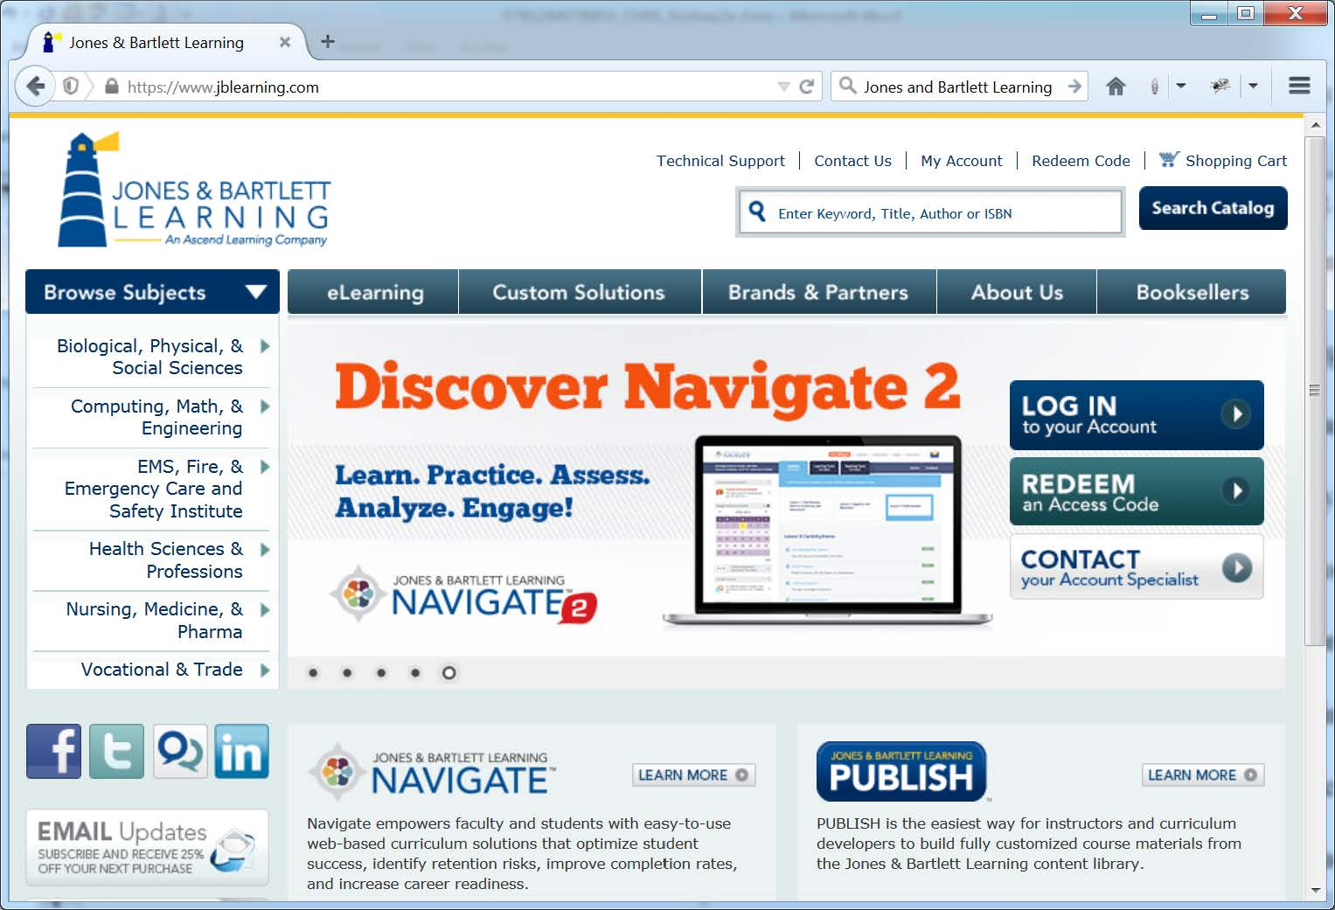
The Home Page of a Real-World Web Site: Jones and Bartlett Publishing

Slide 14
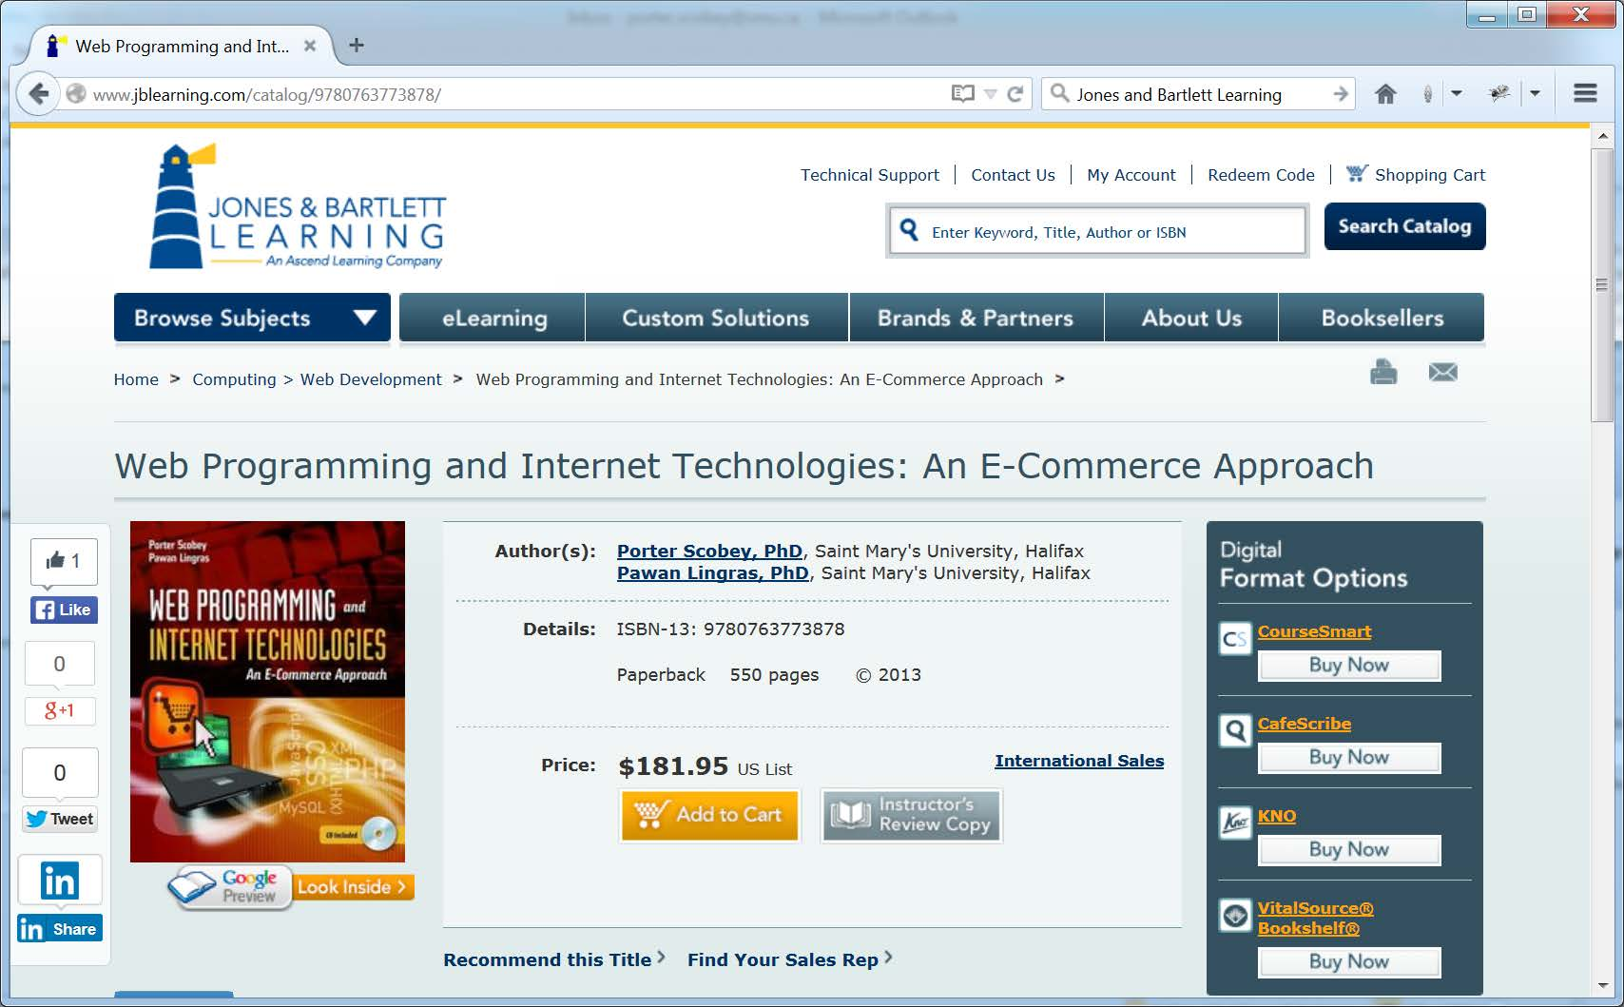
A web page showing a book title from Jones and Bartlett Publishing

Slide 15
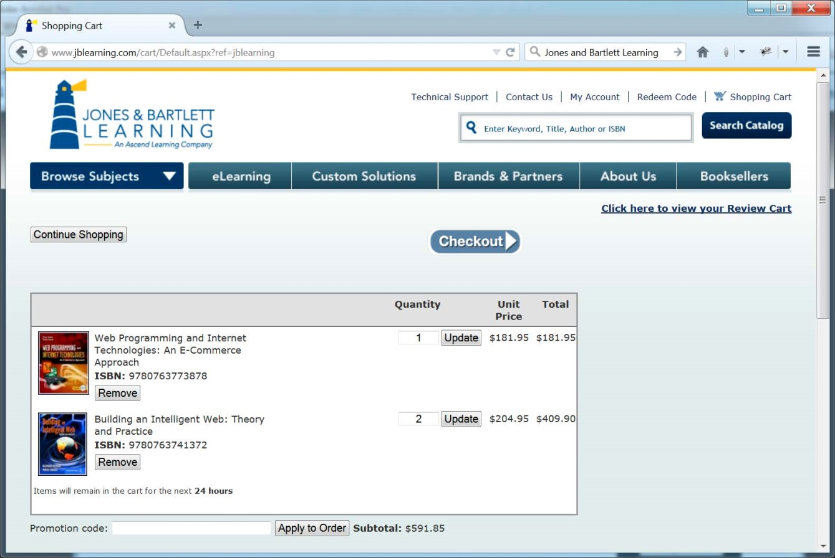
An invoice page showing purchase of two titles from Jones and Bartlett Publishing

Slide 16
Technologies We Will Study (1 of 2)
HTML 5 for describing web page structure
CSS2.1 and CSS3 for styling our web pages
JavaScript for giving our pages “behavior”
The DOM and DHTML for “connecting” the above three technologies
PHP for server-side scripting
MySQL for database storage on the server
Our first ten chapters cover the above topics in some detail, including the use of PHP with MySQL for client-server database interaction

Slide 17
Technologies We Will Study (2 of 2)
Our final two chapters give a very brief introduction to the following:
XML, DTDs, and XSLT for data description and transformation
Collection (on the server) of web site visitor data, followed by later analysis using various tools (Analog, Pathalizer, StatViz)

